Slide 1

Welcome

Slide 2
Welcome to our Phase 3 meeting

Slide 4









Slide 5
Expectations for the Phase
Role models for school values
Uniform
Attendance and punctuality
THRIVE – behaviour is communication
Curriculum – Power Maths, I'm a St Wilfrid's Writer, White Rose Science,
master Readers, Curriculum learning
Boom Reader
Homework – Spelling Shed, Times Table Rockstars, MyMaths, Microsoft Teams
Parental partnerships - year4@stwilfrids-hh.school , year5@stwilfrids-hh.school , year6@stwilfrids-hh.school
Weekly learning updates

Slide 6

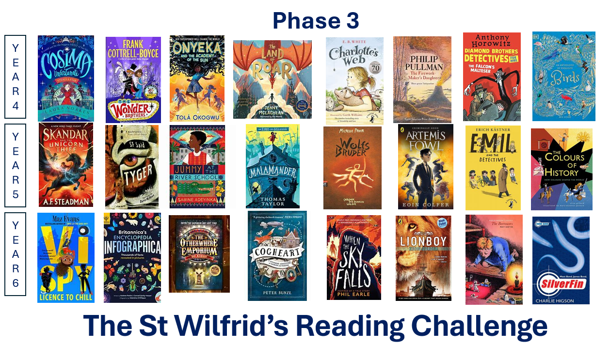
The St Wilfrid's Reading Challenge

Slide 7
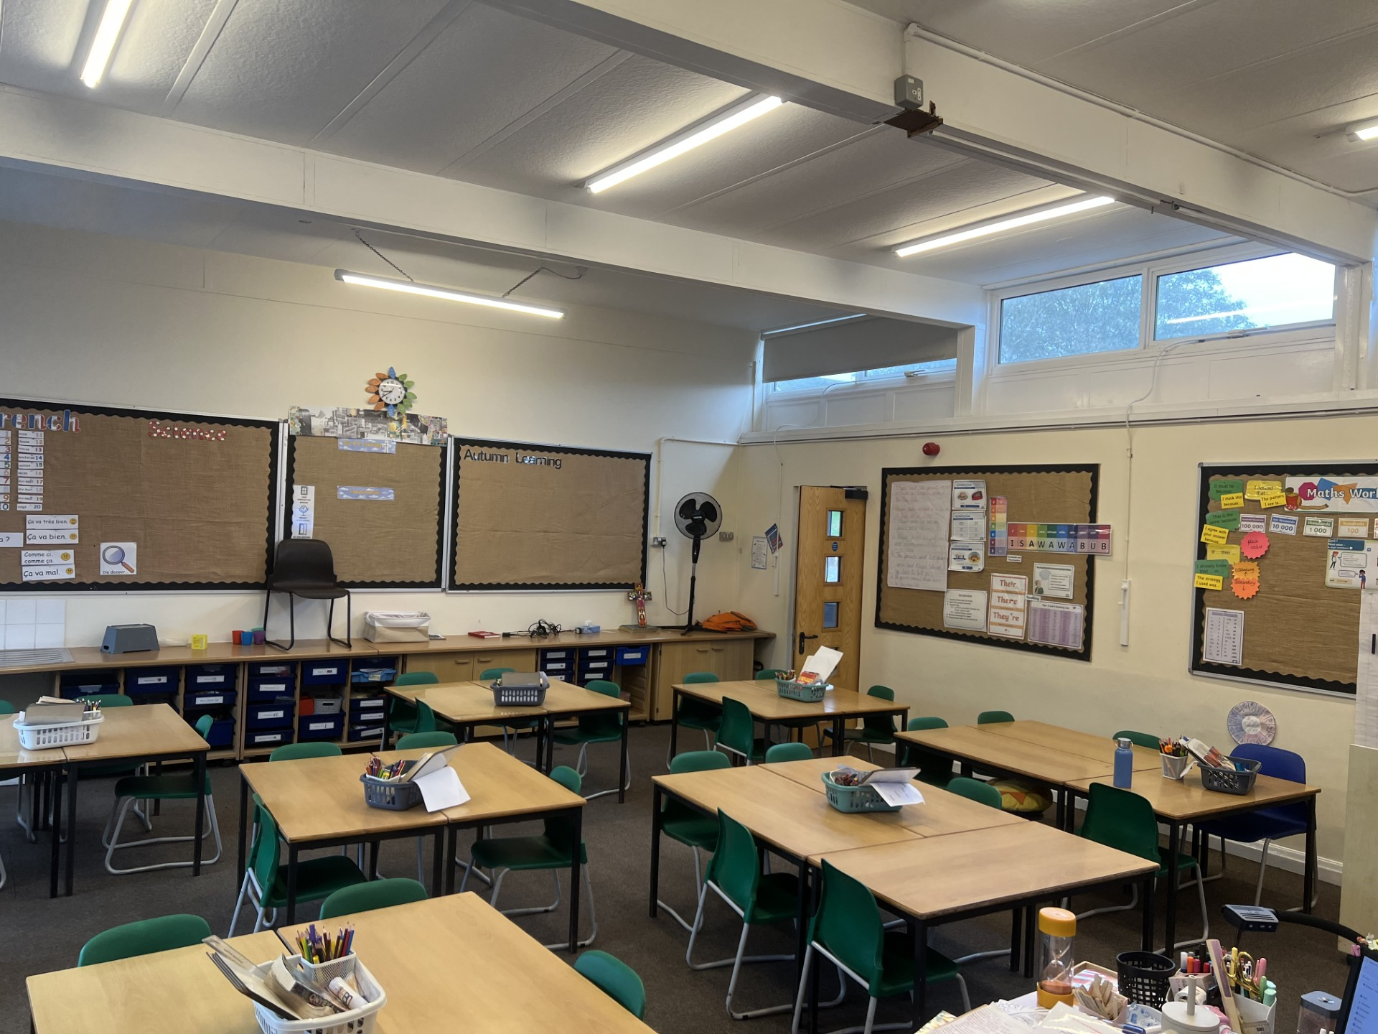
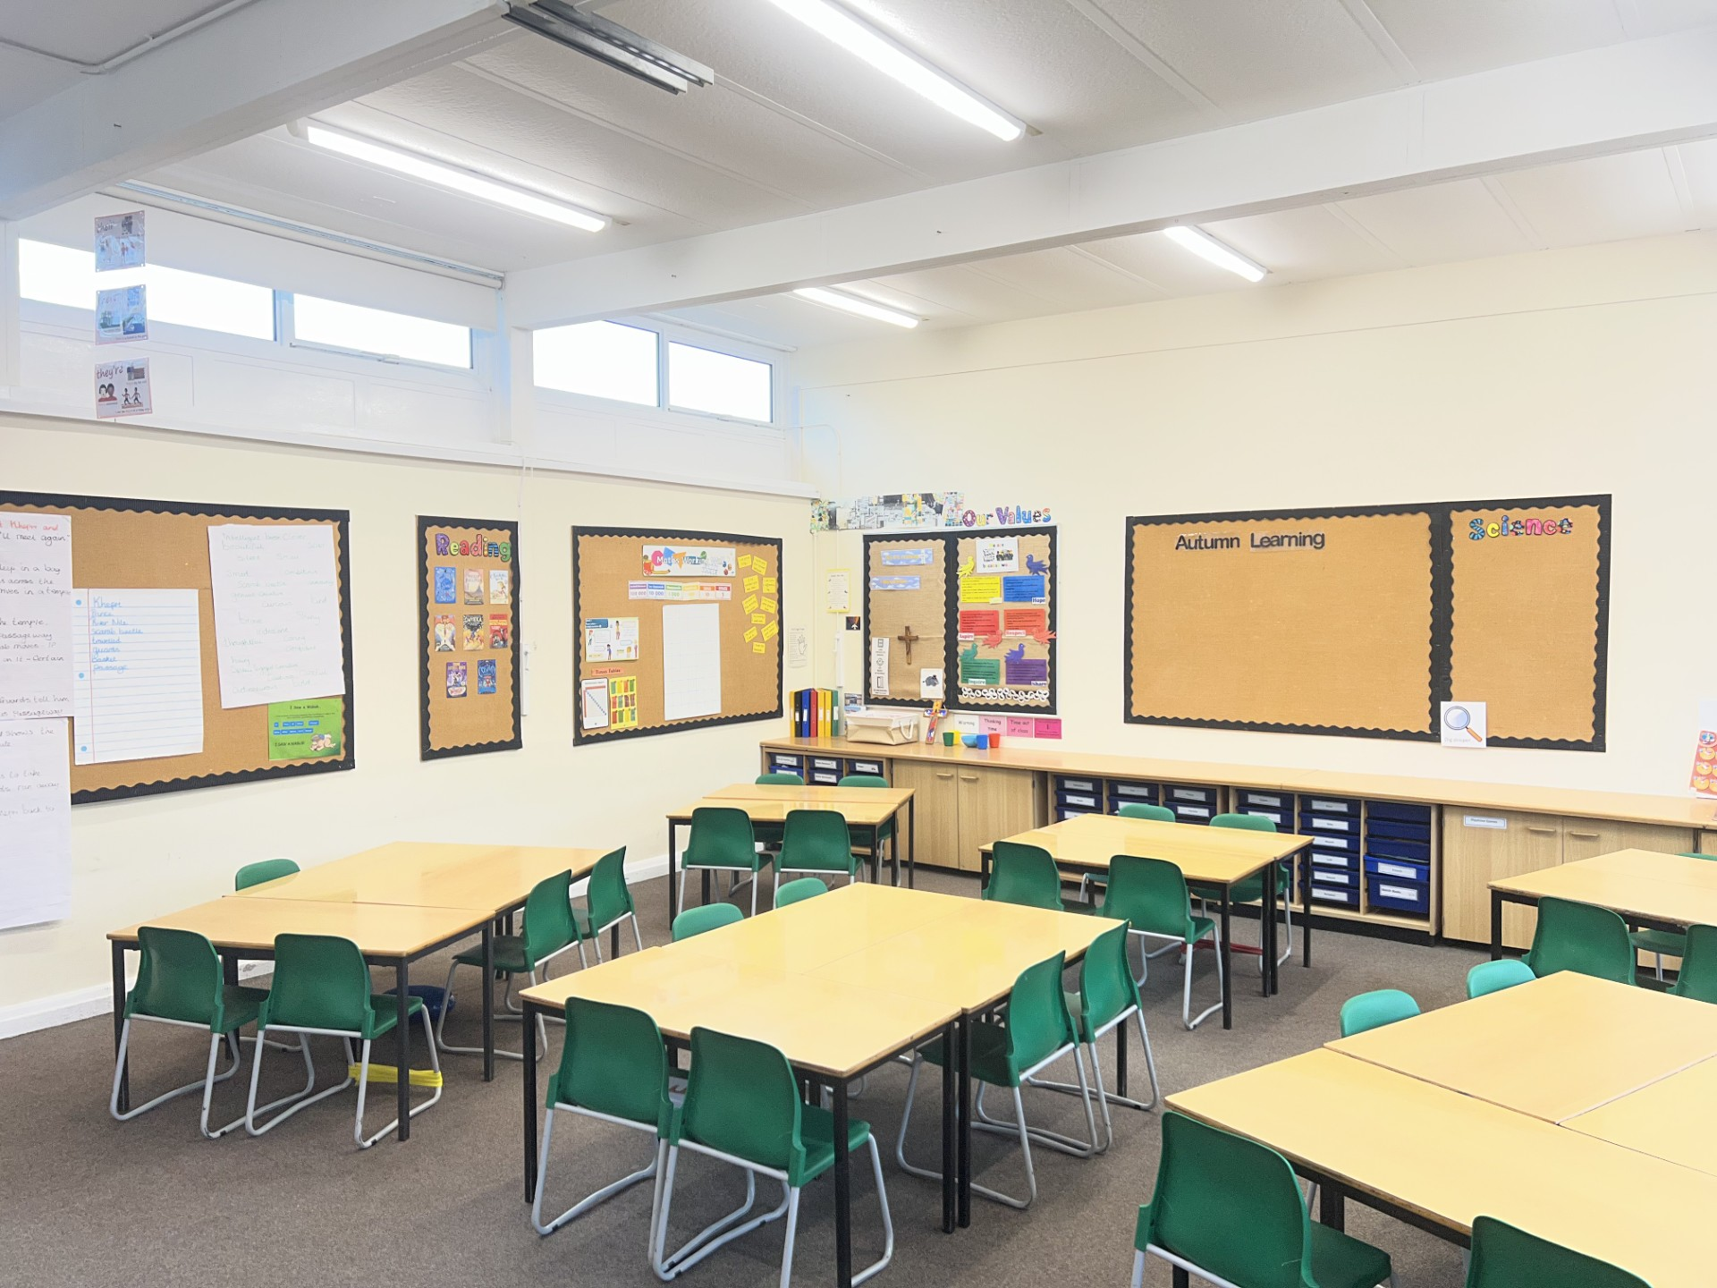
Year 4 – Classroom photos

Slide 8
Year 4 – Expectations
Our Autumn term learning:
History: Ancient Egypt and Ancient Mayans
Art: The human figure
DT: Frames and structures
Timestables (TTRS and Maths Frame)
Homework - set on Wednesdays
​
Our PE days are Tuesday and Friday
Swimming (fortnightly)

Slide 9
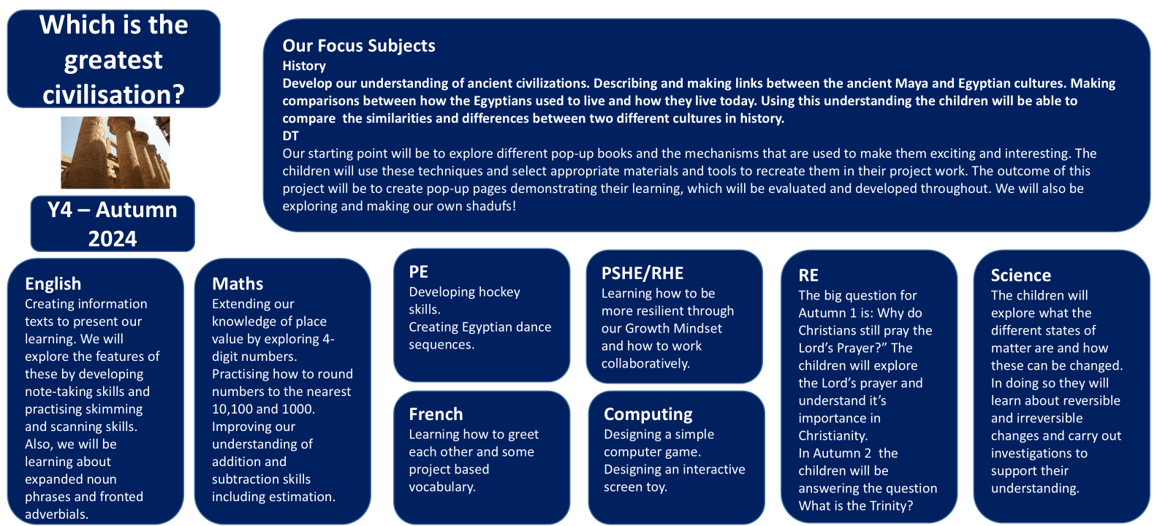
Year 4
Autumn Term Learning
2026
Art
We begin the year considering the human form, different artists' interpretations, and how they have changed over history. We will have a go at drawing our own images using Ancient Egyptian, Leonardo Da Vinci and Quentin Blake's styles as inspiration.
DT
After half term we will be exploring Ancient structures. Using what we've learned, we will design our own structures based on a design criteria.
PE
Following the GetSet4PE scheme of work, we will begin exploring how to improve our fitness and dance skills.
PSHE
We will be looking at how to stay safe, in school, at home and in the community.
Science
The children will learn how to classify and group living things. We will practice our data collection and handling skills. We will finish the term by exploring states of matter and carrying out investigations to support our understanding.

Slide 10
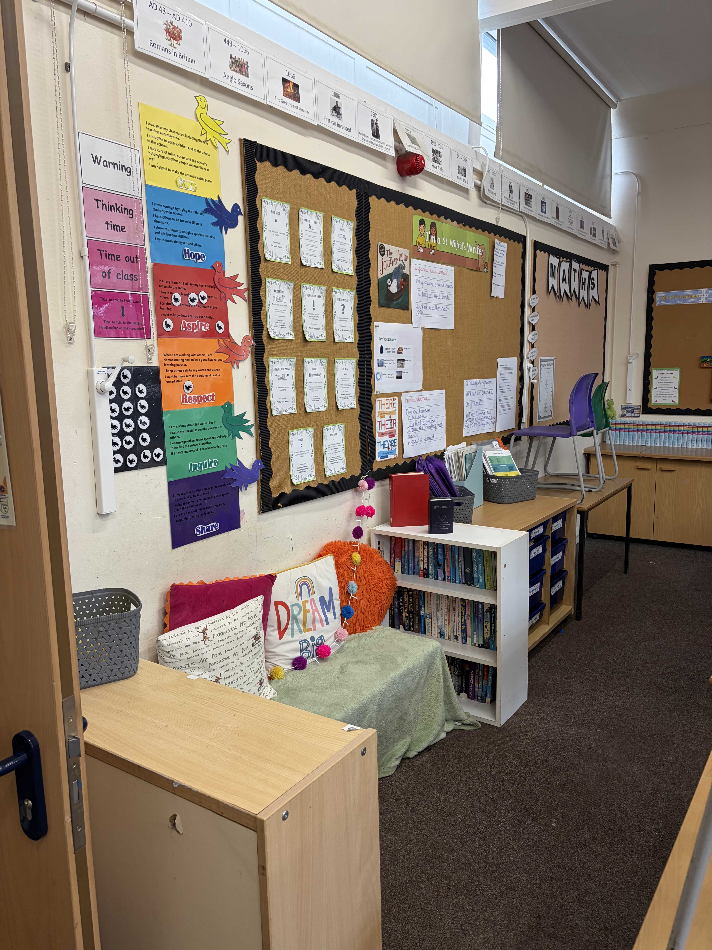
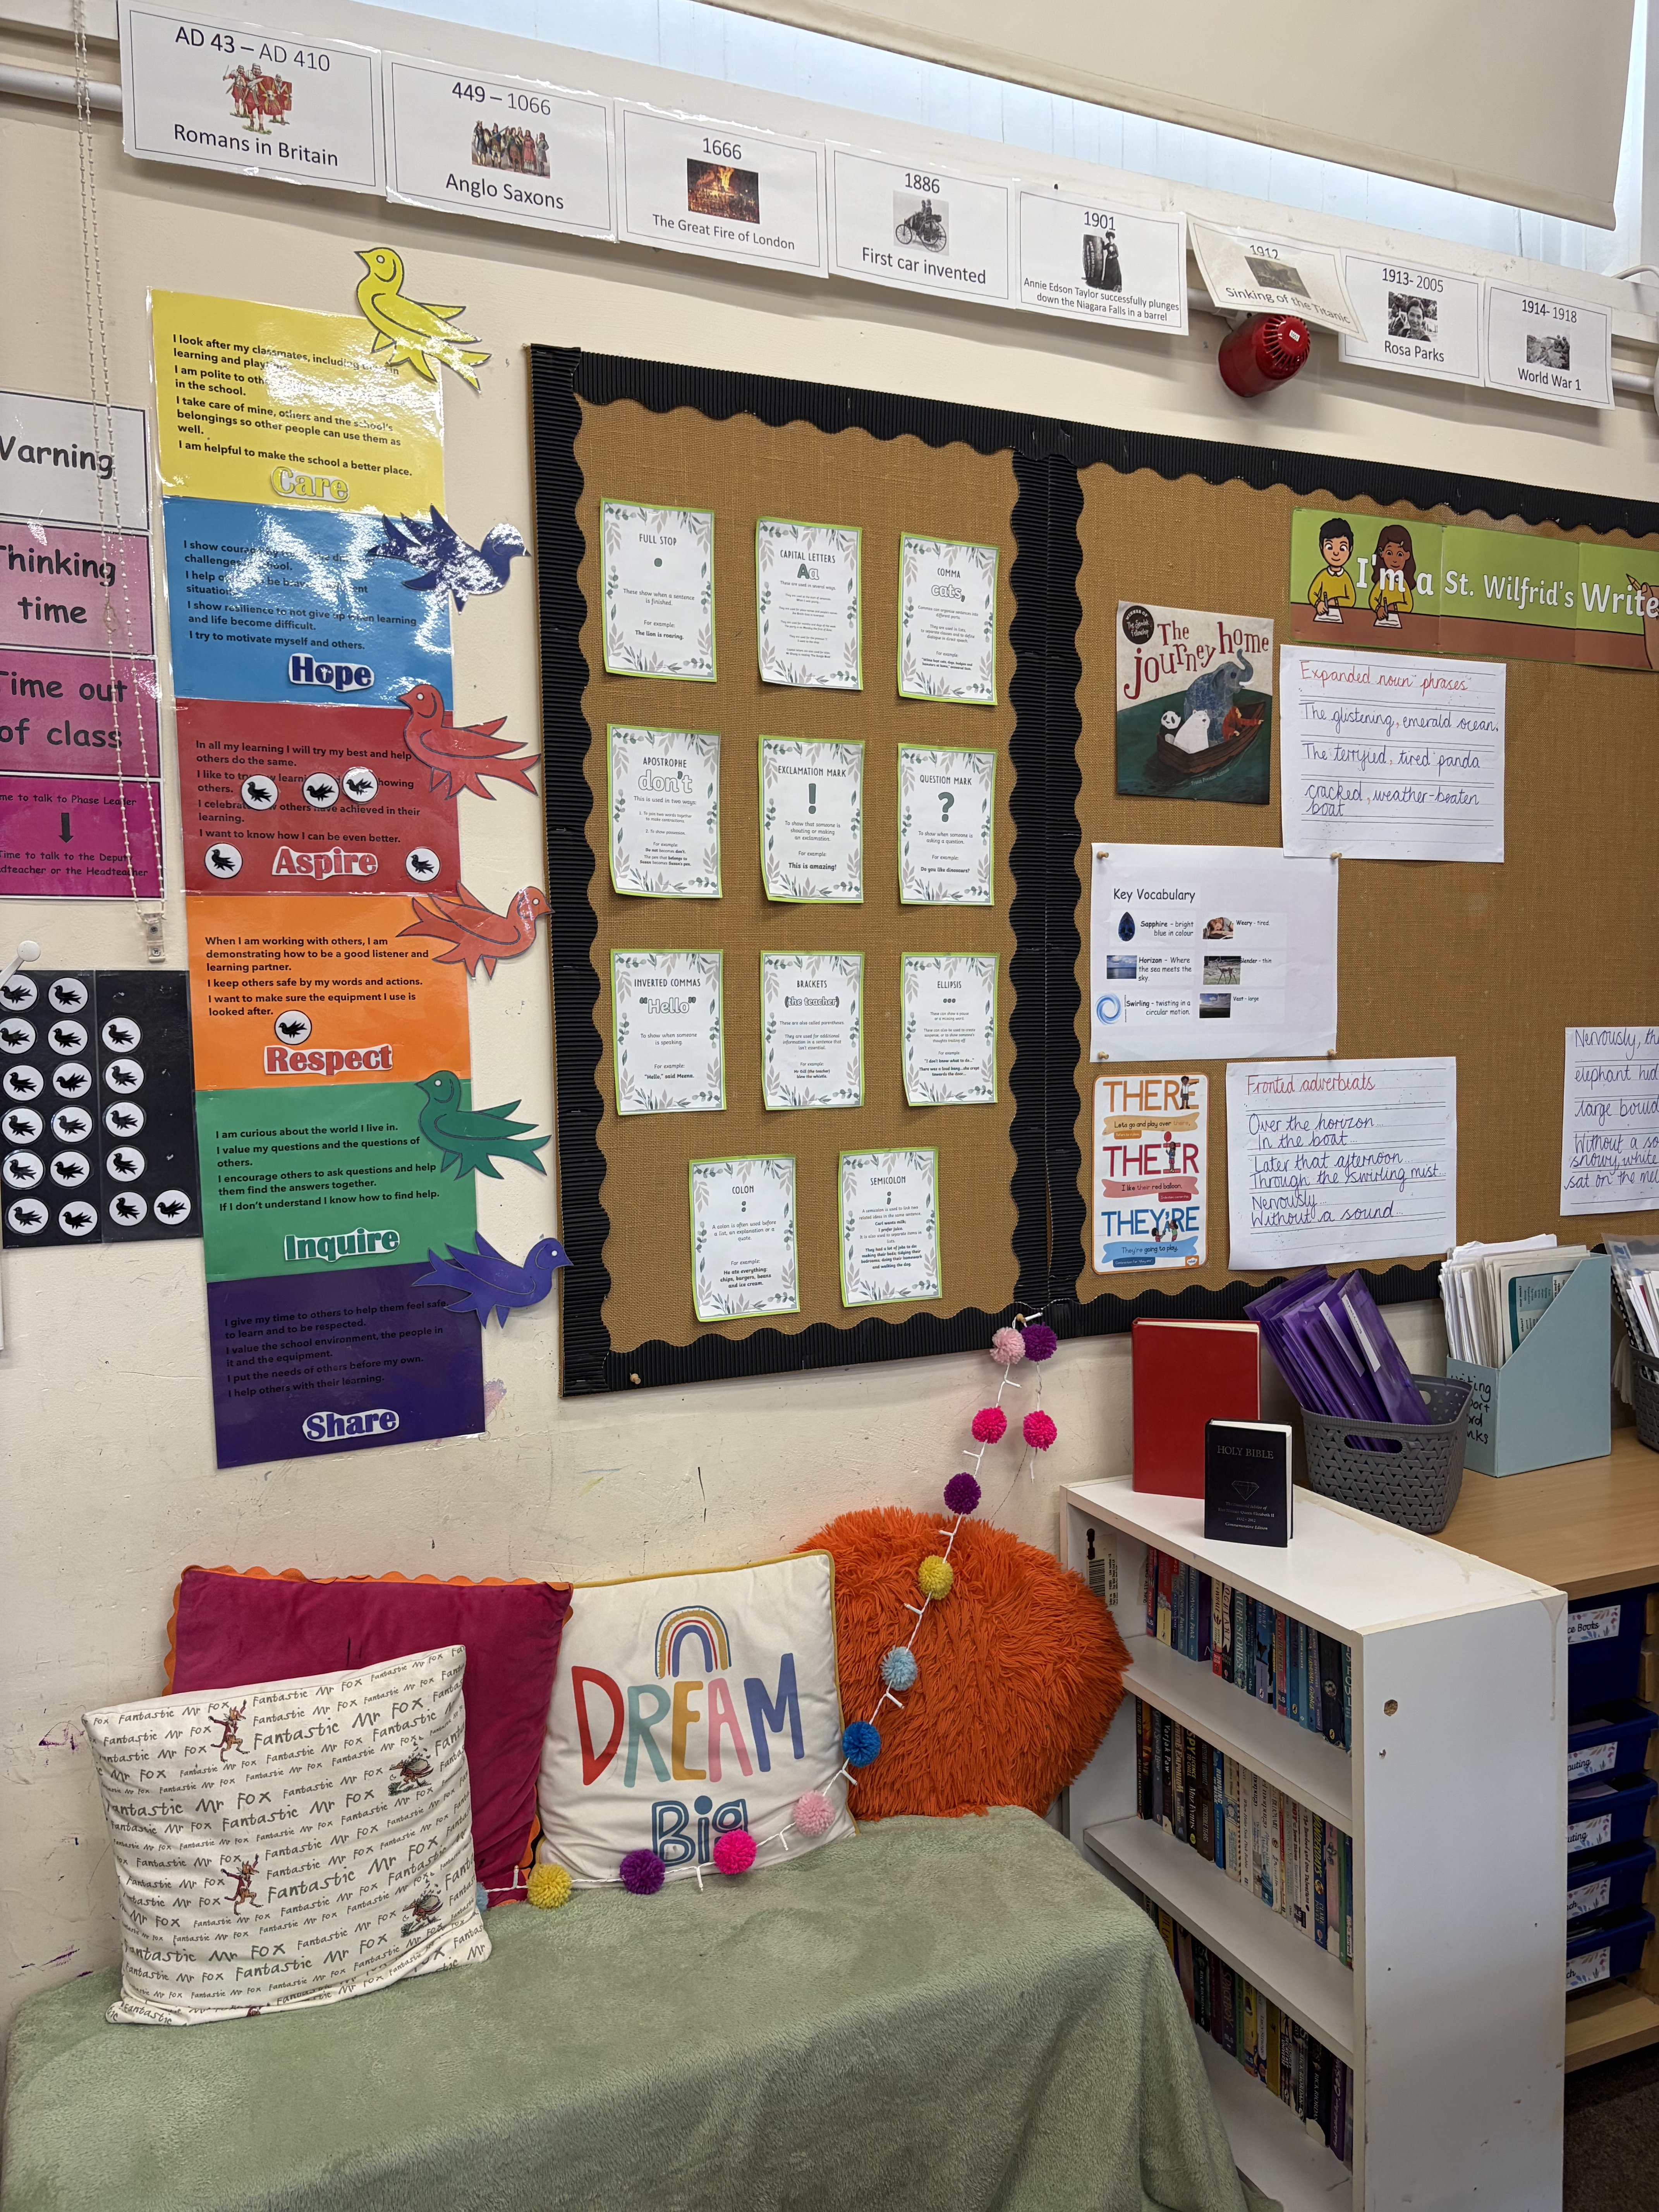
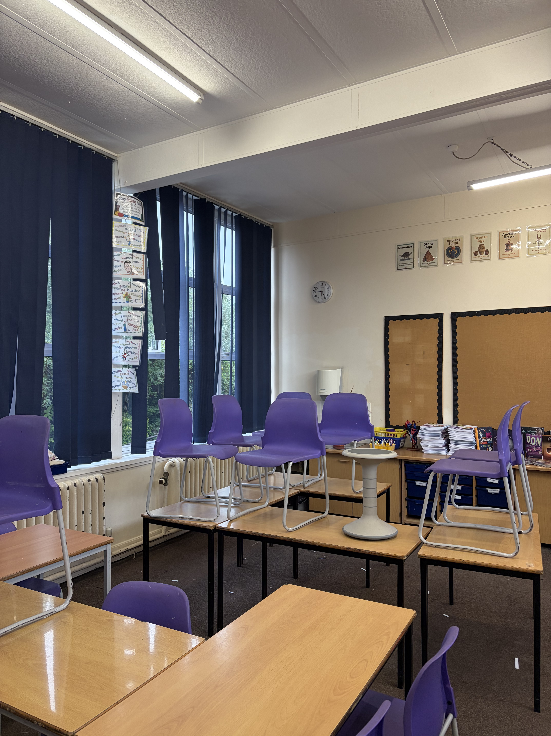
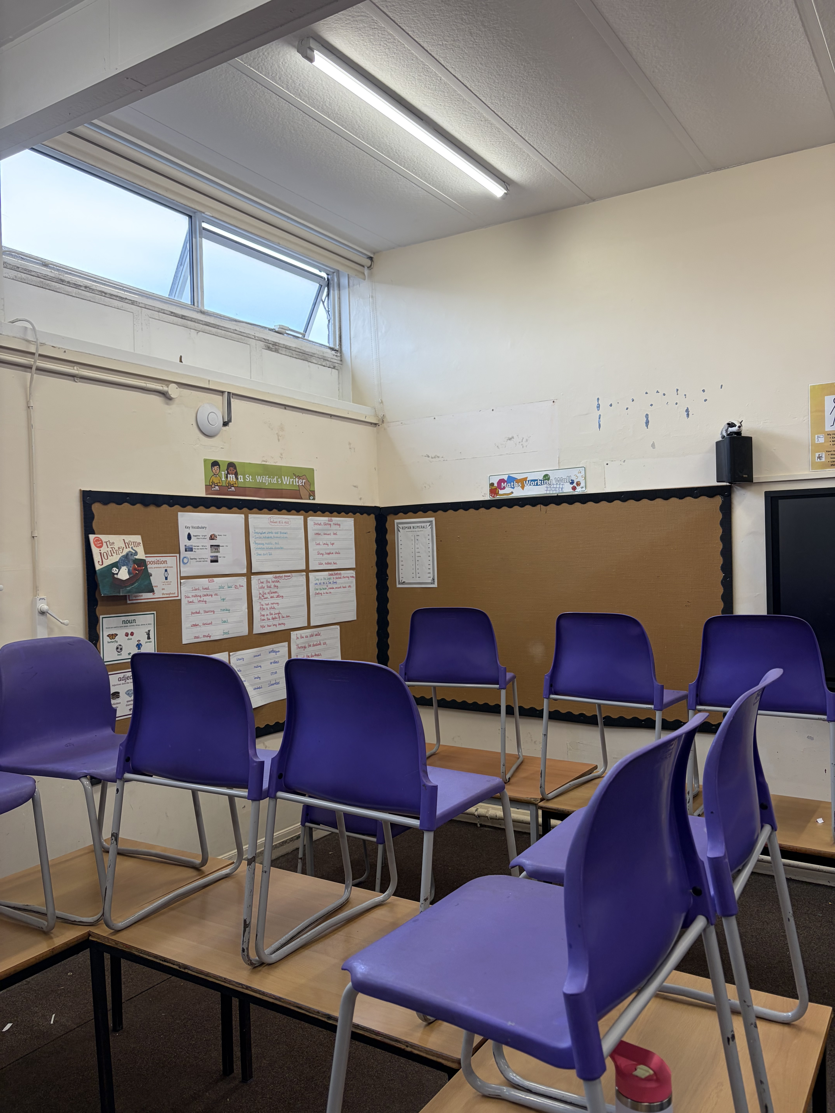
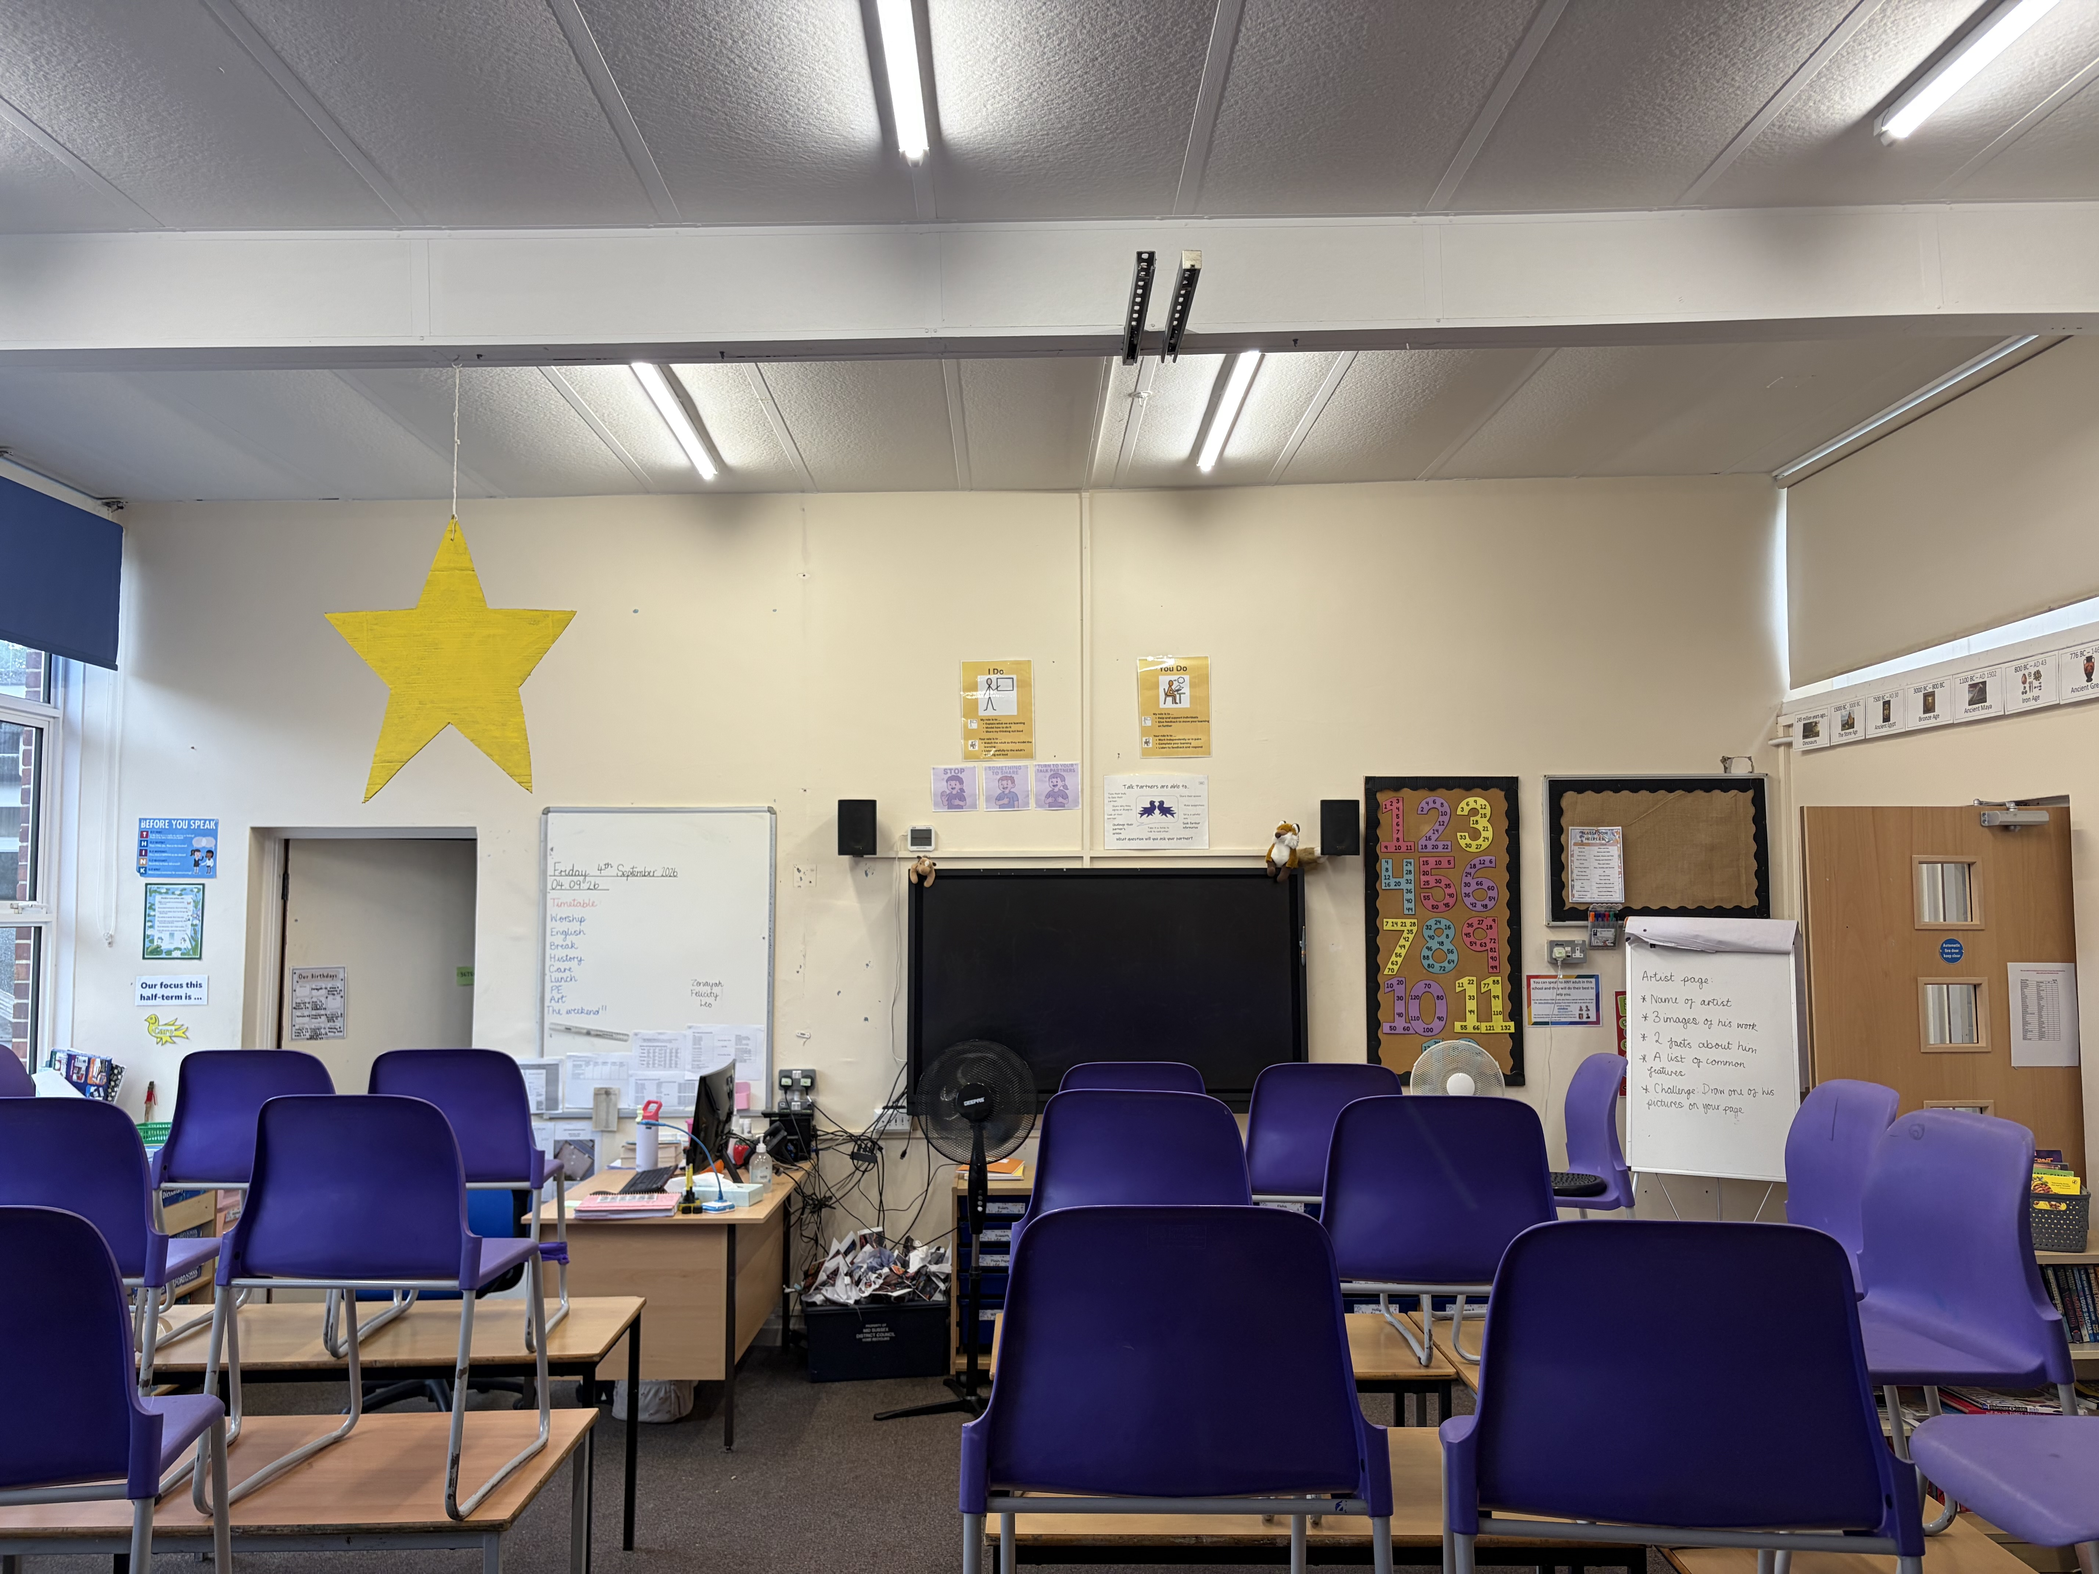
Year 5 – Badgers and Foxes classrooms

Slide 11
Year 5 – Expectations
Our PE days are Wednesday and Friday
Our Autumn term learning is all about space!
Homework will be set weekly from this Friday, 11th September, onwards. Maths homework is set on a Friday and needs to be submitted by the following Friday on Mymaths. English homework is set at the beginning of each month and is due in at the end of each month. Spellings will be set on Spelling Shed and tested on a Thursday each week.

Slide 12
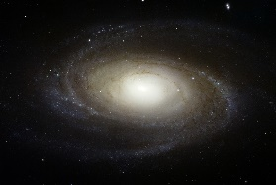

Space
Our Focus Subjects
Science
Describing the movement of the Earth, moon and other planets relative to the sun in the solar system.
Investigating forces- air resistance, friction and buoyancy by planning and carrying out investigations. Understanding the importance of fair testing, predicting, recording results and drawing conclusions.
History
We will be investigating some of the most significant discoveries around the theme of space and learning about key figures who contributed to this.
Y5 – Autumn term learning
Maths
Understanding place value-Improving mental strategies
Improving fluency and problem solving when adding, subtracting, multiplying and dividing. Finding common factors and multiples and recognising prime numbers.
Finding equivalent fractions and adding and subtracting fractions.
PE
Fitness – explore and develop strength, stamina, speed, co-ordination, balance and agility. (Friday)
Dance – how to use movement to explore and communicate ideas and issues and own feelings and thoughts (Wednesday)
Computing
Computing systems and networks- system searching
RE
Explaining what worship is
Knowing what prayer is and explain how believers pray
Exploring art and music and their use in worship
Exploring some religious artefacts
Science
Describing the movement of the Earth, moon and other planets relative to the sun in the solar system.
Investigating forces- air resistance, friction and buoyancy by planning and carrying out investigations. Understanding the importance of fair testing, predicting, recording results and drawing conclusions
English
Exploring the features of non fiction texts
Reliving the experience of watching the moon landing by writing a diary entry
Uncovering the role of black women in space and develop persuasive writing skills.
Writing and perform Space poetry.
Creating science fiction stories .
Art
Exploring the work of Peter Thorpe and using him as inspiration to create our own rocket painting.
French
Do you have a pet?
The Weather
PSHE/RHE
We will be investigating how we care for each other and who cares for us
We are game
developers-
developing an interactive
Game.
We are cryptographers-cracking codes.

Slide 13
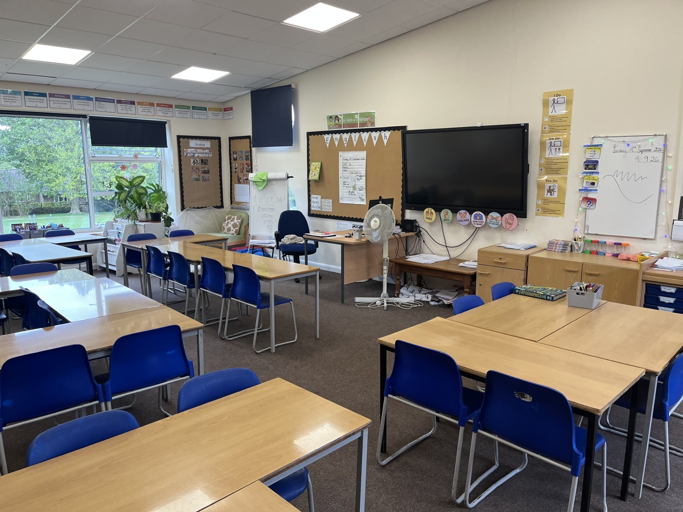
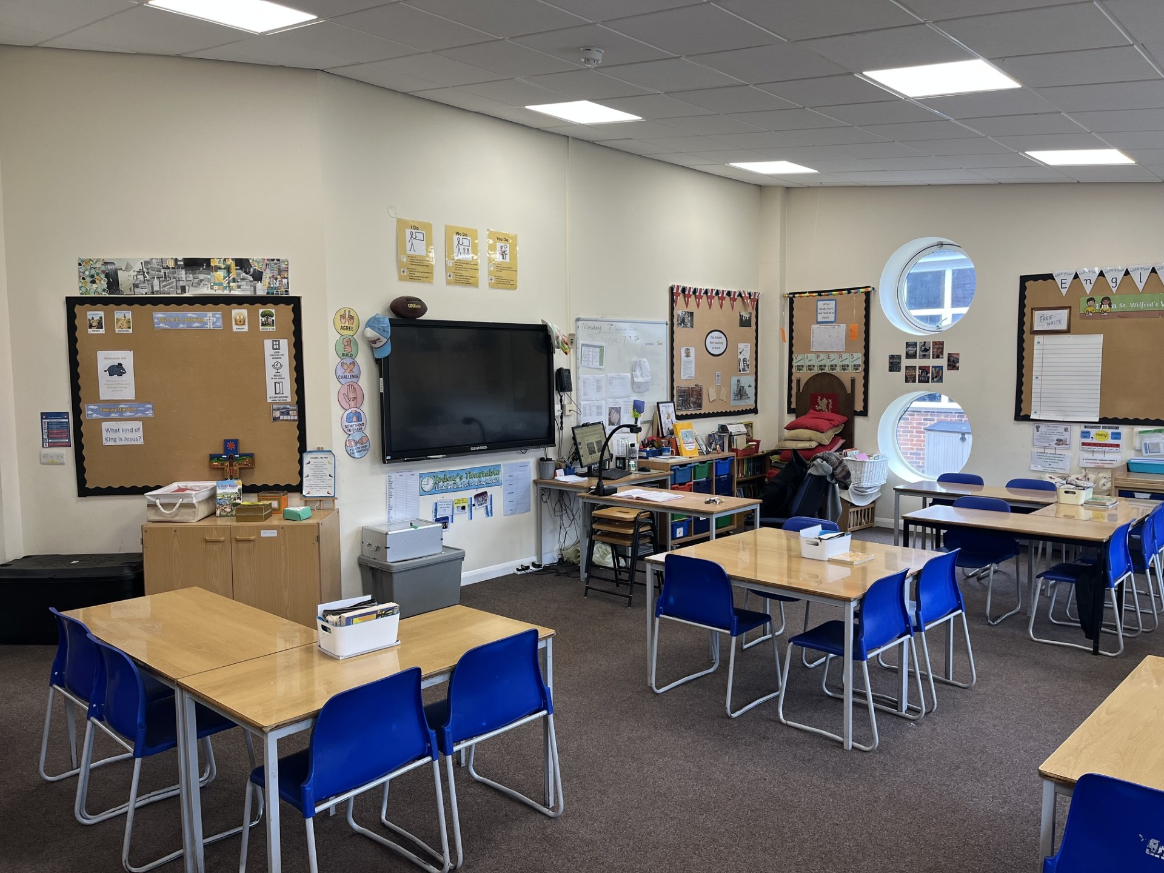
Hawks Kestrels

Slide 14
Year 6
Our Autumn term history learning is focused on WW2
Boom reader
Homework expectations
SATs/residential
Our PE days are Monday and Thursday
Tangmere trip – November (more info to be sent out shortly)

Slide 15
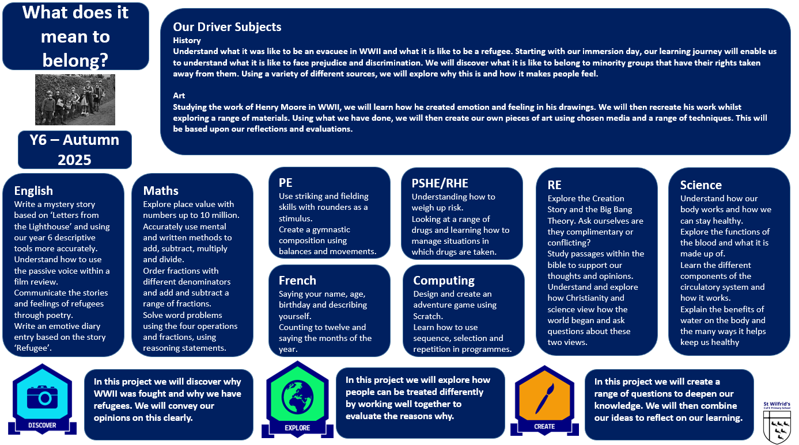
Year 6
Autumn Term Learning
2026
Year 6 – Autum Term curriculum map
We start by exploring the text 'Can I Build Another Me?'. We then start to explore several different quality books based on WW2 – from chapter books to picture books. Within our writing learning we also develop our Year 6 grammar, punctuation and spelling expertise. Our focus is developing Year 6 into independent writers.
This term we are exploring our dance unit of learning on a Monday and our fitness unit of learning on a Thursday.
Our RE learning this terms centres on the big enquiry question 'What kind of king is Jesus?'. Pupils explore what they already know about who Jesus is for Christians and then begin to look more deeply at verses from the New Testament to help us answer our big question. We then move on later in the term to our Christmas enquiry where we explore different narratives of the Nativity story from different gospel writers.

