Slide 1
Year 6
and Beyond
Welcome
Notes:
Simon – Welcome to St Wilfrids Community St Wilfrids Philosophy – Together we will be our best. Go through what will happen during the evening and the transition plan to ensure all children have a happy calm start to their school career Thank FSOW for coffee

Slide 2
Aims
We aim to share with you,
Information about SATs
Information about the Isle of Wight residential
Information about the rest of the 2023/2024 academic year.
Notes:
Simon Introduces the aims of the meeting

Slide 3
National Curriculum Assessment
At the end of Year 6, pupils will be provided with a teacher assessment confirming whether they have met the expected standard in the following areas;
Mathematics
English Reading
English Writing
Science
A scaled score will also be awarded for ‘Grammar, Punctuation and Spelling’, ‘Reading’ and ‘Mathematics’.
Notes:
SH explains next steps.

Slide 4
The Mathematics Papers
There are three papers in mathematics;
Paper 1 Arithmetic test: 30 mins (40 marks)
Paper 2 Reasoning test: 40 mins (35 marks)
Paper 3 Reasoning test: 40 mins (35 marks)
Notes:
SH explains next steps.

Slide 5
Maths
Arithmetic paper

Slide 6
Maths
Reasoning paper

Slide 7
Maths
Reasoning paper

Slide 8
The English Papers
There are three papers in English;
Reading Comprehension: 1 hour (50 marks)
Spelling : 20mins (20 marks)
Grammar, Punctuation and Spelling: 45mins (50 marks)

Slide 9
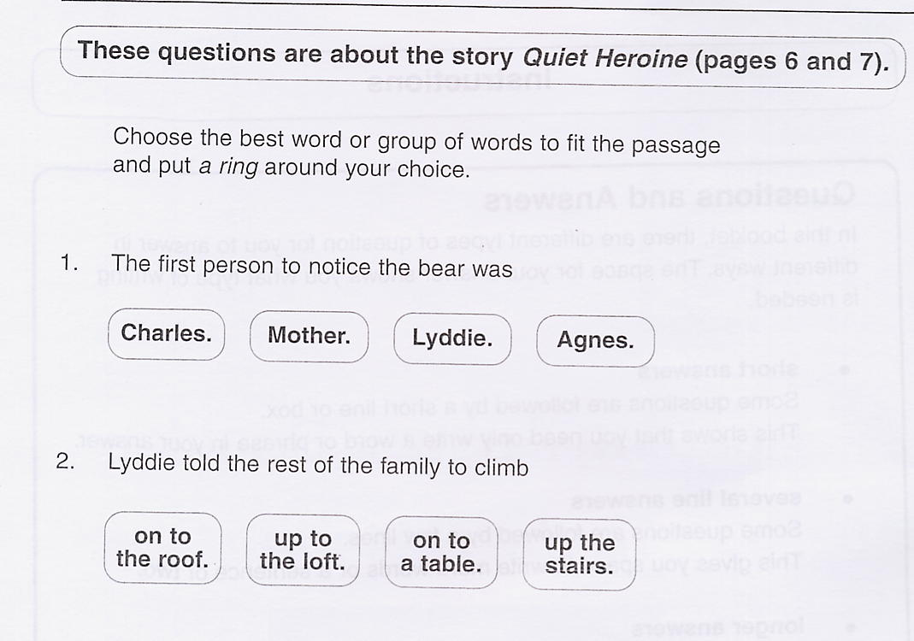
The Reading Test

Slide 10
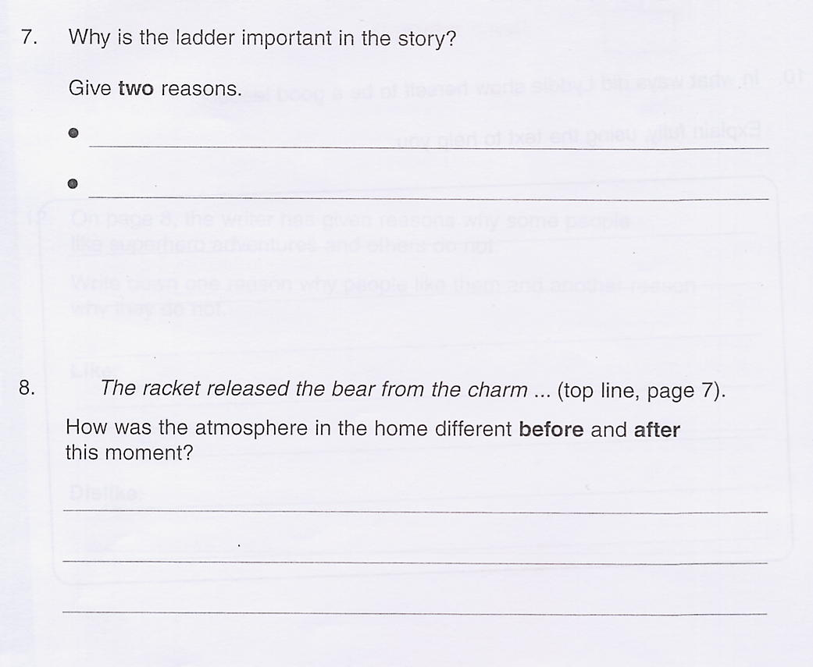
because it hits the bear on the nose
because it stops creaking
The noise distracted the bear so it was no longer spellbound.

Slide 11
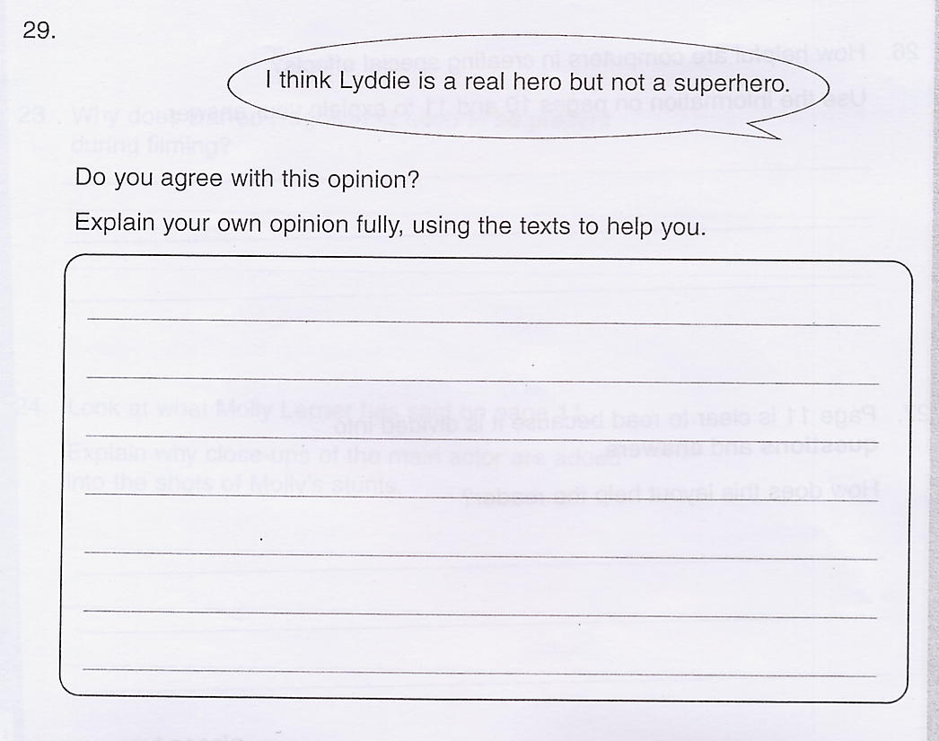
I agree that Lyddie is a real hero because she showed great courage to save her family. She is not a superhero because she didn’t have a secret identity, wear a special costume or have super human powers.

Slide 12
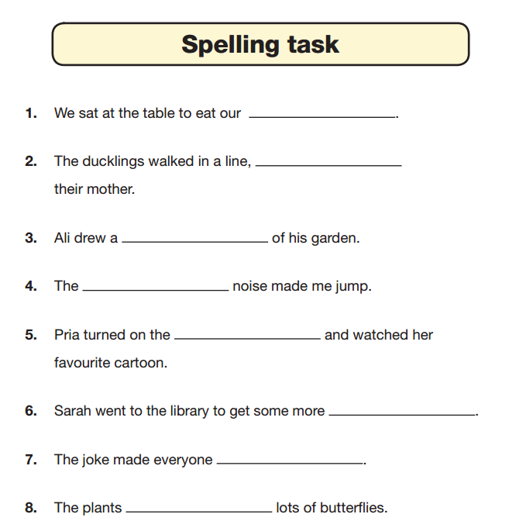
The Spelling
Test
dinner
following

Slide 13
The Grammar and Punctuation Test
This test is made up of various questions relating to grammar, punctuation and vocabulary.
This test was introduced to replace the writing tasks that were set previously.
We still assess your child’s writing throughout the year and report this to you with their results.

Slide 14
Grammar
me
I
me
C
A
B
D

Slide 15
Punctuation
Max
Max is someone’s name.
“
“
“
“

Slide 16
Vocabulary
play
play
mis
in
im

Slide 17
How can you help your child?
Assist and review homework
Times tables and maths games
Listen to your child read and discuss the book
Study/Revision books are available but not essential
The test results are unlikely to affect children’s
secondary school classes
Children should be encouraged to be determined
and do their best, but should not feel stressed

Slide 18
Study Guides
CGP (Coordination Group Publications)
available from bookshops
Letts Revision Guides and Workbooks

Slide 19
Y6 NCT Timetable 2024
Monday 13 May | Tuesday 14 May | Wednesday 15 May | Thursday 16 May | Friday 17 May
Grammar and Punctuation (short answers) 45 minutes Spelling (20 words) | Reading (3 sections) 60 minutes | Mathematics Paper 1: (arithmetic test) 30 minutes Mathematics Paper 2: (reasoning) 45 minutes | Mathematics Paper 3: (reasoning) 45 minutes

Slide 22
Why go to the Isle of Wight?
Develops social skills and independence
Curriculum links – to enhance schoolwork with first-hand experiences

Slide 23
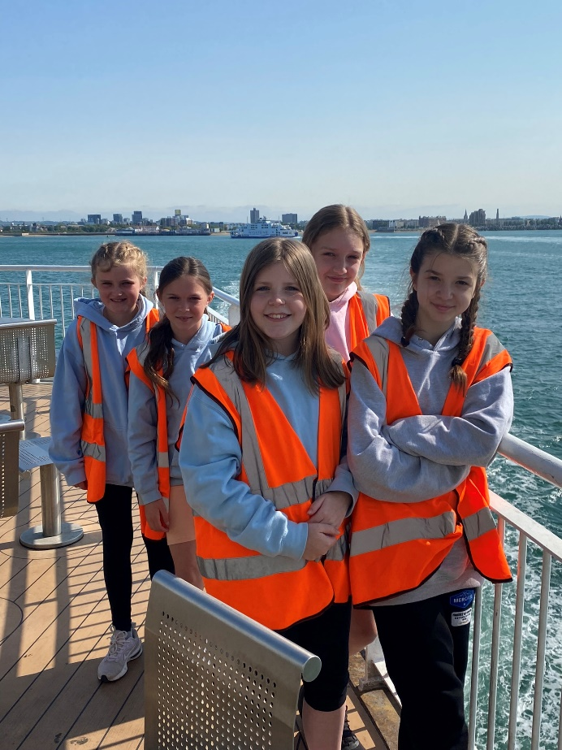
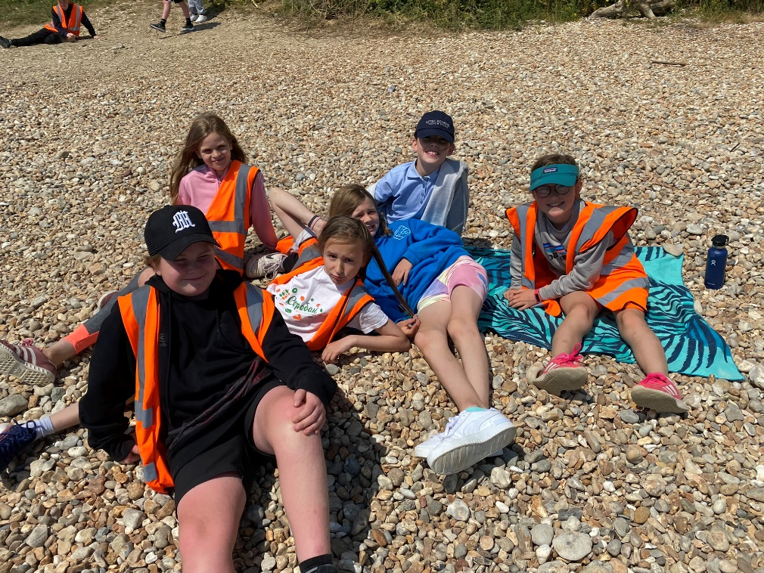
Developing social skills and independence

Slide 24
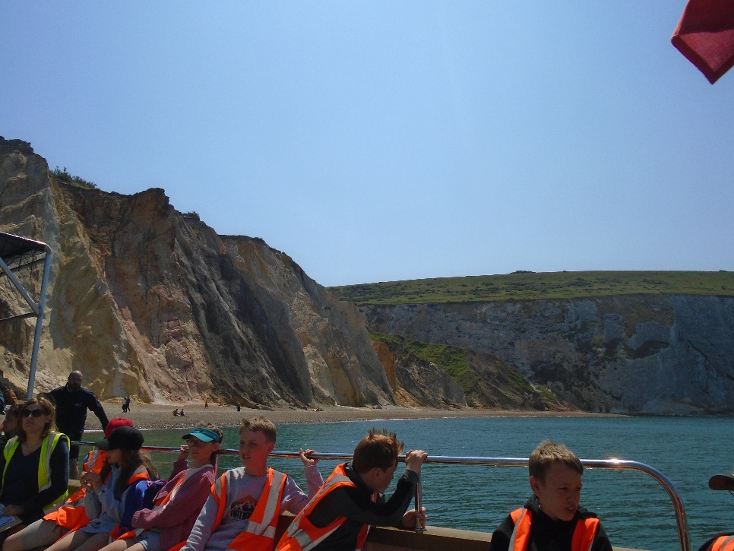
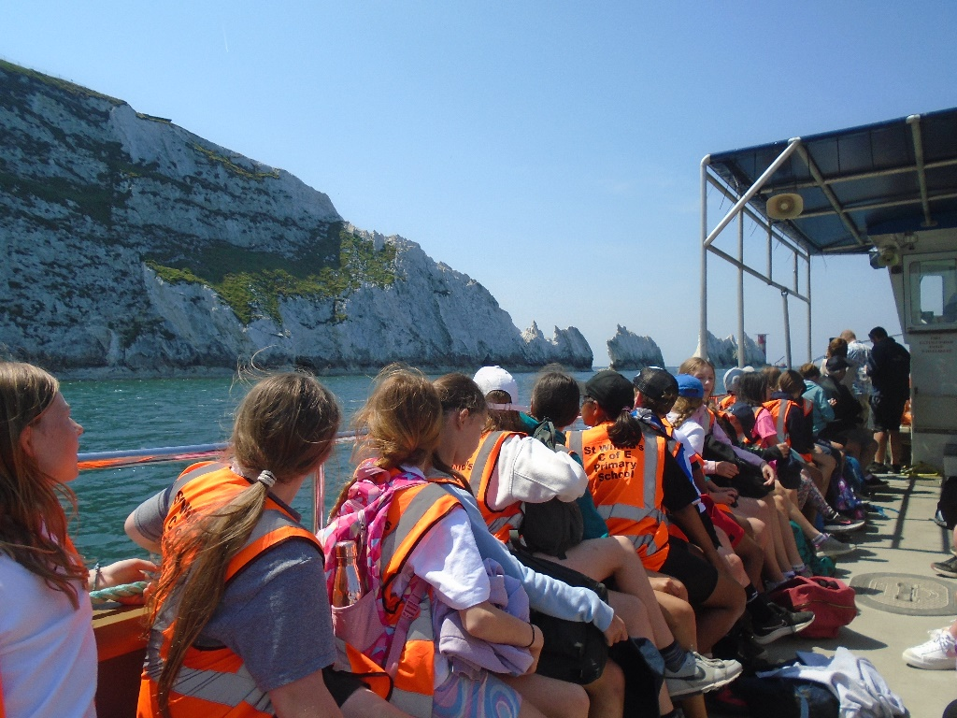
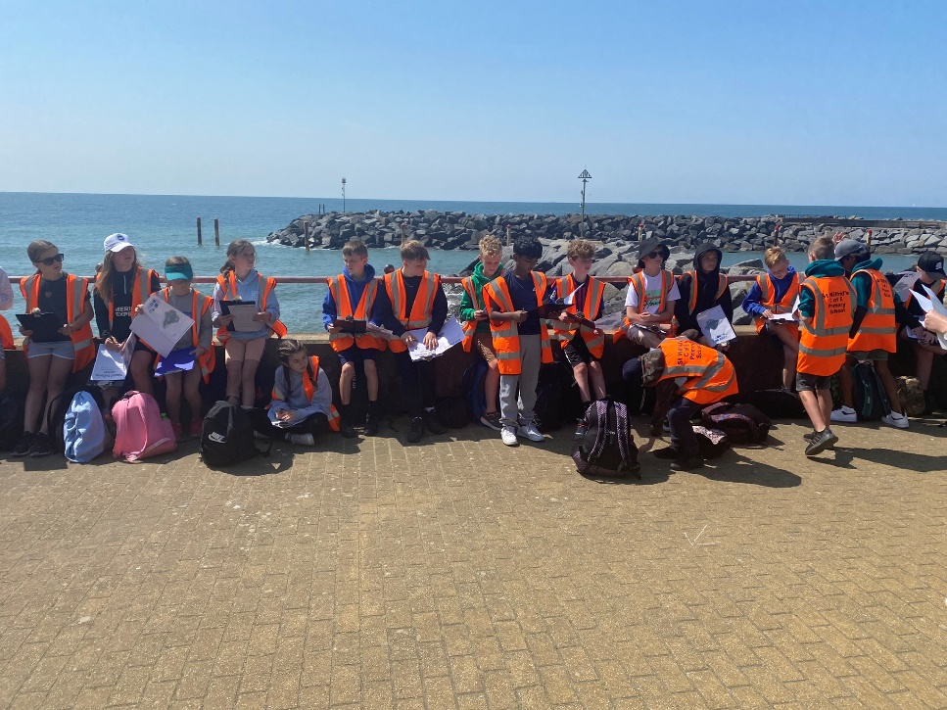
Curriculum Links
Geography - All about coasts

Slide 25
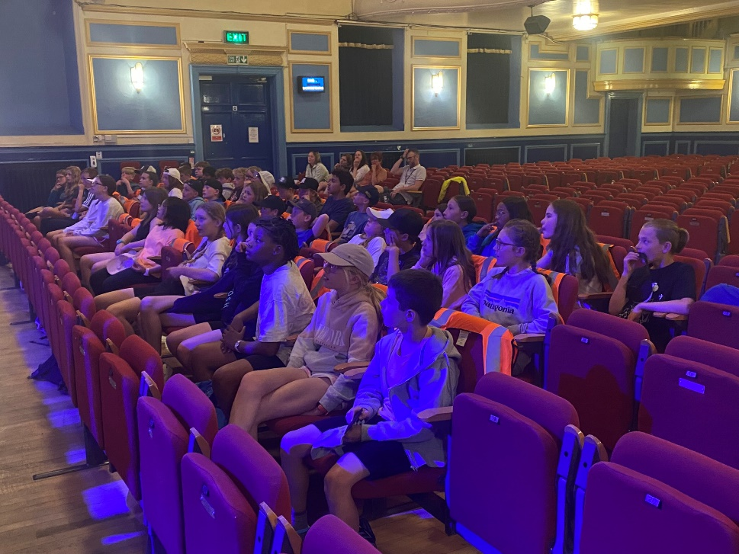
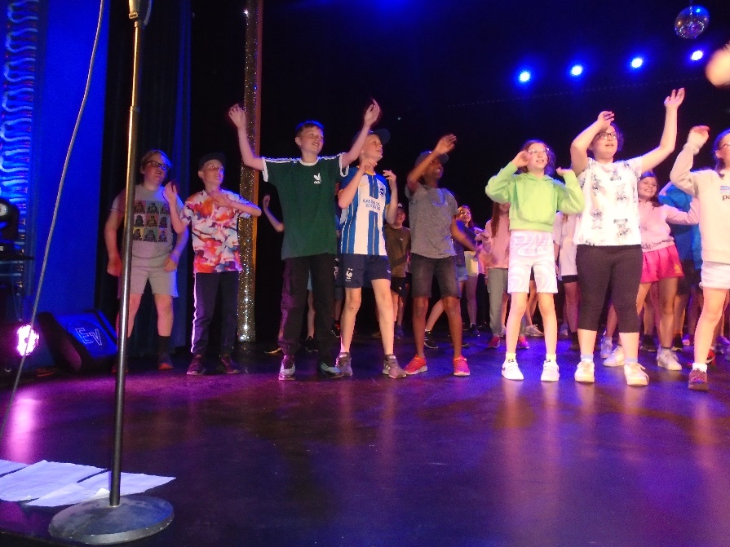
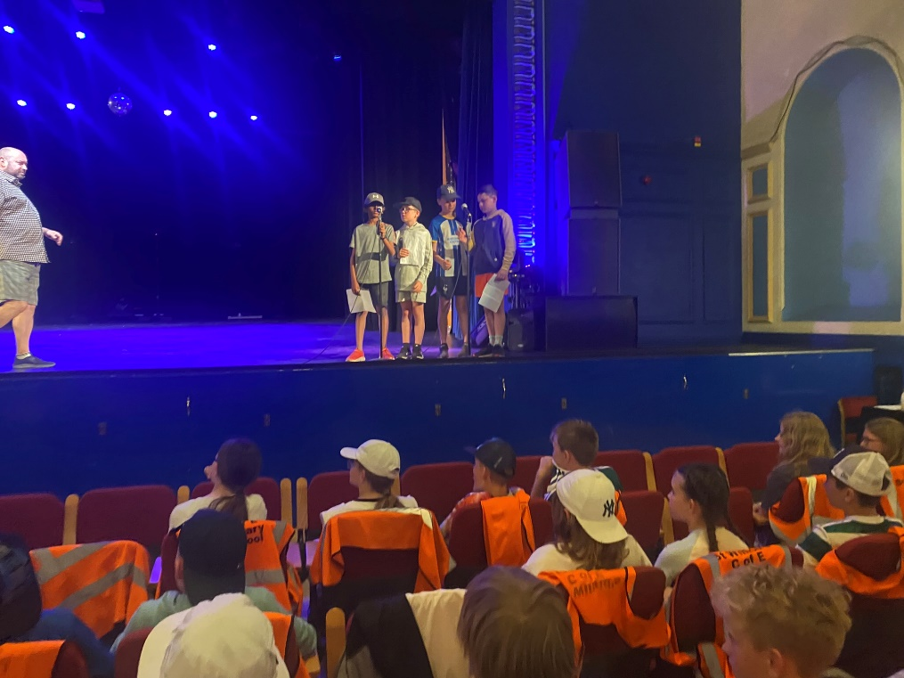
Curriculum Links
Drama
Theatre performance, tour and workshop

Slide 26
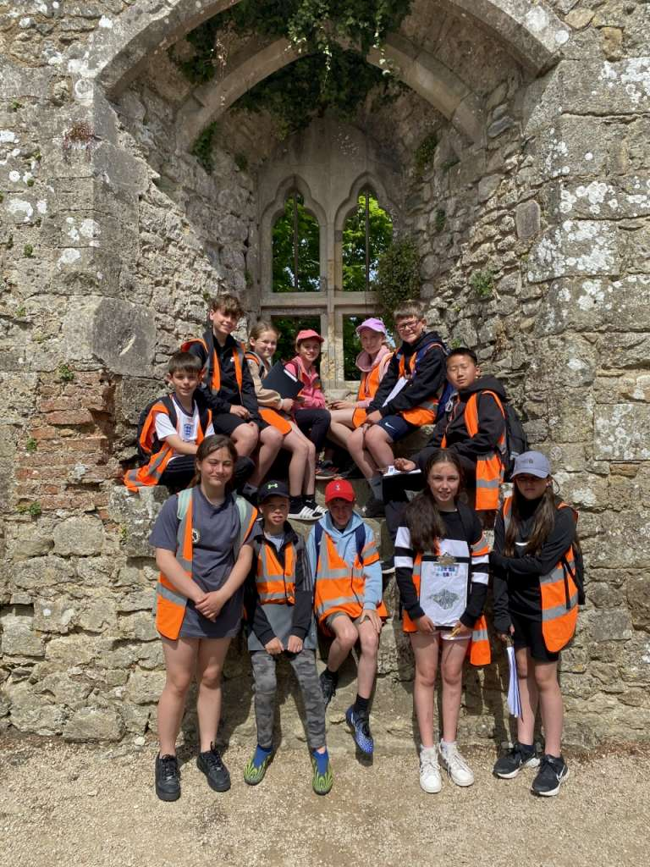
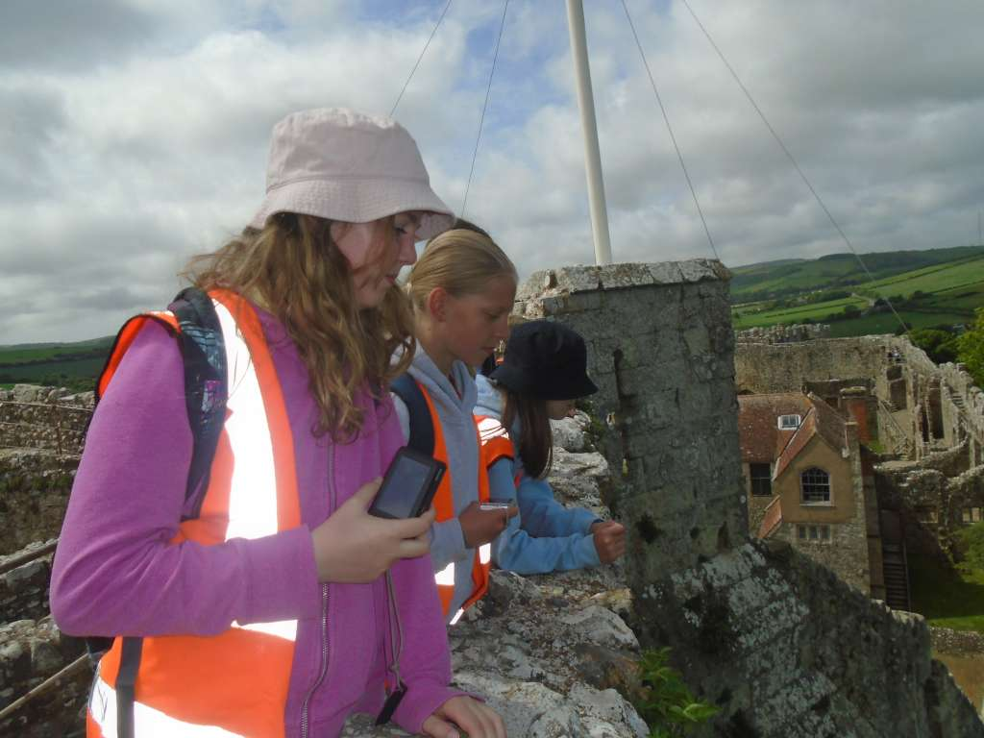
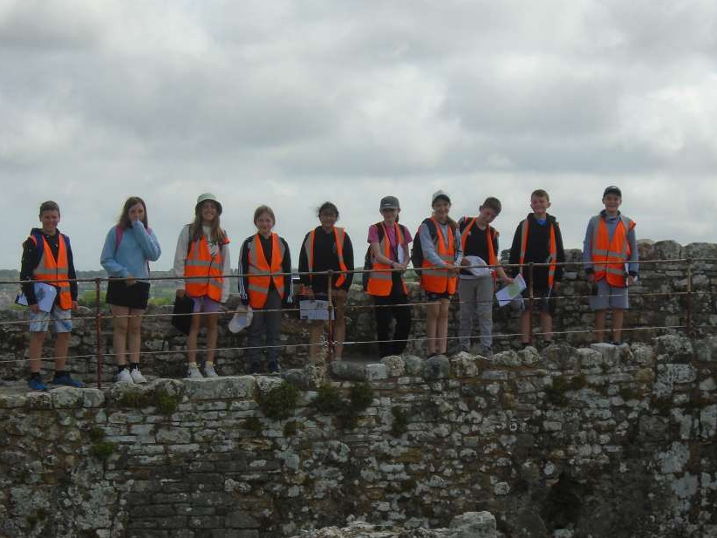
Curriculum Links
History
Carisbrooke Castle

Slide 27
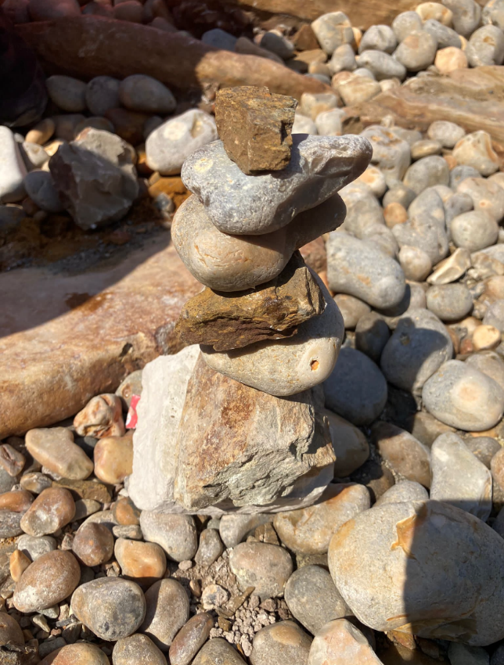
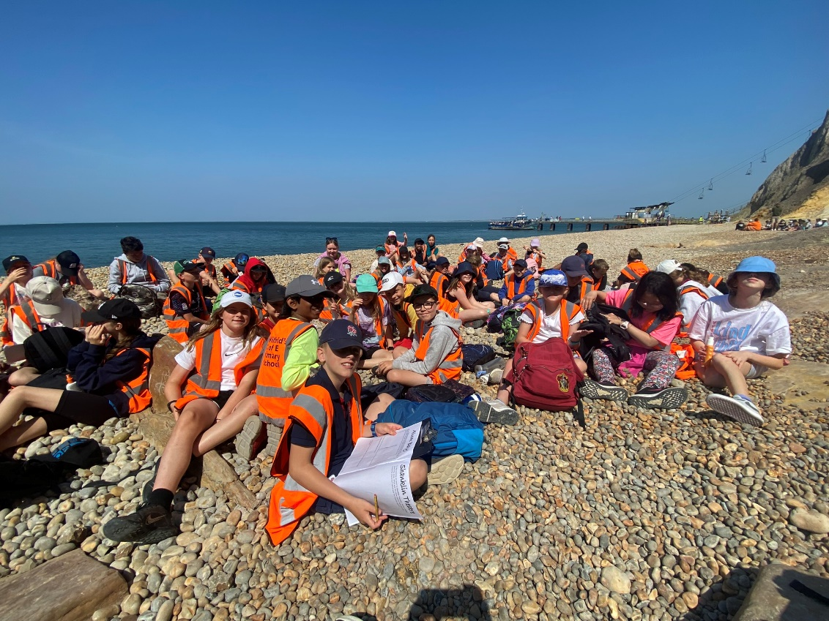
Curriculum Links
English
Beach Poetry
Art
Sketching and making sculptures on the beach

Slide 28
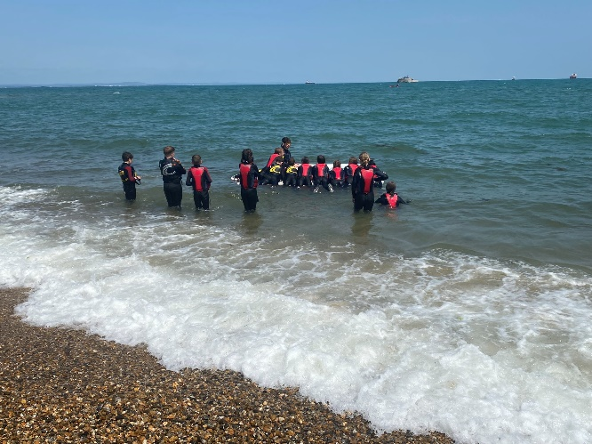
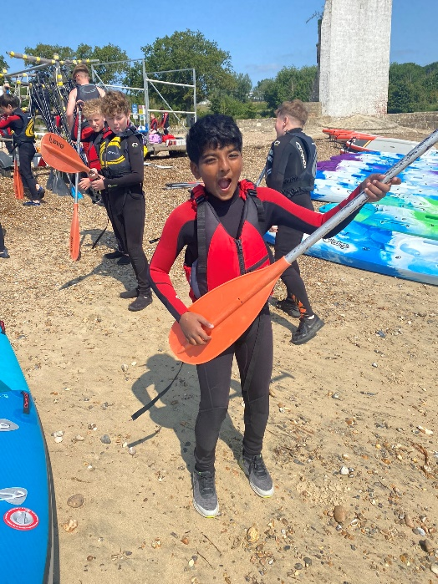
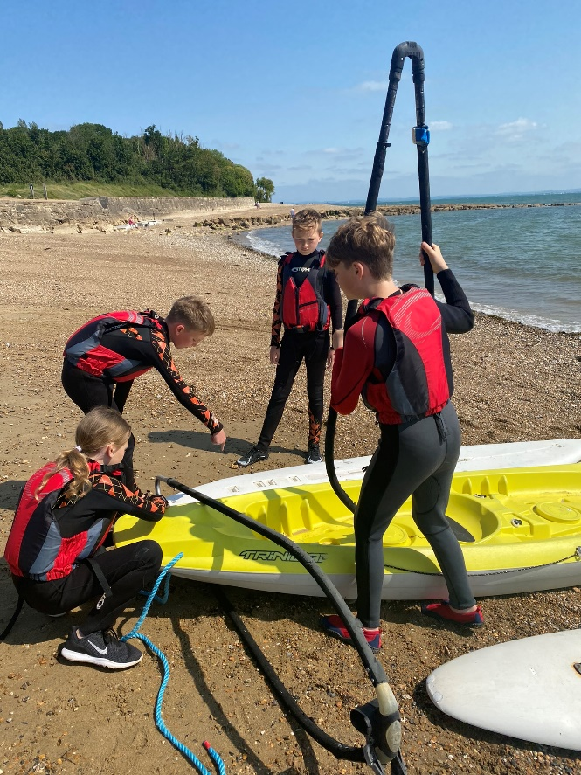
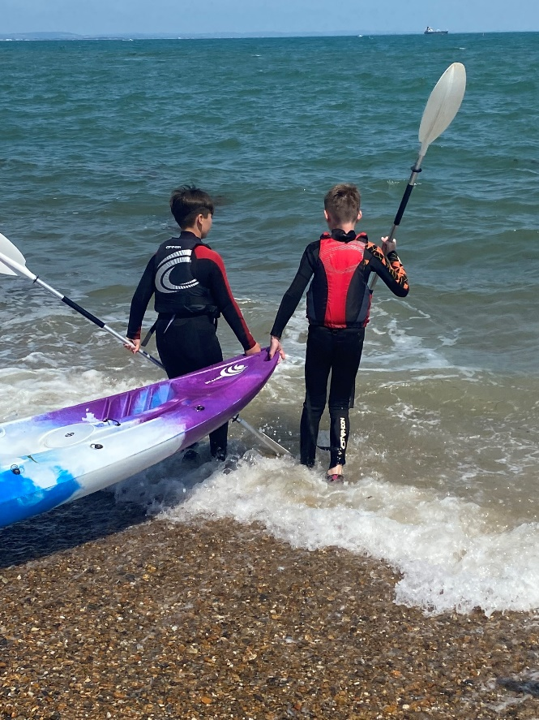
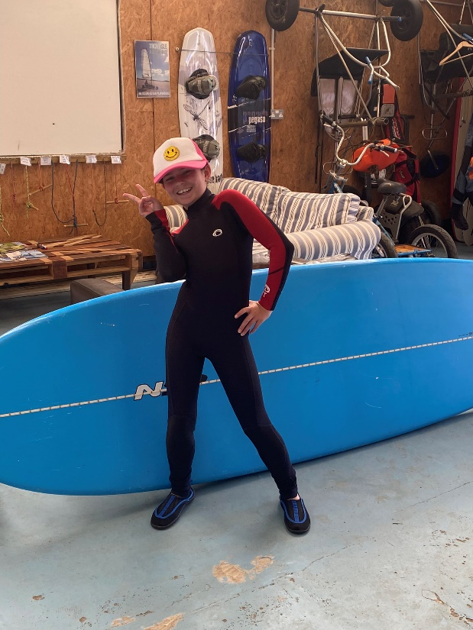
Outdoor activities
Water Sports

Slide 29
Important Issues
Come and speak to us!
No mobile phones or devices that link to the internet

Slide 31
Dates for your diary
13th May – 17th May: SATs week
3rd June – 7th June: Isle of Wight residential
Monday 1st July: Diocesan leavers service at Christ’s Hospital
Tuesday 2nd July: Key Stage Two sports morning
Wednesday 3rd July: Secondary school induction day
Tuesday 9th July: Production (afternoon and evening)
Thursday 11th July: Production (evening)
Wednesday 17th July: Leavers worship (AM) and BBQ.

