Slide 1
Introduction to Read Write Inc.

Slide 2
Why Read Write Inc Phonics?
-Tried and tested over many years
-Systematic and structured - homogenous groupings across EYFS and KS1
-Early success in reading
-Opportunities for training and ongoing staff development
Parents - Ruth Miskin Literacy - What is RWI phonics?

Slide 3
Phonics
Just as children walk and talk at different ages they learn to read at different ages. A few children go through these very quickly at an early age.
Often an older child in the family just seems to read and it comes as a surprise when the next child needs more time to go through each stage. It is a developmental process. We need to support that process.

Slide 4
What is phonics?
Phonemes (sounds)
Graphemes (sound written down)
English alphabetic code
44 sounds
26 letters
Over 150+ graphemes (letter combinations)
One of the most complex alphabetic codes in the world!

Slide 5
Speed Sounds Set 1 and Set 2

Slide 6
Speed Sounds Set 3

Slide 7
Sounds – How do we pronounce them?
Pure sounds - It is very important that children pronounce each phoneme correctly.
‘Schwa’ - putting ‘uh’ after each phoneme such as ‘c’ becomes ‘c-uh’ and ‘t’ becomes ‘t-uh’.
This stops a child from being able to blend and segment a word correctly hindering their spelling words – c_a_t.
Parent video: How to say the sounds – YouTube (1.00)

Slide 8
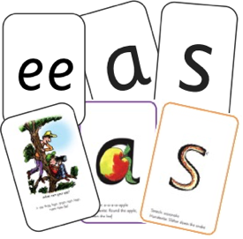




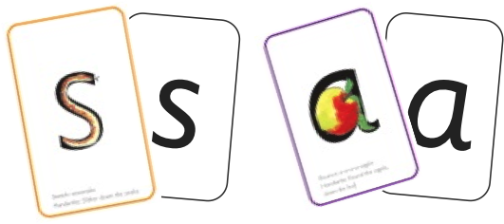





Read Write Inc. Phonics daily lessons
+
sounds + blending = reading

Slide 9
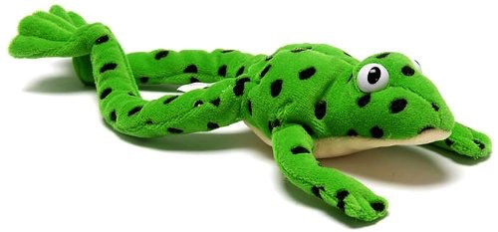
Fred the frog...
Fred helps children learn to read.
Fred can only talk in sounds...
(He can only say c_a_t, he can’t say cat)
We call this ‘Fred Talk’
If children understand Fred
they can blend orally.
We try and use Fred talk as much as we can throughout the day!

Slide 10

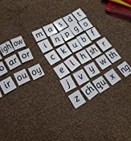
Speed sounds session – 10 minutes daily
-Partner Work – “My Turn, your turn”.
-Learn sound – then write sound.
-Blend words – using letter tiles.
-Speed sounds – can we spot the new sound?

Slide 11
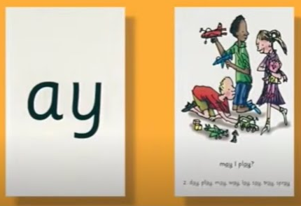
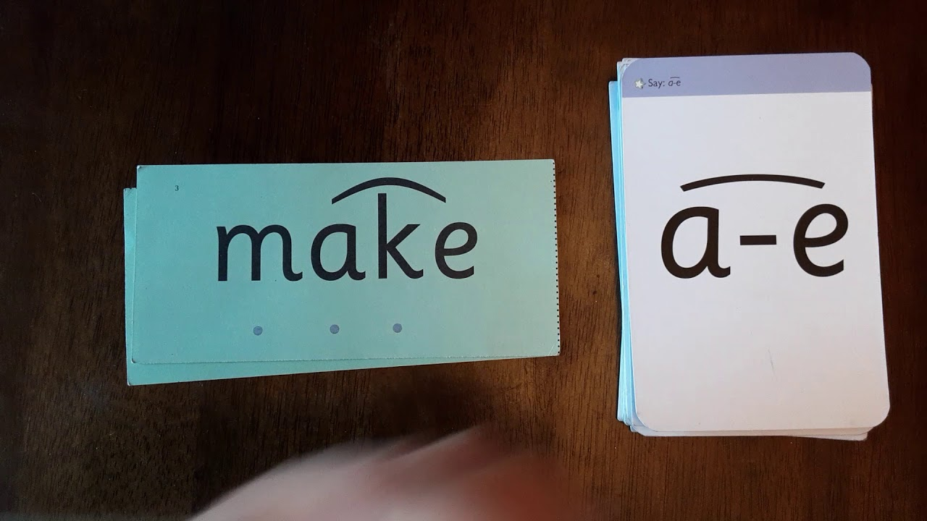
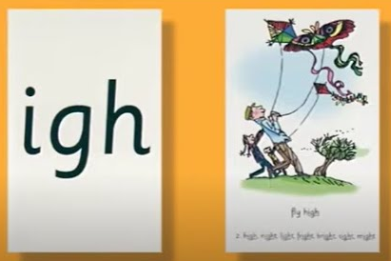
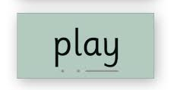
Speed sounds – 10 minutes daily
-Special friends – 2 or 3 letters making one sound.
-Green Words – read words containing new sounds.
-Fred in your head - Once able to read it, no need to decode out loud.
diagraph
split diagraph
trigraph

Slide 12
More Fred...
Fred helps children learn to spell as well!
Children then convert words into sounds
They pinch the sounds they hear on to their fingers...
We call this Fred Fingers

Slide 13
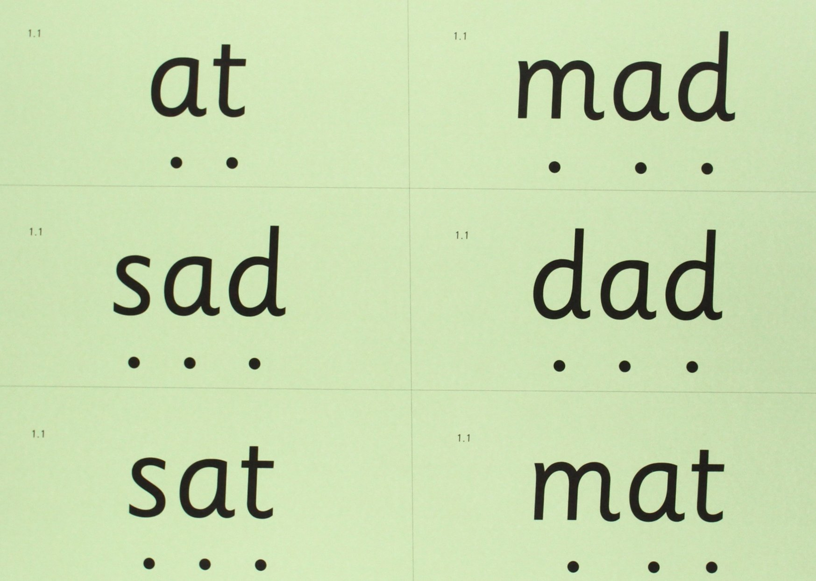
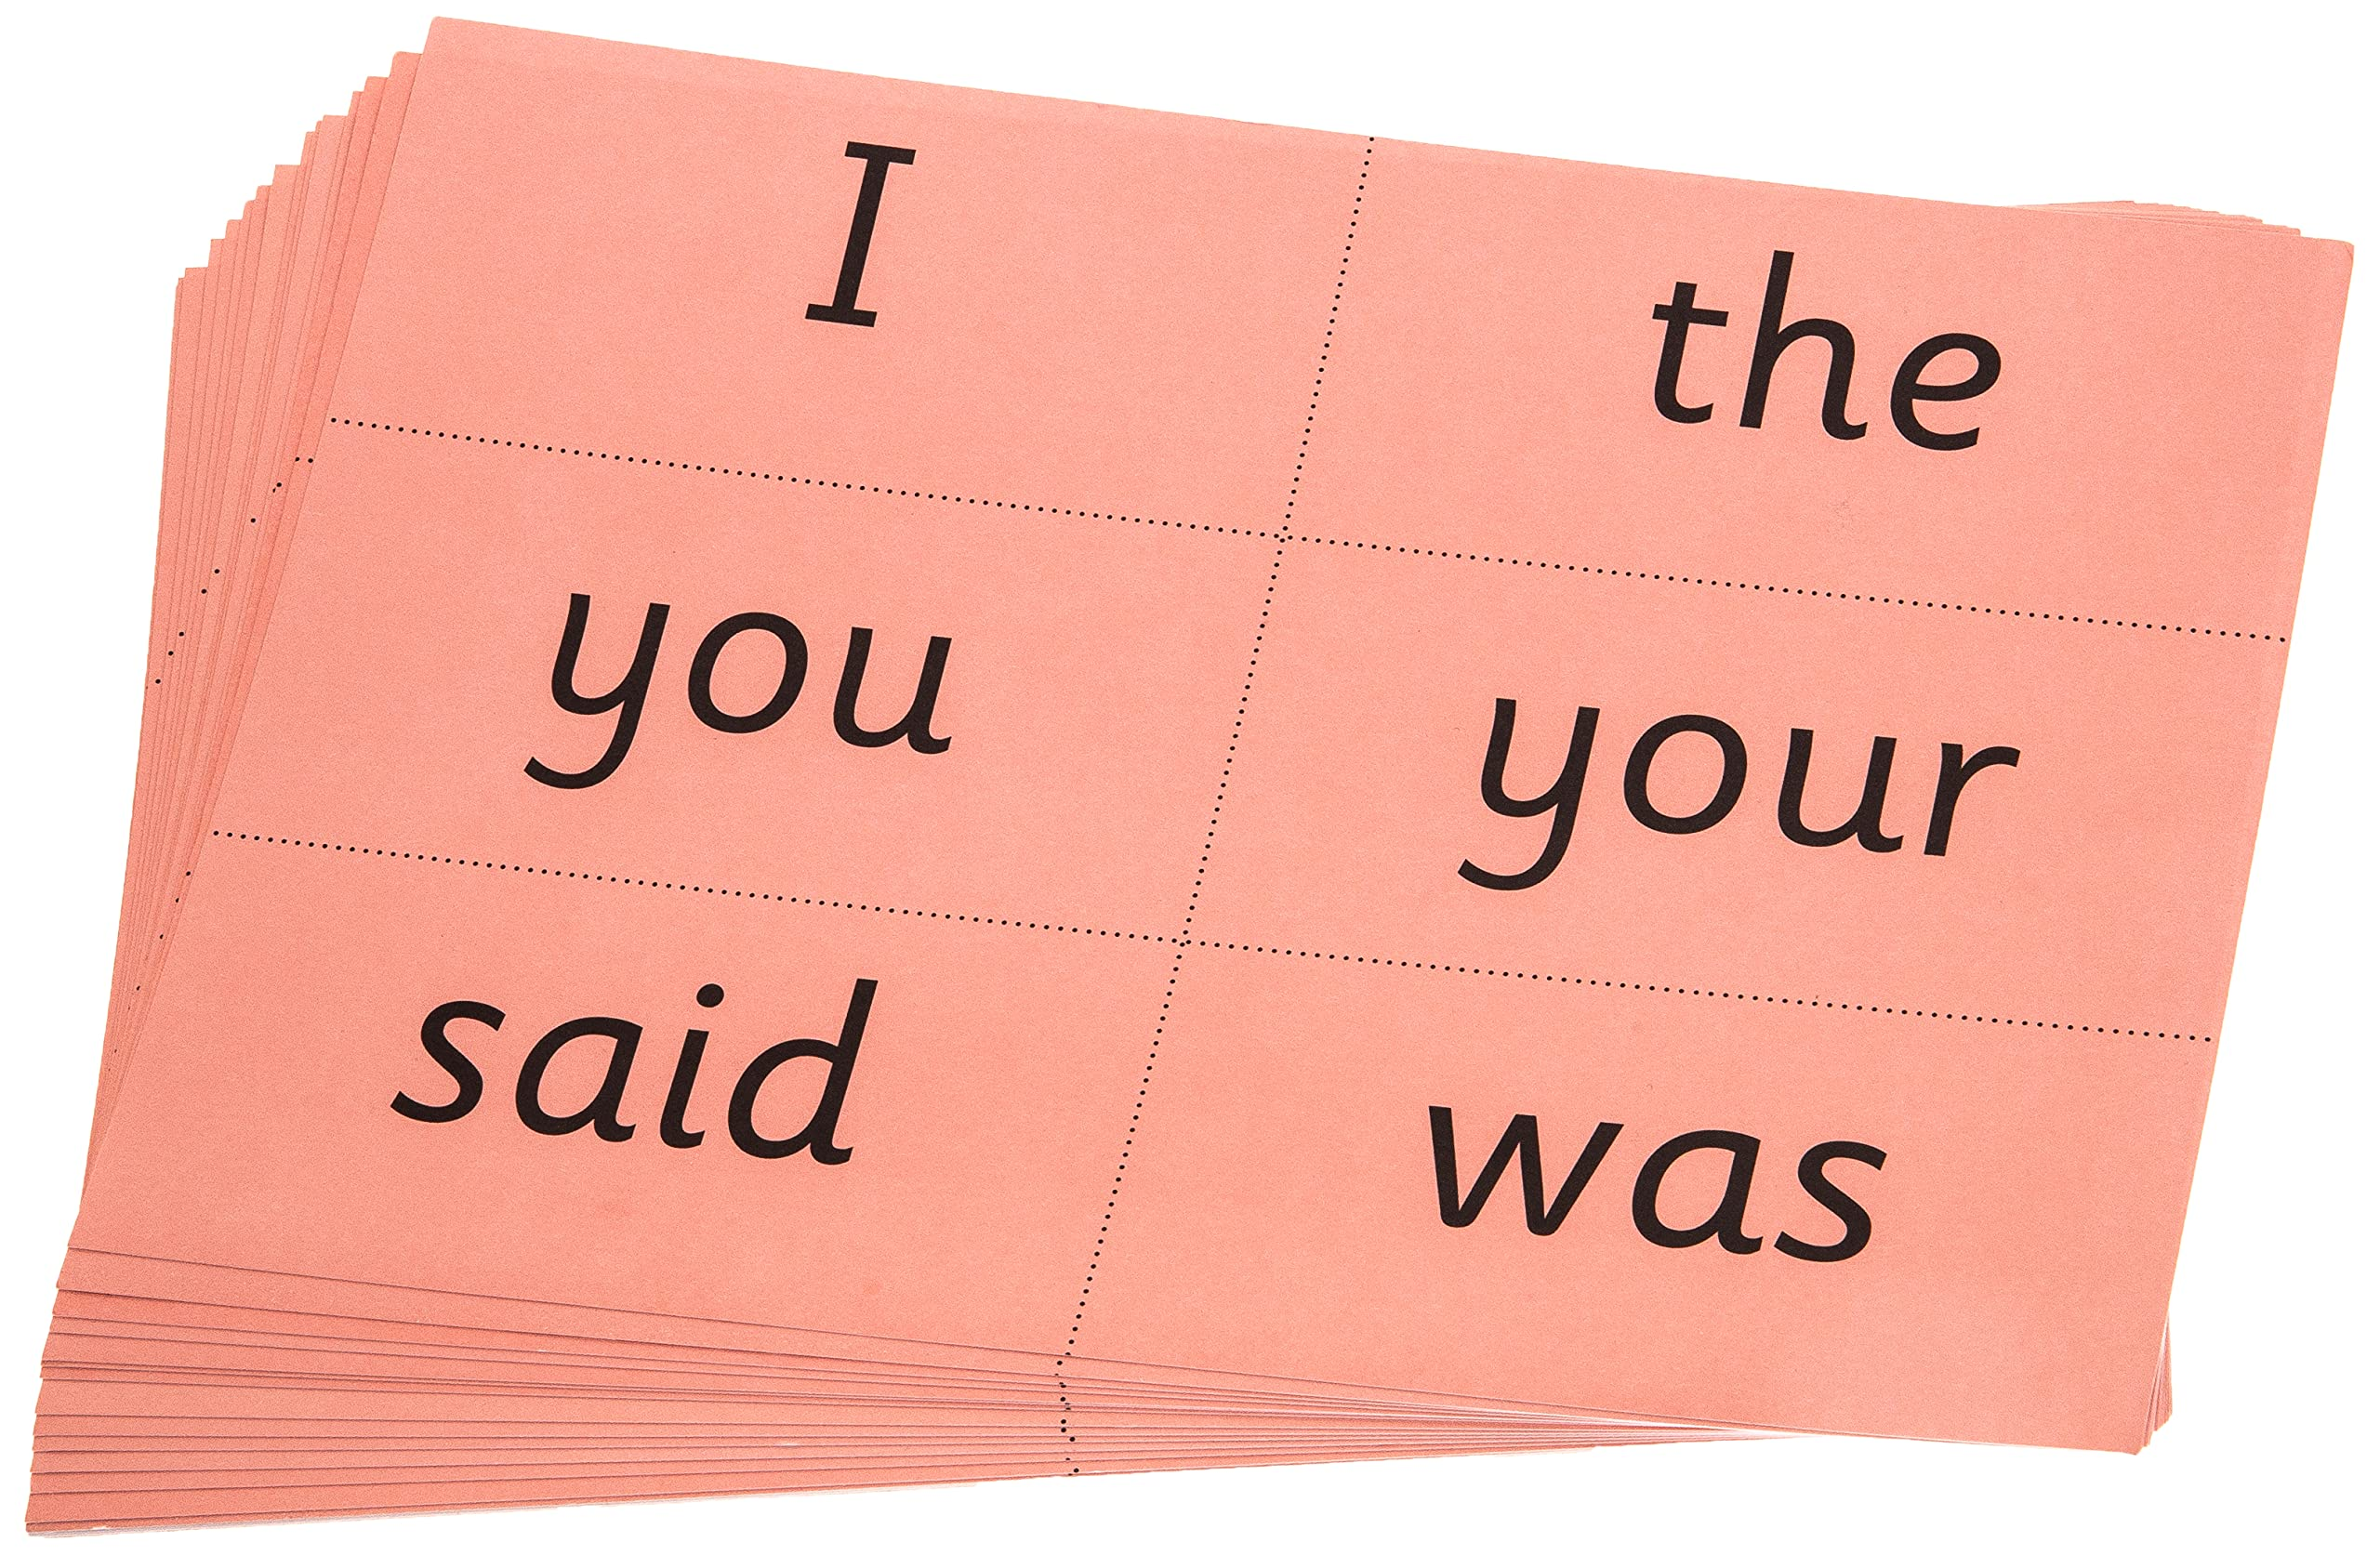
Red Words
Green Words
Words which can be decoded easily using sounding out and blending.
Words which can not be decoded easily, sometimes called “tricky” words.
Words that need to be learnt and become part of their visual memory.

Slide 14



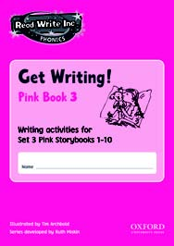


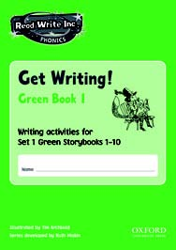


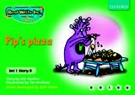


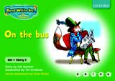


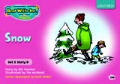



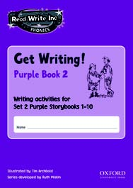
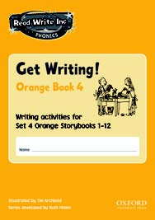

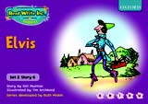


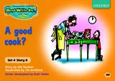




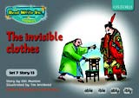

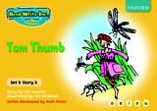
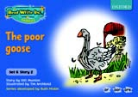
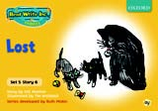
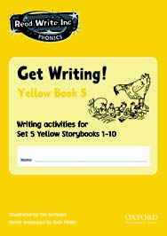


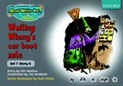
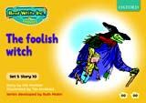

RWI Reading session – 20 minutes daily

Slide 15
Three reads at school, then read at home
1. Accuracy
2. Fluency
3. Readers voice and understanding
4. Read and enjoy at home

Slide 16
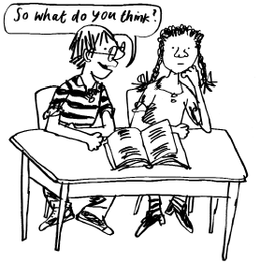
Comprehension skills
Speaking and listening:
Talk a lot about what they have read to show they understand.
Listen to and discuss other ideas to deepen understanding.
This is comprehending.

Slide 17

Which books will children bring home?
+
+

Slide 18
What can I do at home?
Use pure sounds with children.
Use Fred Talk to read and spell words when reading with your child as much as possible.
Listen to your child read their RWI Storybook every day.
Read stories to your child every day.
Begin to ask simple questions about the story.
What is happening?
What is the character thinking?
What do you think
happens next?
What do you
think the character is
feeling now? Why?
What is the character saying?

Slide 19
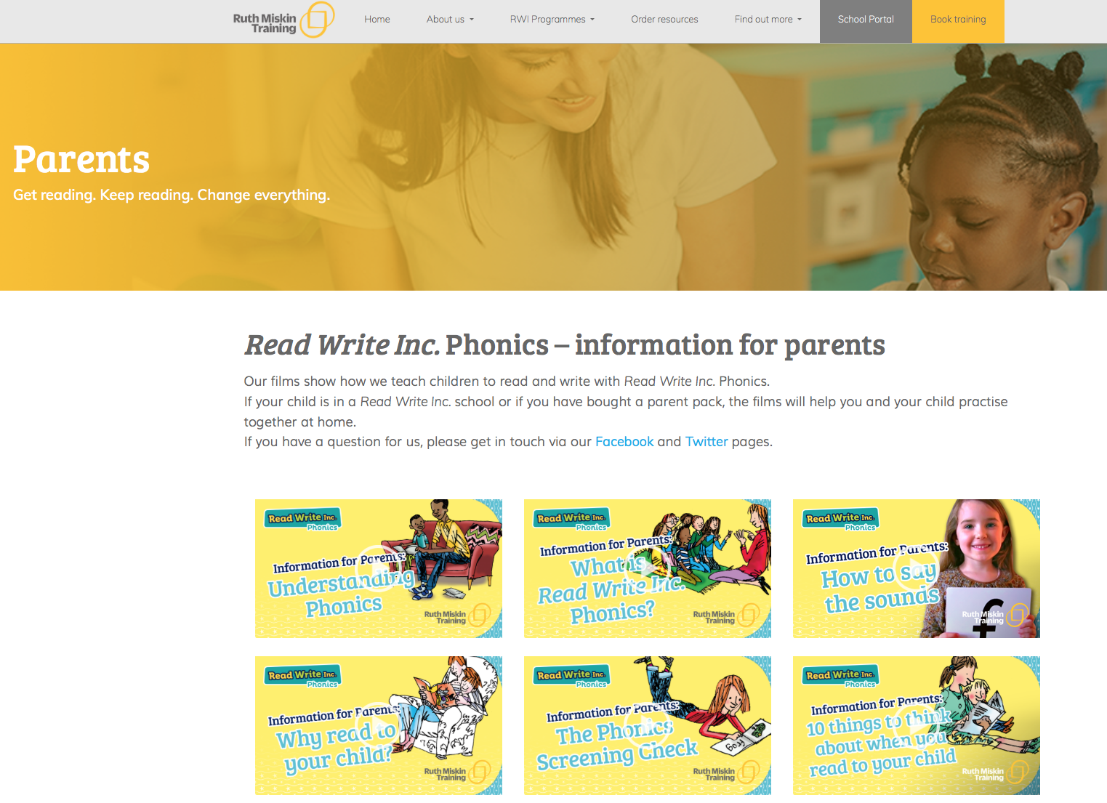
Free Video Tutorials (ruthmiskin.com)
Ruth Miskin Parents’ Page: www.ruthmiskin.com/en/parents/

Slide 20
Any other questions
?

