Slide 1

Welcome

Slide 2
Welcome to our Phase 1 meeting

Slide 4









Slide 5
Expectations for Phase 1
Become familiar with new routines
Teaching children school values (EYFS)
Deepening understanding of school values (Year 1)
Learning through play – outside areas
Behaviour is communication – THRIVE
Good amount of sleep (9 to 12 hours)
Uniform
Attendance and punctuality
Phonics meeting – 23rd September 6pm
Parental partnership is important - yearr@stwilfrids-hh.school , year1@stwilfrids-hh.school
Weekly learning updates

Slide 6
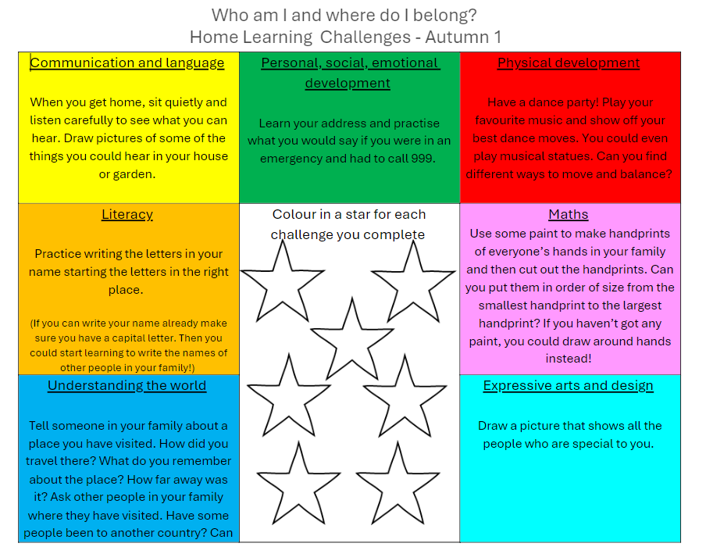
Phase 1 Homework
EYFS | Year 1
Read with your child daily - Record with signature in reading diaries | Read with your child daily - Record with signature in reading diaries
Project challenges Half termly challenges linked to 7 areas of learning You can upload what has been completed to Evidence Me | Homework book Alternates between English and maths weekly Starts after half term More information to follow
Letter formation sheets weekly in Autumn 1 | Complete the Year 1 reading challenge
Complete the Reception reading challenge | RWI speedy reading words

Slide 7



The St Wilfrid's Reading Challenge

Slide 8
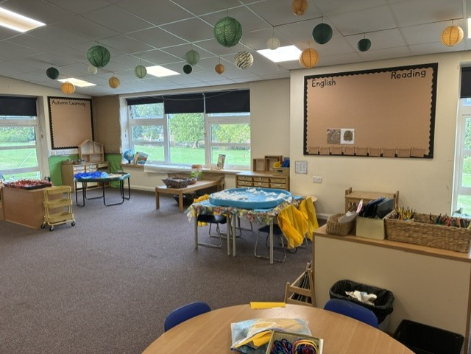
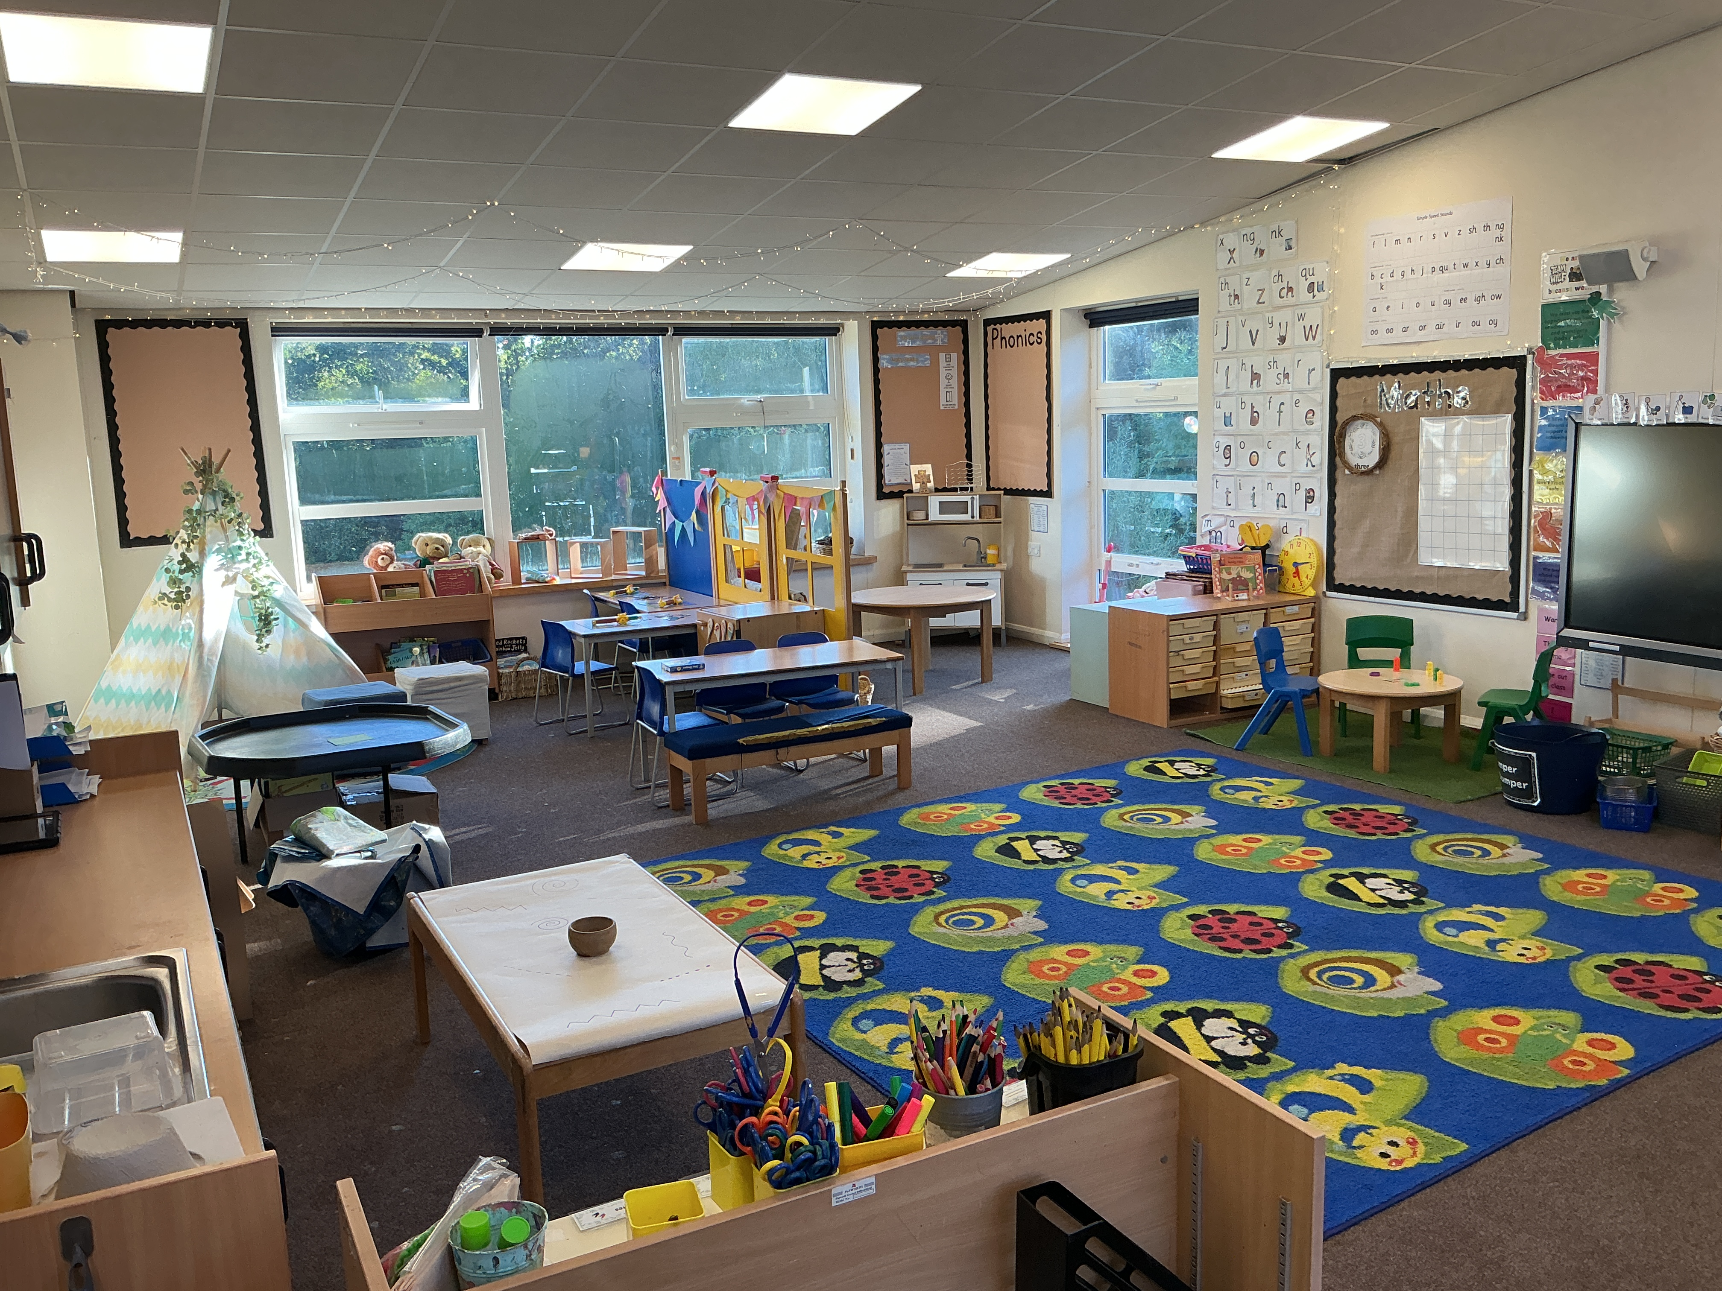
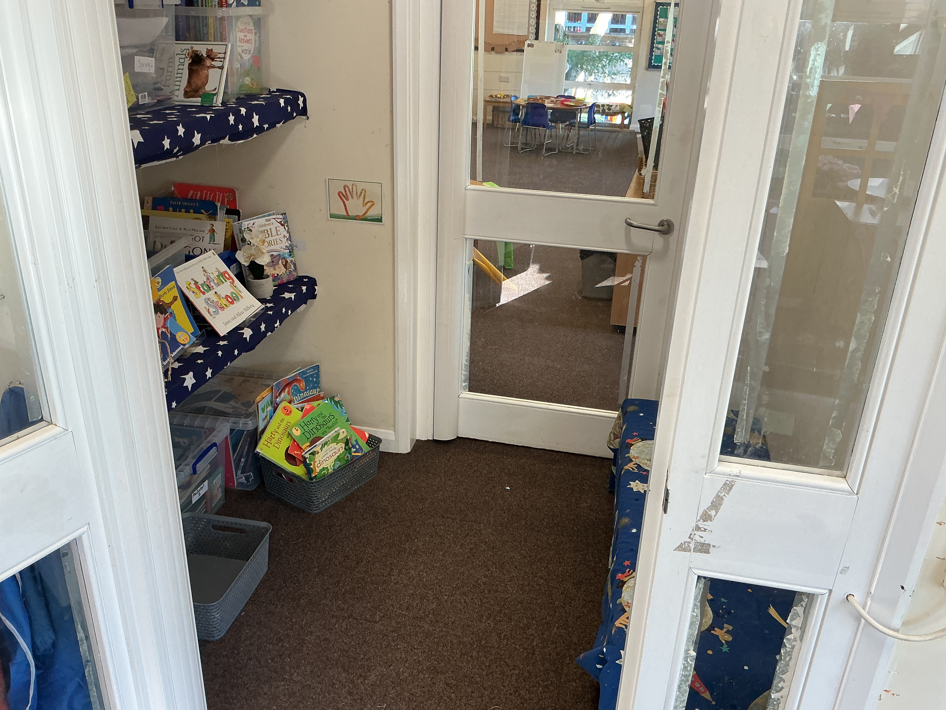
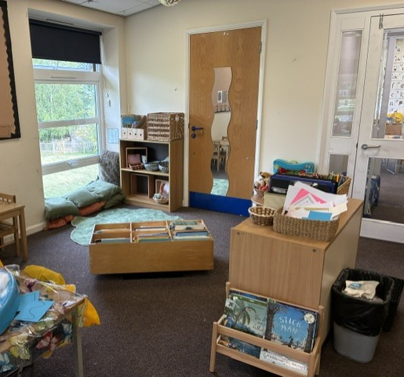
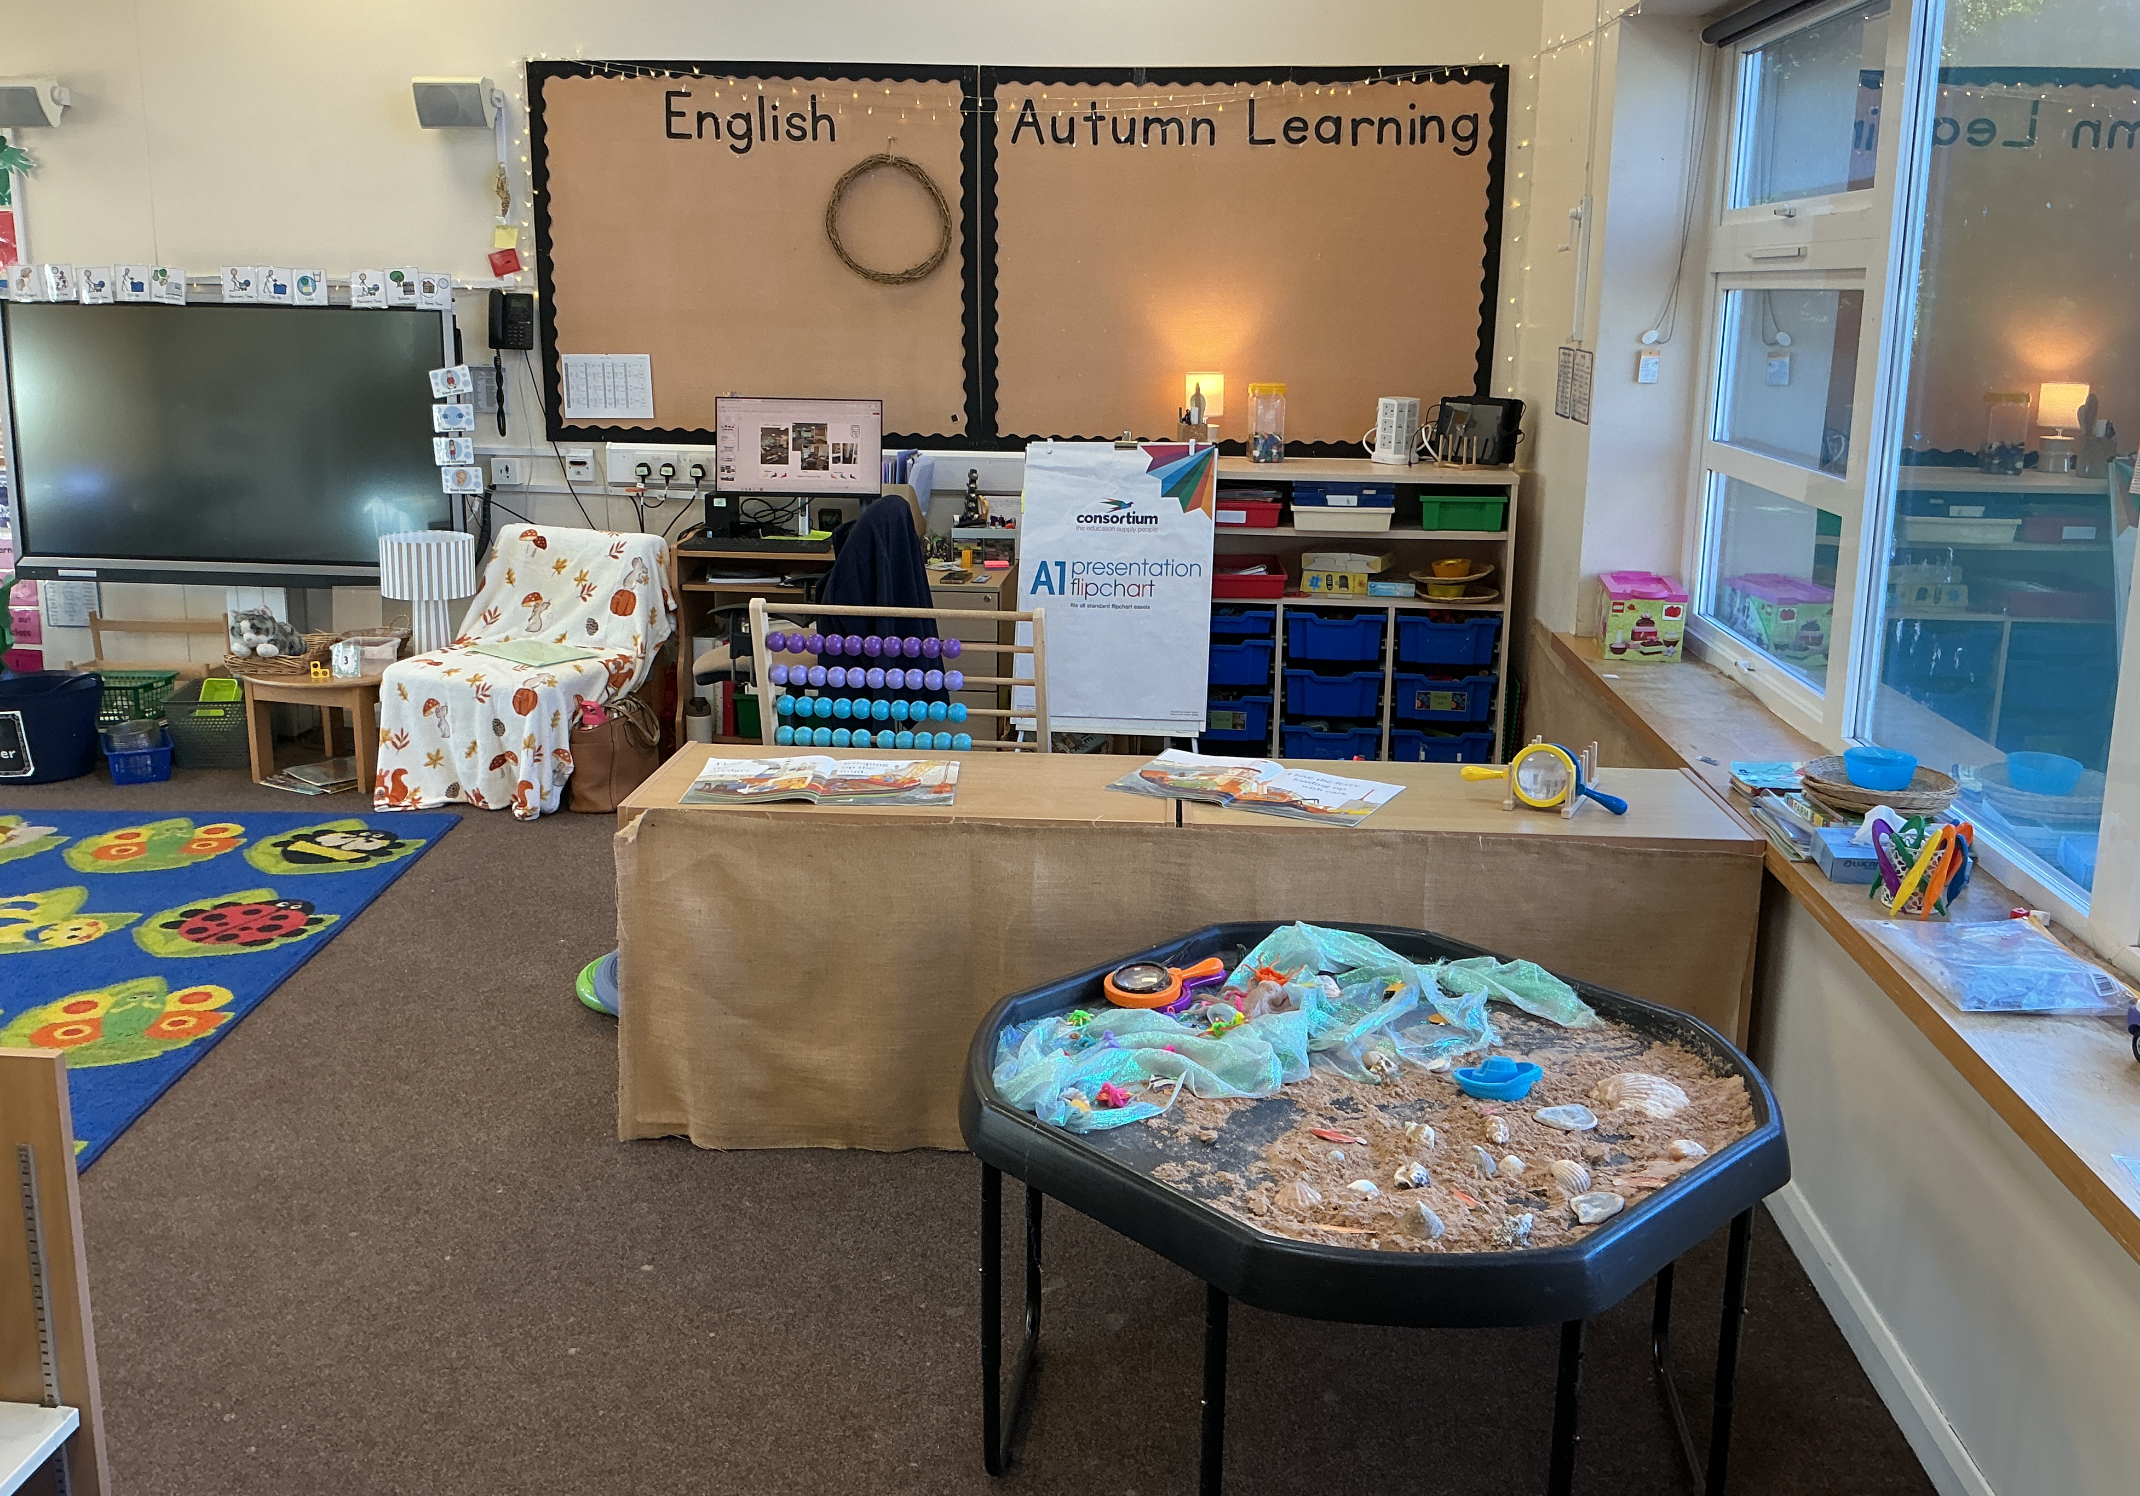
EYFS – Classrooms
Reception
Newts Tadpoles Book Nook

Slide 9
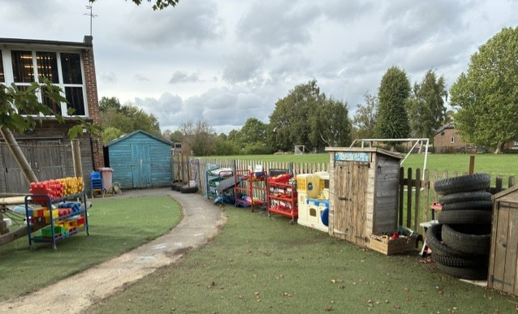
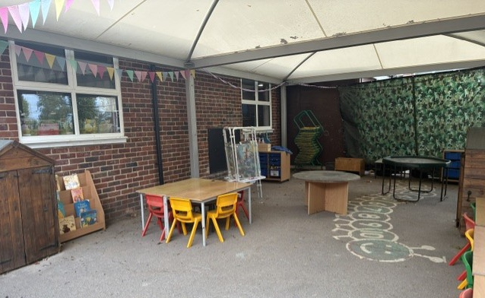
EYFS – Outside
Top Deck Bottom Deck
Focus on Prime Areas in Autumn 1;
Personal, Social and Emotional Development, Physical development and Communication and Language.
During the half term we will be supporting our children to develop routines and encouraging them to make great choices to help them be the new members of Team Wilf!

Slide 10
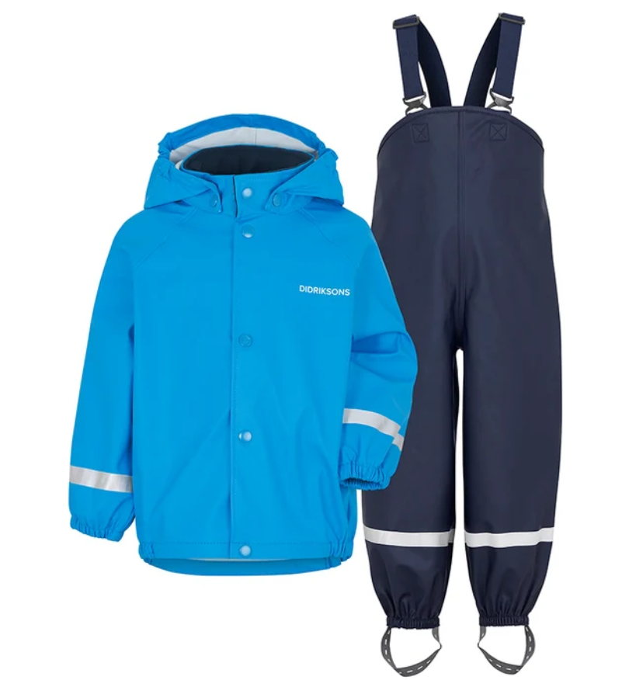
Reception – Key Messages
Wet Weather Gear: Please provide named waterproofs and wellies to remain in school
by Friday 18th September, ready for our regular Welly Walks.
Spare Clothes: Could each child have a named set of spare clothes in school in a carrier bag.
PE: PE lessons will begin after Christmas. Further information about PE kit will be shared nearer the time.
Parent Volunteers & Visitors: We welcome parent involvement throughout the year, including our People Who Help Us talks and supporting Welly Walks. More information about how you can get involved will be shared shortly.
Bags
Reading Records & Book Bags: Children will come home with them tomorrow and these should be brought to school daily.

Slide 11
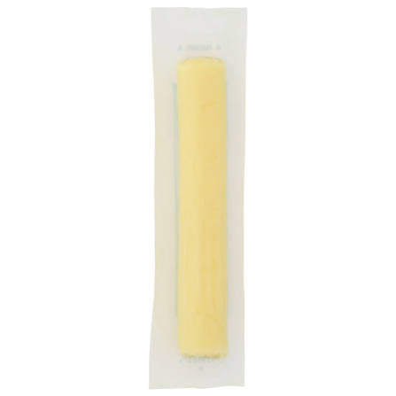
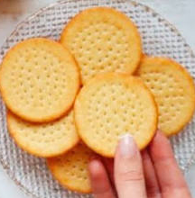
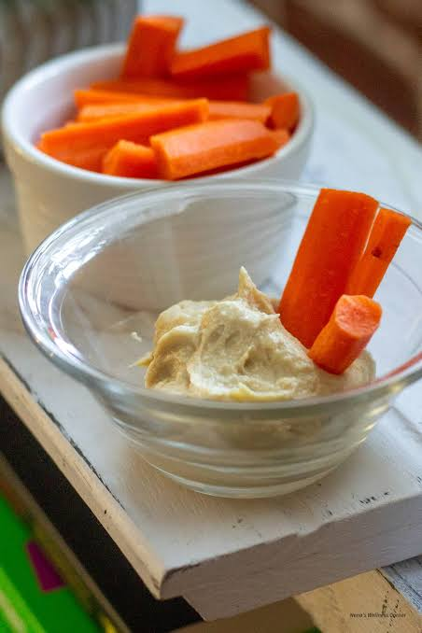

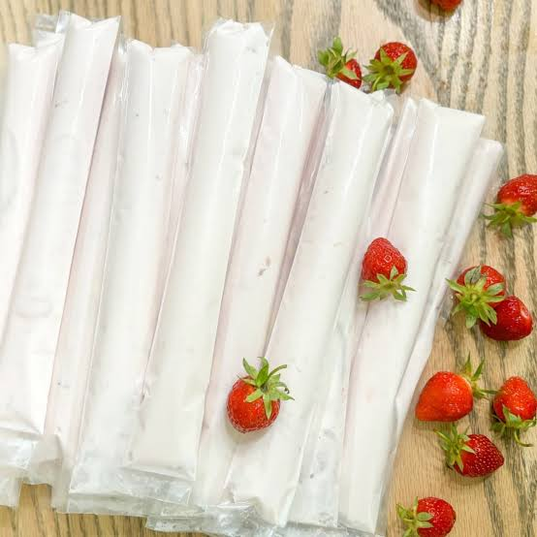
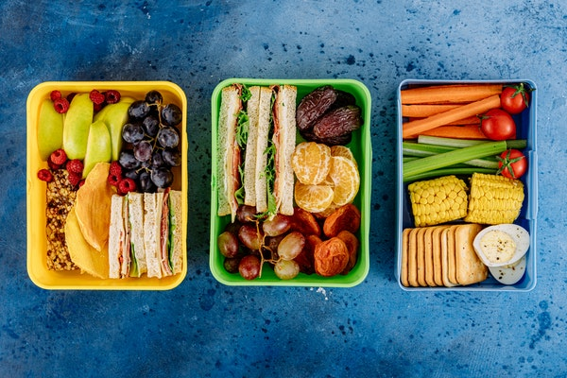
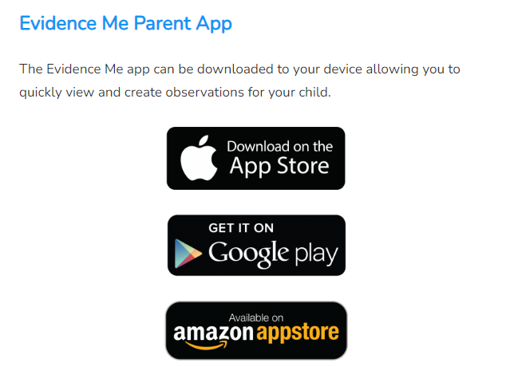

Continued
Healthy Food & Snacks
As a Healthy School, we encourage healthy choices to support children's wellbeing and learning.
Please provide a balanced packed lunch and, if required, one healthy snack item.
Please do not send sweets, chocolate, crisps, or biscuits.
To keep all children safe, we are a nut-free and egg-free school, including foods containing nuts such as pesto.

Slide 12


Autumn Term Learning
Literacy
-Understand concepts about print: it has meaning, has different purposes, read English text from left to right and from top to bottom, the names of the different parts of a book and page sequencing.
-Hear and suggest rhyming words
-Write some or all of the letters in their name
-Write some letters accurately, forming correctly.
-Begin to mark make and write for a purpose (e.g writing ‘m’ for Mummy, ‘p’ for pumpkin).
-Learning new sounds in phonics (a,o,c,g,d,s,I,t,f,l,r,p,n) and tricky words (I, go, to)
Mathematics
-Recite numbers and count past 5.
-Show ‘finger numbers’ up to 5
-Subitise amounts up to 5.
-Solving mathematical problems to 5 using part-part whole (e.g that a number is made up of 2 parts – 3 [part] and 2 [part] make 5 [whole]).
-Say one number for each object in order (1 to 1 counting)
-Recognise and understand that numbers and amounts can match (e.g. linking the digit 4 to 4 objects).
-Reading, creating and extending a repeating pattern (e.g stick, leaf, stick, leaf…)
Reception – Autumn 1 2026
Communication and Language
-To understand how to listen carefully and why listening is important.
-Joining in; learning poems and singing a range of songs.
-Listening on the carpet, in small groups to stories.
-To use a wider range of vocabulary.
To talk about themselves, using longer sentences (4-6 words).
-To start a conversation with a friend or adult and continue it for many turns.
-Ask questions to find out more.
Personal, Social and Emotional Development
-Show more confidence in new social settings e.g. starting school, coming into school in the morning.
-Play with one or more children, extending and creating play ideas.
-Beginning to build respectful relationships.
-Be independent in own needs e.g. toileting, saying how they are feeling.
-Following rules and knowing why they are important (making our class charter).
Physical Development
-Practise scissor control, making snips with paper, following lines and using it to cut around object.
-Show preference for a dominant hand when using objects or handling tools.
-Use a comfortable grip (tripod) with good control when holding writing materials.
-Be increasingly more independent getting dressed/undressed, unbuttoning cardigans/unzipping coats, putting shoes/wellies on and off.
Understanding the World
-Name and describe people who are familiar to them (talking about ourselves and families).
-Talk about images of familiar situations.
-Explore the natural world around them (nature walks, exploring Autumn and local environment).
-Describe what you see, hear and feel whilst outside.
-Understand effects of changing seasons.
-Talk about special events in life (Christenings).
Expressive Arts and Design
-Drawing portraits of ourselves.
-To explore textures and patterns.
-Make a collage of yourself using a range of materials
-Singing songs
-Listening to different types of music and creating movement to express own feelings
-Make stories around toys, role play area props, small world toys.
-Use finger and hand puppets to develop story lines.

Slide 13
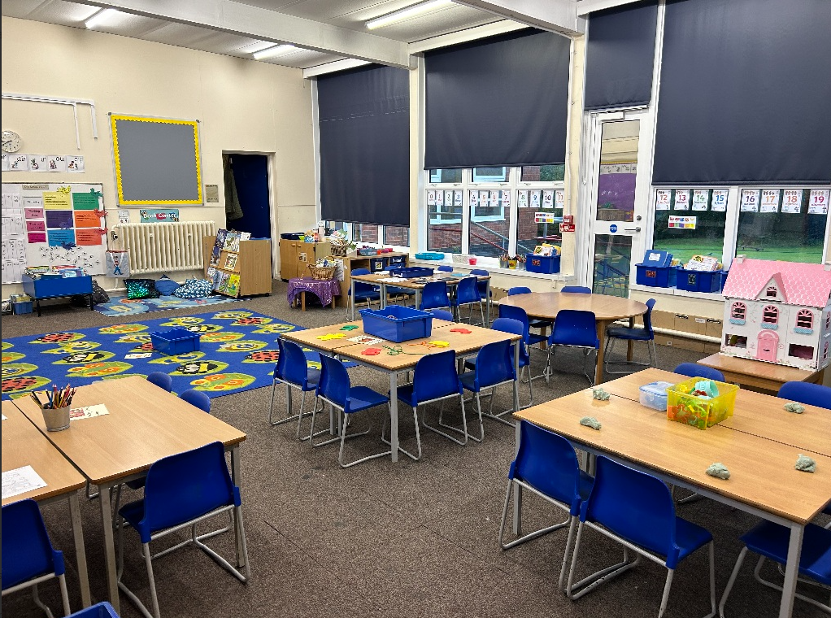
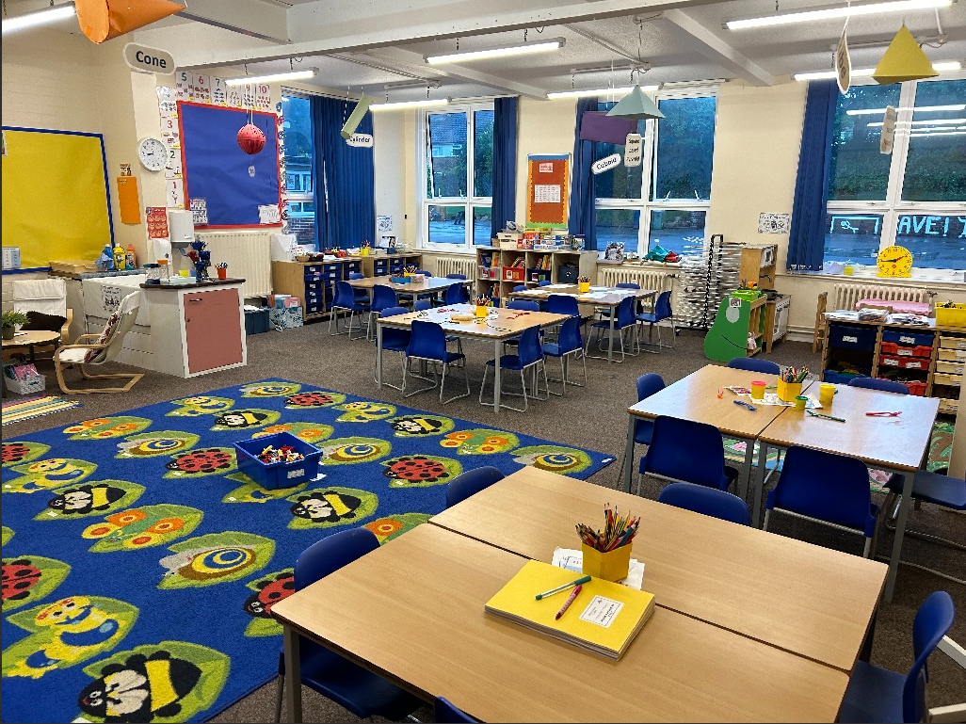
Year 1 – Classrooms
Robins
Wrens

Slide 14
Year 1
PE is on Tuesday afternoon and Friday morning;
Please ensure all uniform, PE kit clothing and water bottles are named;
Children are encouraged to eat a fruit or vegetable snack during morning play;
Please ensure your child has a named pair of Wellington boots in school as we will be using the outside environment for our learning. We'll send a ping when they are needed and they can stay in school.
We will send a weekly review of our learning each Friday with any key dates or information;
We welcome parent/carer volunteers.

Slide 15
Year 1 – Long Term Plan
Autumn | Spring | Summer
Science - Human Body & Senses Materials, Seasonal Changes Geography- Who should look after our world? Our School, our street History- Our School, Our Past & Remembrance Day Art – Kandinsky DT- Kites RE- Creation, Harvest, Incarnation & Christmas PE- Fundamentals, Ball Skills Gymnastics, Target Games | Science – Animals, Planting, Caring for the Planet, Seasonal Changes Geography- Hot & Cold Places History- Who is the greatest? Monarchs Art – Arctic Animal Sculptures DT- Cooking and Nutrition: Healthy Fruit Salad RE- Judaism & Torah, Easter, Synagogue Symbols PE- Dance, Net & Wall Games, Gymnastics, Invasion Games | Science – Plants & Trees, Growing & Cooking, Seasonal Changes Geography- This is the UK, Weather in the UK History- Transport Over Time Art – Collage, Pattern & Print (Matisse) DT- How do we move? Wheels and axles RE- What Do Humanists Believe? PE- Striking & Fielding, Dance, Athletics, Sending & Receiving PSHCE, music and computing

