Slide 1
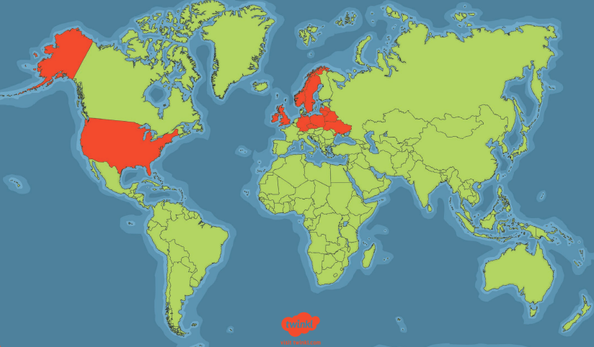
This week’s language of the week is…
Polish
Where is this week’s language spoken?
Polish is officially spoken in more than 12 different countries around the world.
WB: 12.9.22

Slide 2
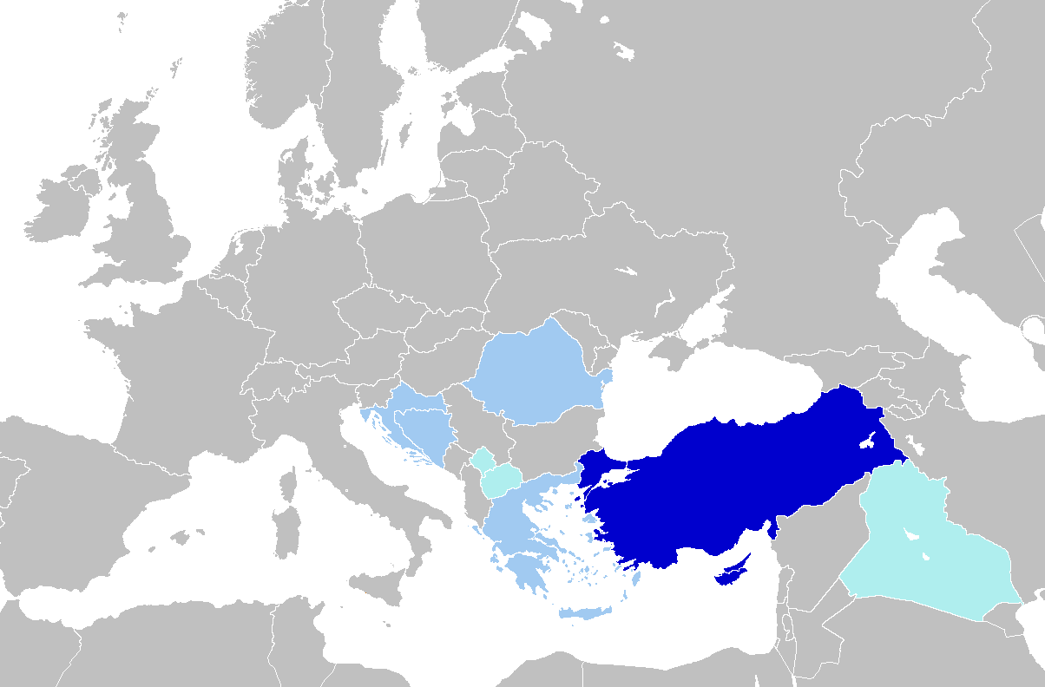
This week’s language of the week is…
Turkish
Where is this week’s language spoken?
Turkish is spoken in Turkey, northern Cyprus, Iraq and Syria. Over 90 million people speak Turkish around the world.
WB: 20.9.22

Slide 3
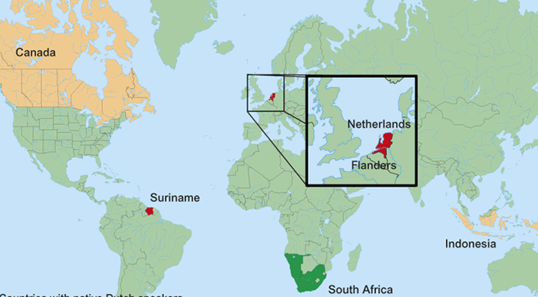
This week’s language of the week is…
Dutch
Where is this week’s language spoken?
Dutch is officially spoken in more than 6 different countries around the world.
WB: 26.9.22

Slide 4
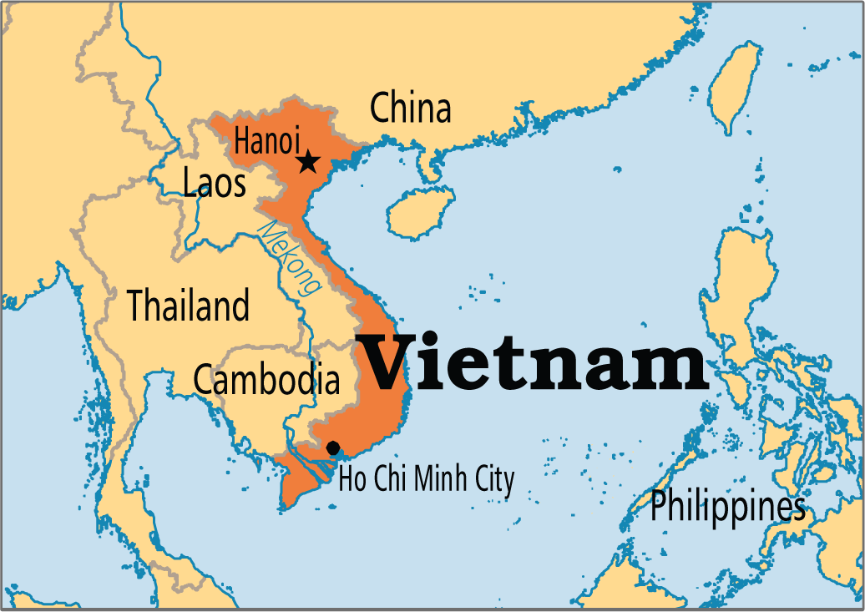
This week’s language of the week is…
Vietnamese
Where is this week’s language spoken?
Vietnamese is spoken by around 80 million people in Vietnam, Cambodia, Laos, the USA and the Czech Republic.
WB: 3.10.22

Slide 5
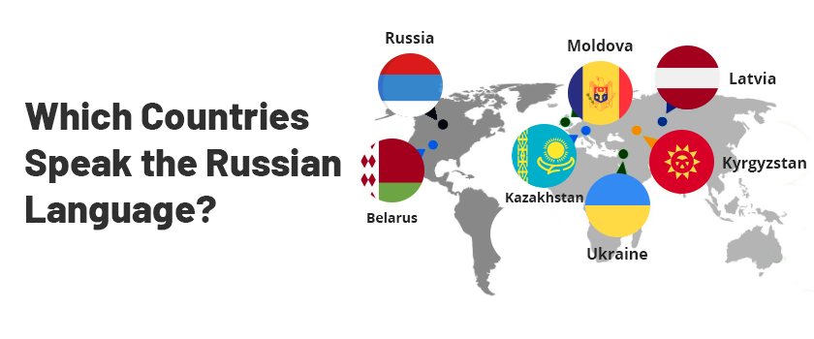
This week’s language of the week is…
Russian
Where is this week’s language spoken?
Russian is officially spoken in 4 different countries around the world.
WB: 10.10.22

Slide 6
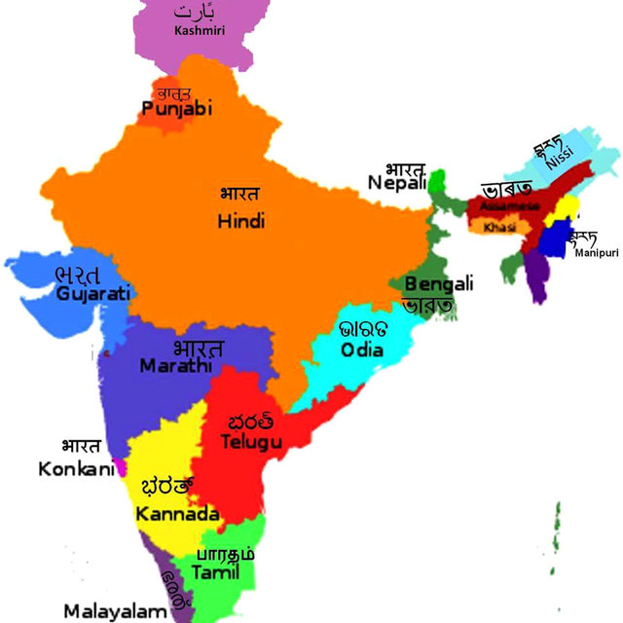
This week’s language of the week is…
Malayalam
Where is this week’s language spoken?
Malayalam is one of the 22 official languages spoken in India.
WB: 17.10.22

Slide 7
Half Term

Slide 8
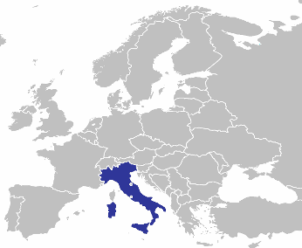
This week’s language of the week is…
Italian
Where is this week’s language spoken?
Italian is officially spoken Italy, Switzerland, San Marino and Vatican City.
WB: 31.10.22

Slide 9
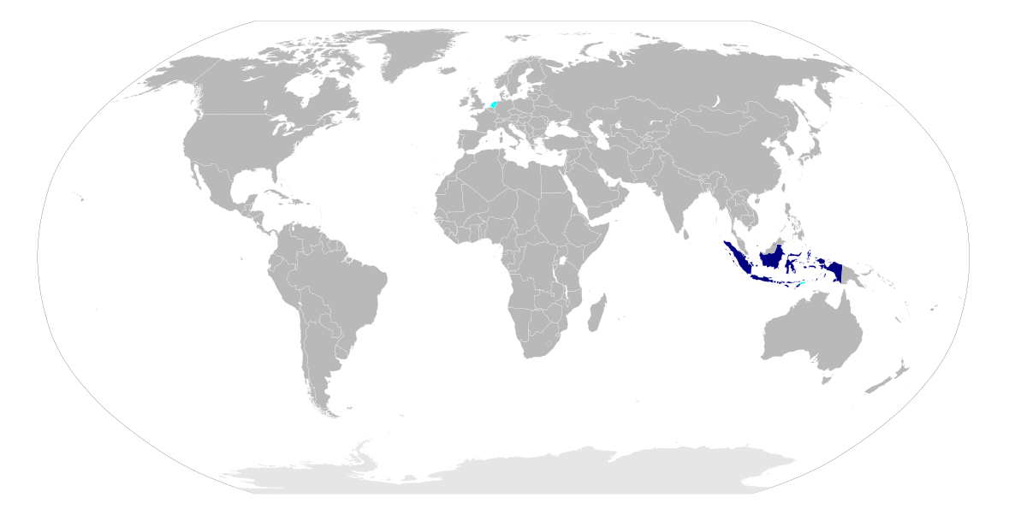
This week’s language of the week is…
Indonesian
Where is this week’s language spoken?
Indonesia is the only country where Indonesian is the national language however it is spoken by over 170 million people around the world. In countries including Hong Kong, Taiwan and Singapore.
WB: 7.11.22

Slide 10
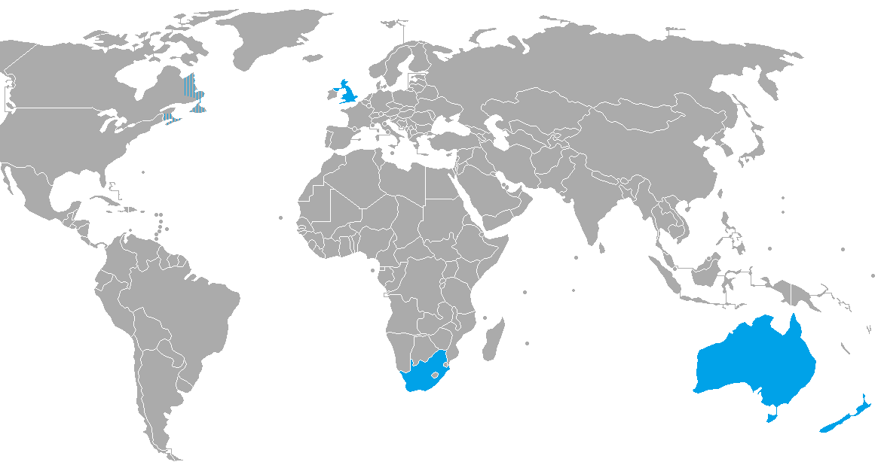
This week’s language of the week is…
British Sign Language
Where is this week’s language understood?
British Sign Language (BSL) is used in Britain but is very similar to the sign language used in Australia and New Zealand. Other countries around the world have their own versions.
WB: 14.11.22

Slide 11
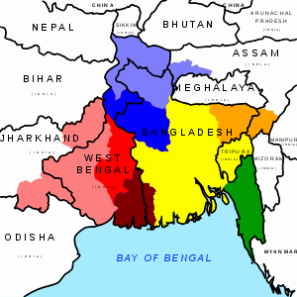
This week’s language of the week is…
Bengali
Where is this week’s language spoken?
Bengali is spoken by over 265 million speakers around the world. It is the official language of Bangladesh. People also speak Bengali in areas of India and Burma.
WB: 21.11.22

Slide 12
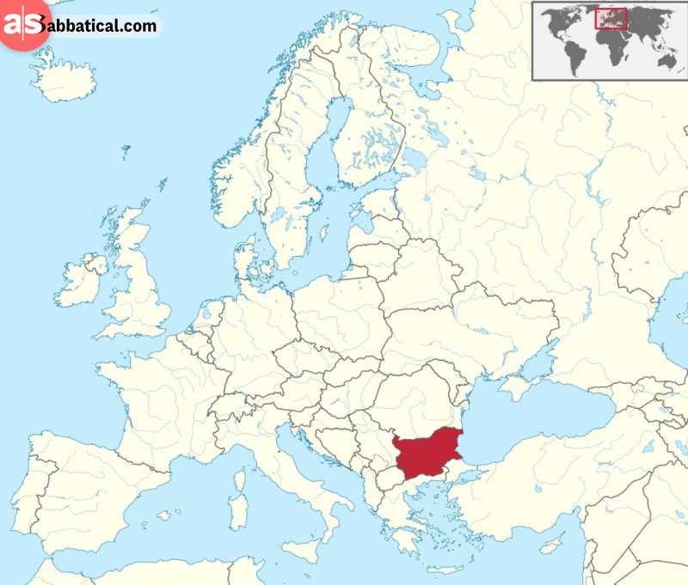
This week’s language of the week is…
Bulgarian
Where is this week’s language spoken?
Bulgarian is spoken in Bulgaria and in the Czech Republic, Hungary, Moldova and several other countries.
WB: 28.11.22

Slide 13
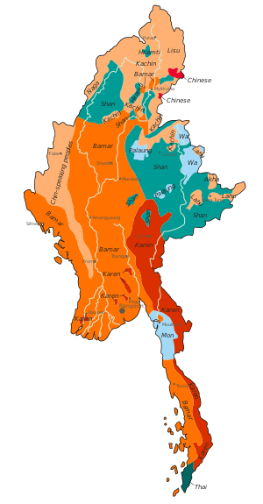
This week’s language of the week is…
Burmese
Where is this week’s language spoken?
Burmese is the official language of Mayanmar (formally Burma). It is spoken by over 38.7 million people. It is also spoken in other countries such as Bangladesh, Malaysia Thailand and the USA.
WB: 5.12.22

Slide 14
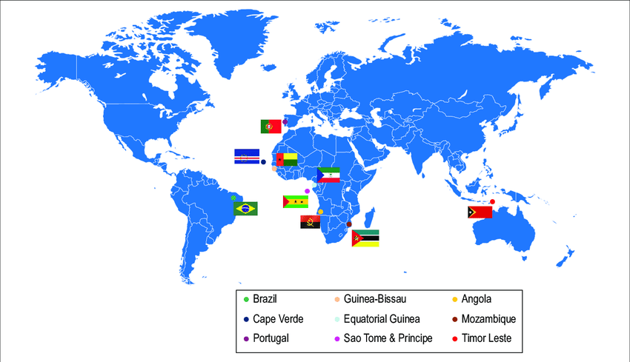
This week’s language of the week is…
Portuguese
Where is this week’s language spoken?
Portuguese is the official language in ten countries and territories, including Brazil, Mozambique, Angola, Portugal, Guinea-Bissau, East Timor, Equatorial Guinea, Macau, Cape Verde, and São Tomé and Príncipe. The language was developed over 2000 years ago.
WB: 12.12.22

Slide 15
Christmas holidays

Slide 16
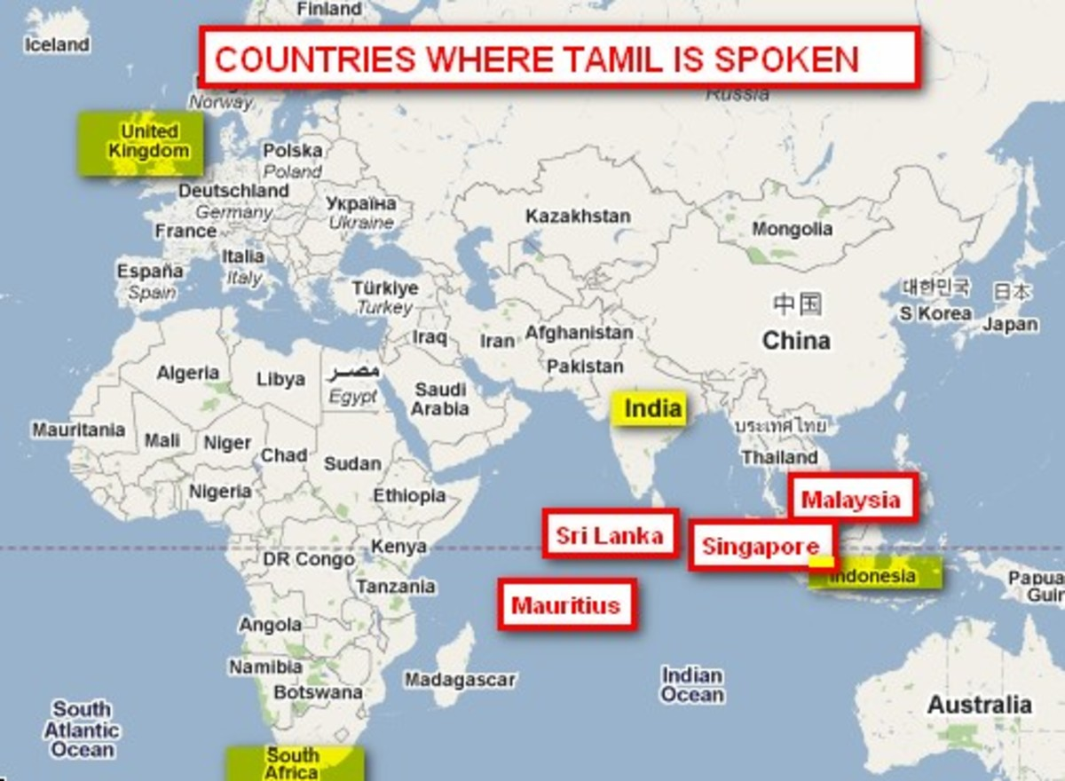
This week’s language of the week is…
Tamil
Where is this week’s language spoken?
Tamil is officially spoken in 8 different countries around the world.
WB: 9.1.23

Slide 17
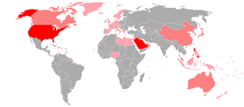
This week’s language of the week is…
Filipino
Where is this week’s language spoken?
Filipino or Tagalog is a language that originated in the Philippine islands. It is the first language of most Filipinos and the second language of most others. More than 50 million Filipinos speak Tagalog in the Philippines, and 24 million people speak the language worldwide.
WB: 16.1.23

Slide 18
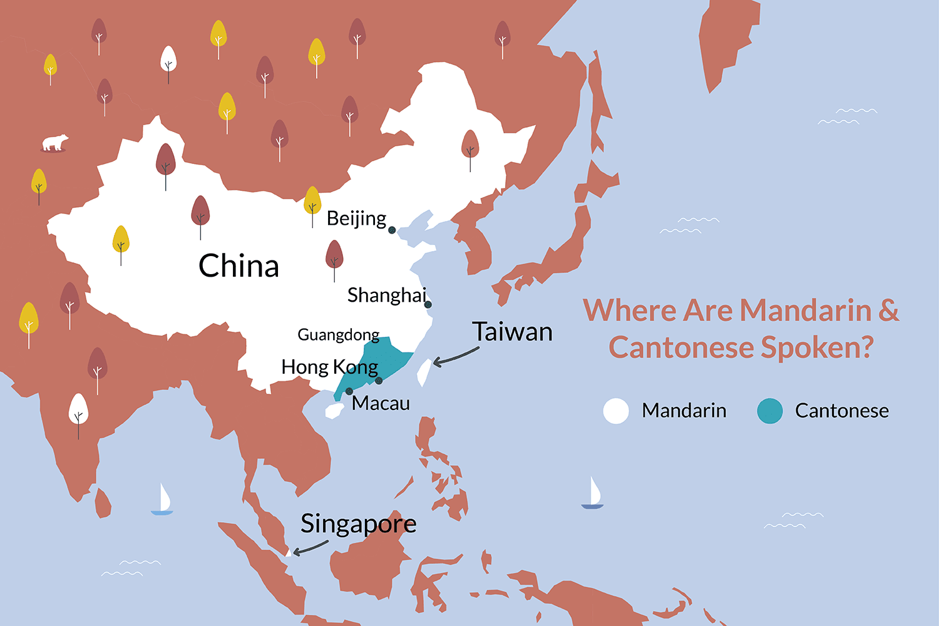
This week’s language of the week is…
Cantonese
Where is this week’s language spoken?
Cantonese is officially spoken in 9 different countries around the world.
WB: 23.1.23

Slide 19
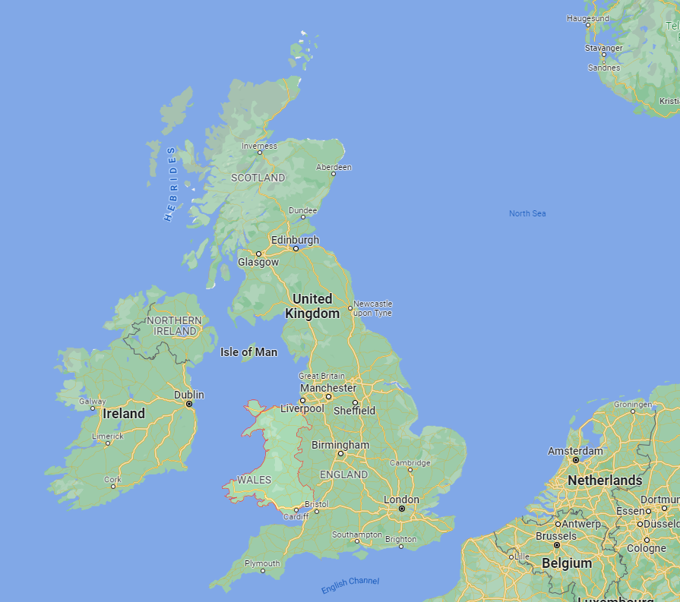
This week’s language of the week is…
Welsh
Where is this week’s language spoken?
Welsh is spoken and understood in Wales – especially in northern and western Wales. It is also spoken in some small communities in Argentina! Around 900,000 people speak Welsh around the world.
WB: 30.1.23

Slide 20
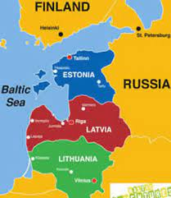
This week’s language of the week is…
Lithuanian
Where is this week’s language spoken?
Lithuanian is the official language of Lithuania and one of the official languages of the European Union. There are about 2.8 million native Lithuanian speakers in Lithuania and about 200,000 speakers in other parts of the world.
WB: 6.2.23

Slide 21
Half term

Slide 22
This week’s language of the week is…
Bulgarian
Where is this week’s language spoken?
Bulgarian is spoken in Bulgaria and in the Czech Republic, Hungary, Moldova and several other countries.
WB: 27.2.23

Slide 23
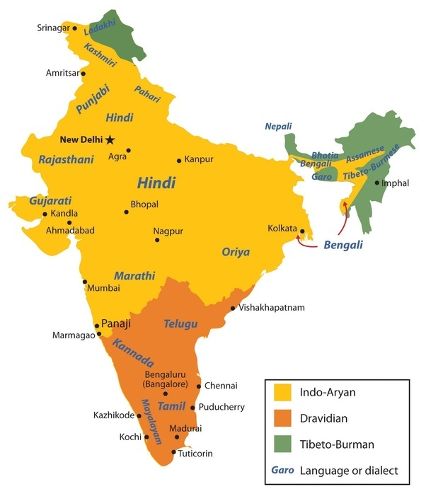
This week’s language of the week is…
Telugu
Where is this week’s language spoken?
75 million people speak Telugu, mostly in the south eastern Indian states of Andhra Pradesh and Telangana
WB: 6.3.23

Slide 24
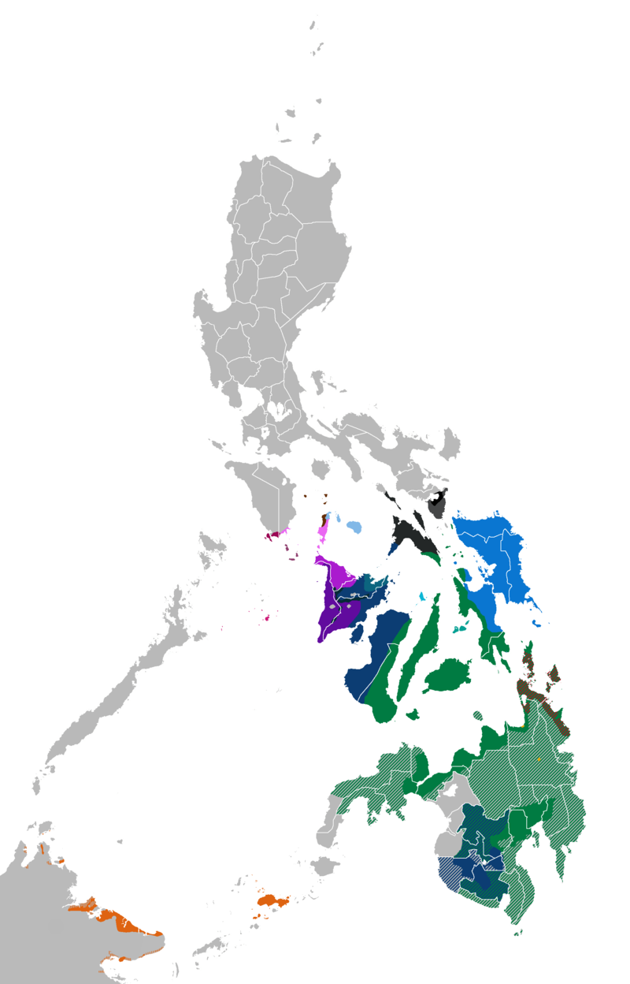
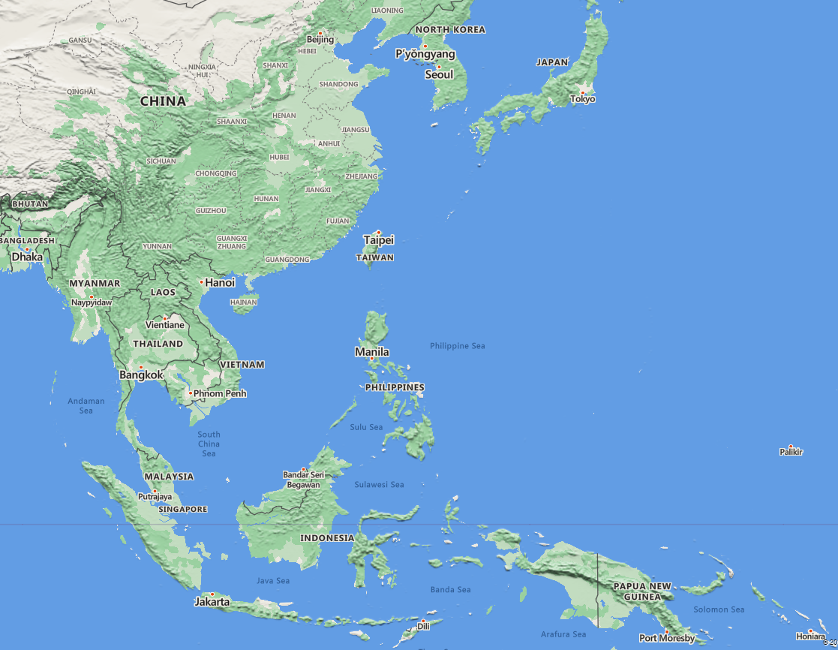
This week’s language of the week is…
Bisayan
Where is this week’s language spoken?
Bisayan is a version of Filipino spoken by around 35 million people in the Philippines.
WB: 13.3.23

Slide 25
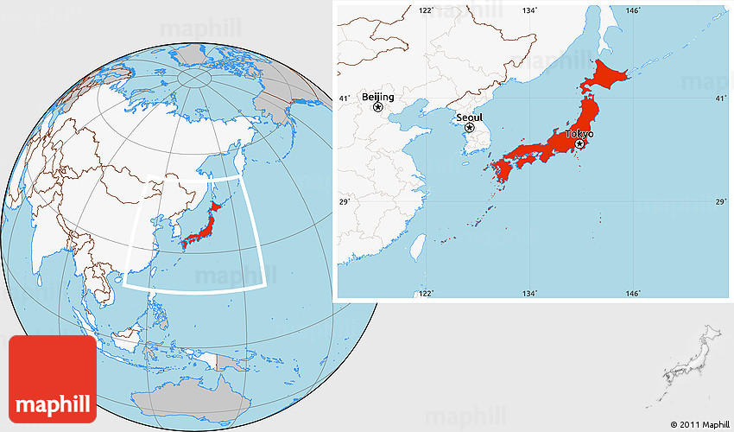
This week’s language of the week is…
Japanese
Where is this week’s language spoken?
Japanese is the official language of Japan. Over 126 million people can speak it!
WB: 20.3.23

Slide 26
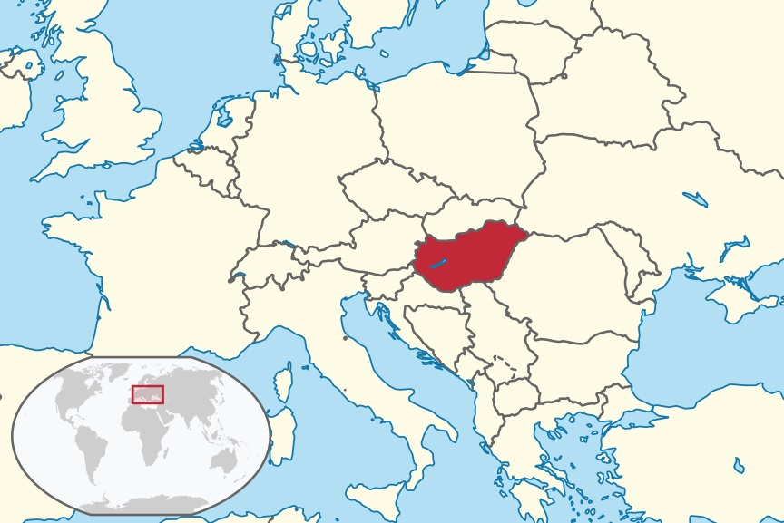
This week’s language of the week is…
Hungarian
Where is this week’s language spoken?
Hungarian is spoken widely in Hungary and in other countries nearby such as Croatia, Slovakia and the Ukraine.
WB: 27.3.23

Slide 27
Easter holiday

