Slide 1
Year 6
and Beyond
Welcome
Notes:
Simon – Welcome to St Wilfrids Community St Wilfrids Philosophy – Together we will be our best. Go through what will happen during the evening and the transition plan to ensure all children have a happy calm start to their school career Thank FSOW for coffee

Slide 2
Aims
We aim to share with you,
Information about SATs
Information about the Isle of Wight residential
Information about the rest of the 2024/2025 academic year.
Notes:
Simon Introduces the aims of the meeting

Slide 3
National Curriculum Assessment
At the end of Year 6, pupils will be provided with a teacher assessment confirming whether they have met the expected standard in the following areas;
Mathematics
English Reading
English Writing
Science
A scaled score will also be awarded for ‘Grammar, Punctuation and Spelling’, ‘Reading’ and ‘Mathematics’.
Notes:
SH explains next steps.

Slide 4
The Mathematics Papers
There are three papers in mathematics;
Paper 1 Arithmetic test: 30 mins (40 marks)
Paper 2 Reasoning test: 40 mins (35 marks)
Paper 3 Reasoning test: 40 mins (35 marks)
Notes:
SH explains next steps.

Slide 5
Maths
Arithmetic paper

Slide 6
Maths
Reasoning paper

Slide 7
Maths
Reasoning paper

Slide 8
The English Papers
There are three papers in English;
Reading Comprehension: 1 hour (50 marks)
Spelling : 20mins (20 marks)
Grammar, Punctuation and Spelling: 45mins (50 marks)

Slide 9
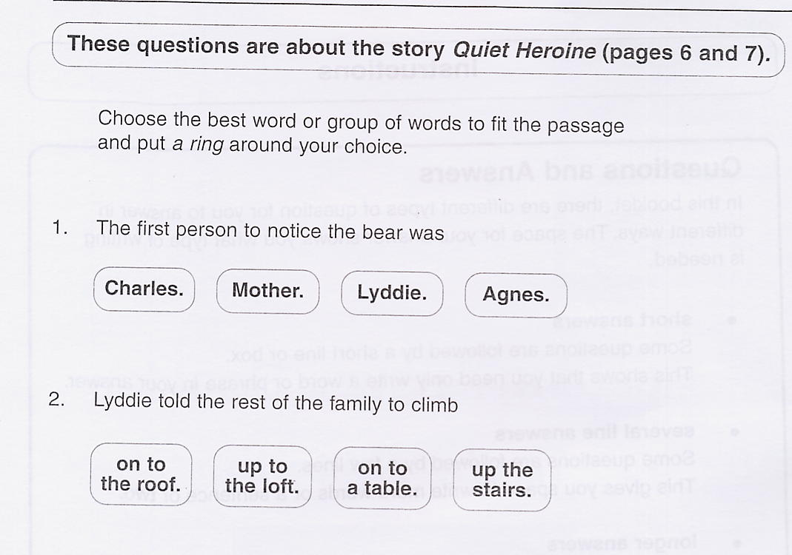
The Reading Test

Slide 10
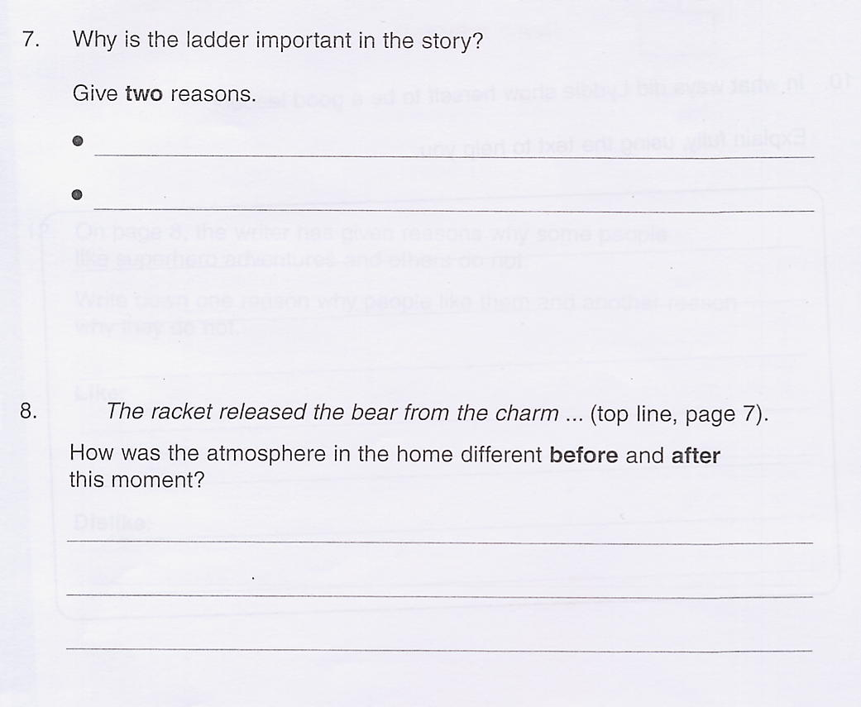
because it hits the bear on the nose
because it stops creaking
The noise distracted the bear so it was no longer spellbound.

Slide 11
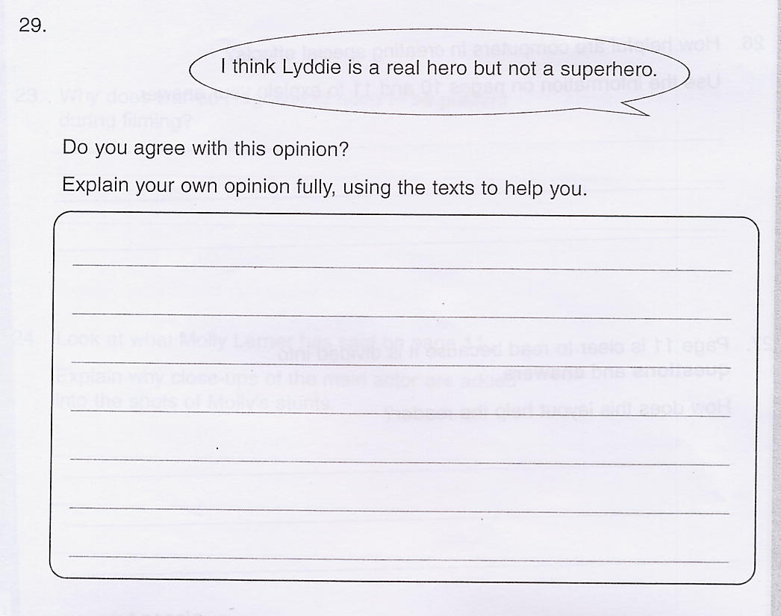
I agree that Lyddie is a real hero because she showed great courage to save her family. She is not a superhero because she didn’t have a secret identity, wear a special costume or have super human powers.

Slide 12
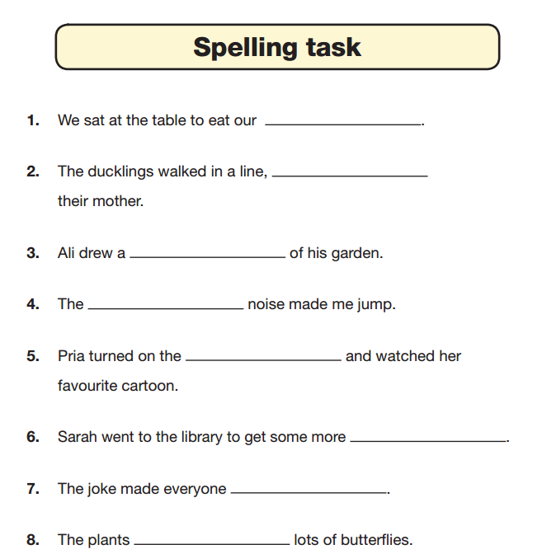
The Spelling
Test
dinner
following

Slide 13
The Grammar and Punctuation Test
This test is made up of various questions relating to grammar, punctuation and vocabulary.
This test was introduced to replace the writing tasks that were set previously.
We still assess your child’s writing throughout the year and report this to you with their results.

Slide 14
Grammar
me
I
me
C
A
B
D

Slide 15
Punctuation
Max
Max is someone’s name.
“
“
“
“

Slide 16
Vocabulary
play
play
mis
in
im

Slide 17
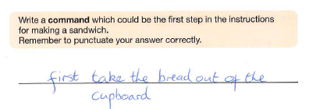
The biggest way to support your children…
The response is correct but this will not get a mark because the sentence does not start with a capital letter or end with a full stop.

Slide 18
The biggest way to support your children…
The conjunction is correct but it has been written with a capital ‘A’ so this response won’t get a mark!

Slide 19
The SATs are not just about Year 6 learning!
Over 59% of the questions from the 2017 SATs and 57% in the 2016 SATs covered year 3 to year 5 content.
As you’d expect, there is a significant emphasis on the four operations across all papers. In fact “addition, subtraction, multiplication and division” have accounted for 78 marks out of the 220 total marks in the last two SATs.
The next highest strands on the list are “fractions, decimals and percentages” which have been worth 48 marks and number and place value (27 marks).
To put this in context mastery of “geometry – position and direction” would only have earned a pupil a total of four points overall over the past two years.

Slide 20
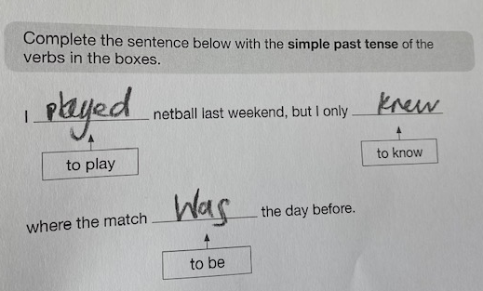
The biggest way to support your children…
This response won’t get a mark because the ‘P’ doesn’t go over the line and is therefor considered a capital letter. The ‘W’ looks larger than the ‘a’ so the ‘W’ will be considered a capital letter!

Slide 21
How can you support your child?
Sitting next to them when they complete their Maths homework – remind them to ask you read the question to them if they find this helpful.
Take a look at how they form their numbers – sometimes a four looks like a nine and zeros look like sixes.
TTRS – it is so important to develop confidence recalling times tables and division facts.
Getting your child to ‘teach’ you what they’ve been learning about in Maths. Can they recall their learning?

Slide 22
How can you help your child?
Assist and review homework
Times tables and maths games
Listen to your child read and discuss the book
Study/Revision books are available but not essential
The test results are unlikely to affect children’s
secondary school classes
Children should be encouraged to be determined
and do their best, but should not feel stressed

Slide 23
Also...
SATs are just a snapshot of your child on that particular day – they DO not tell us that your child creative, kind, thoughtful.....
We still teach Year 6 a great curriculum – I know this all sounds like we ONLY do maths and grammar, but we really don't!

Slide 24
Study Guides
CGP (Coordination Group Publications)
available from bookshops
Letts Revision Guides and Workbooks

Slide 25
Y6 NCT Timetable 2025
Monday 12 May | Tuesday 13 May | Wednesday 14 May | Thursday 15 May | Friday 16 May
Grammar and Punctuation (short answers) 45 minutes Spelling (20 words) | Reading (3 sections) 60 minutes | Mathematics Paper 1: (arithmetic test) 30 minutes Mathematics Paper 2: (reasoning) 45 minutes | Mathematics Paper 3: (reasoning) 45 minutes

Slide 28
Why go to the Isle of Wight?
Develops social skills and independence
Curriculum links – to enhance schoolwork with first-hand experiences

Slide 29
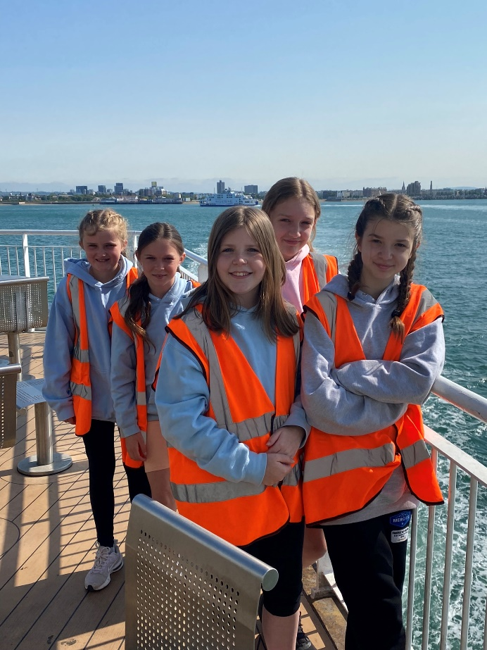
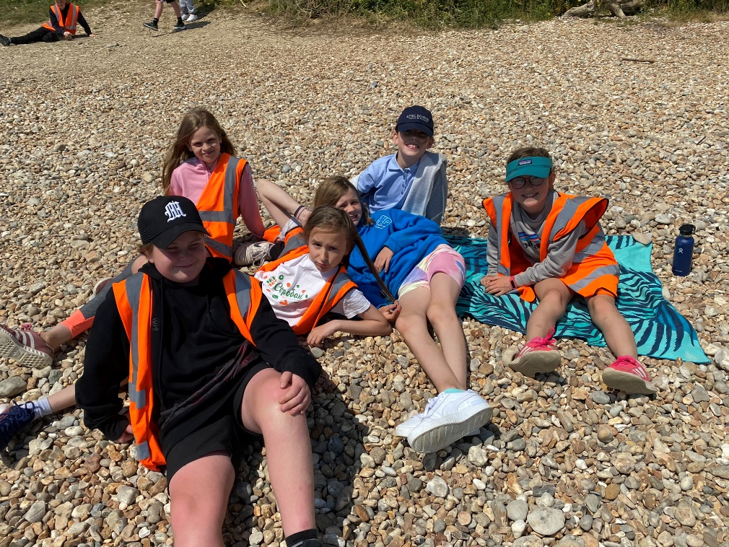
Developing social skills and independence

Slide 30
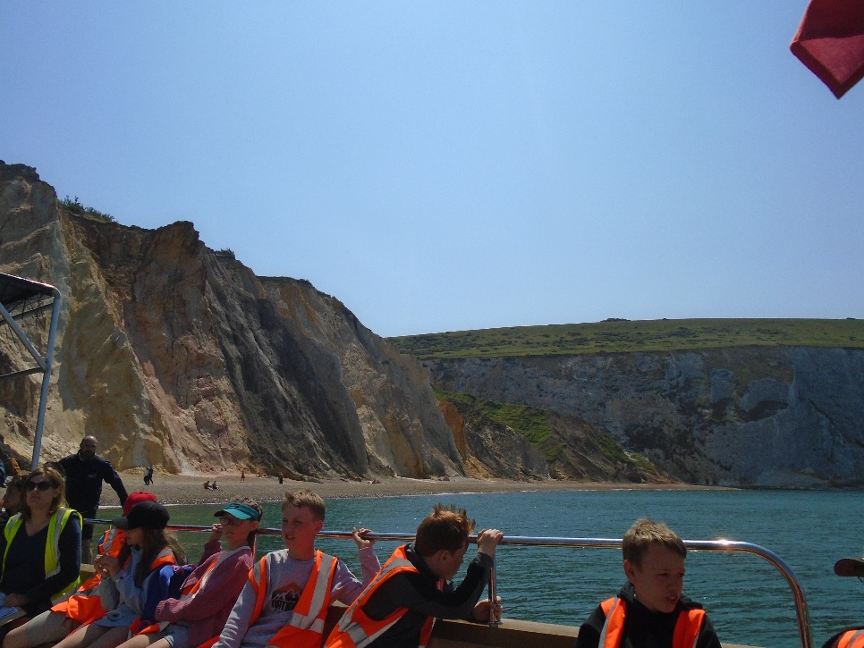
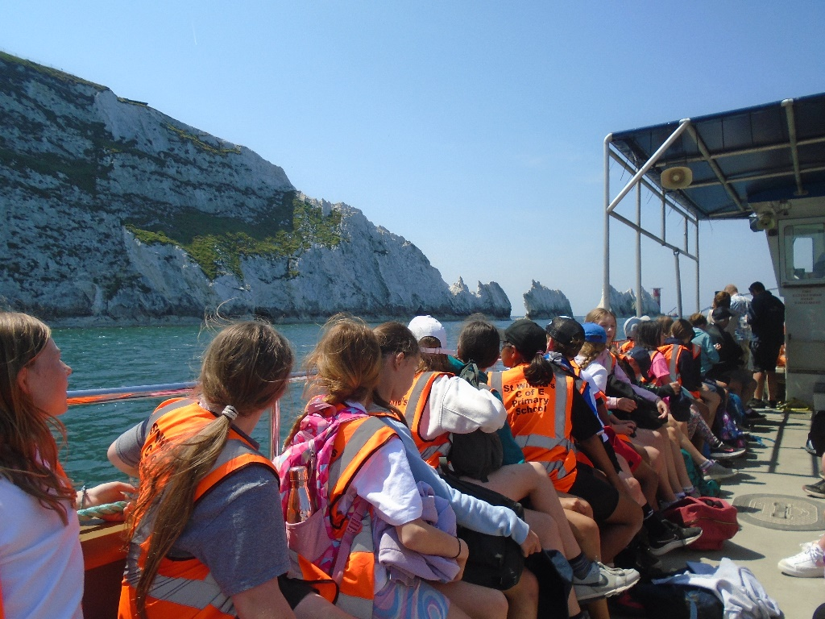
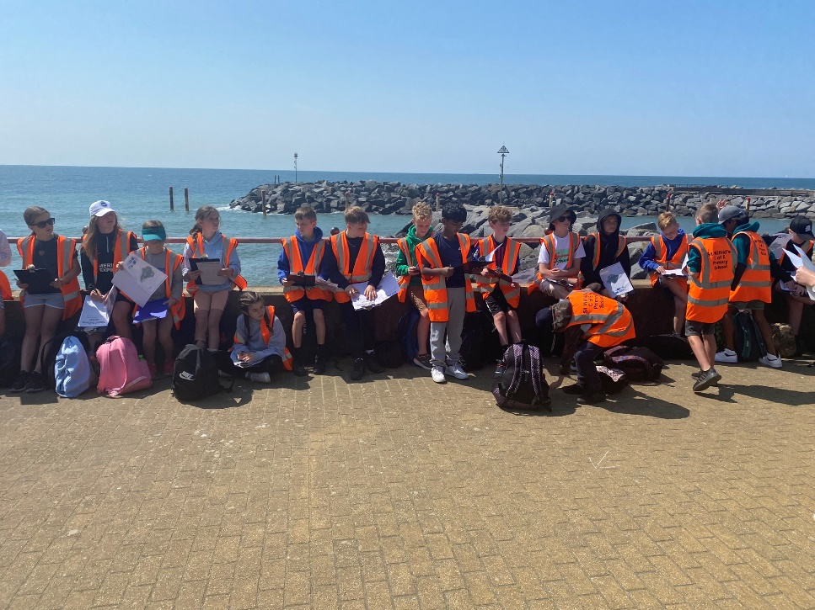
Curriculum Links
Geography - All about coasts

Slide 31
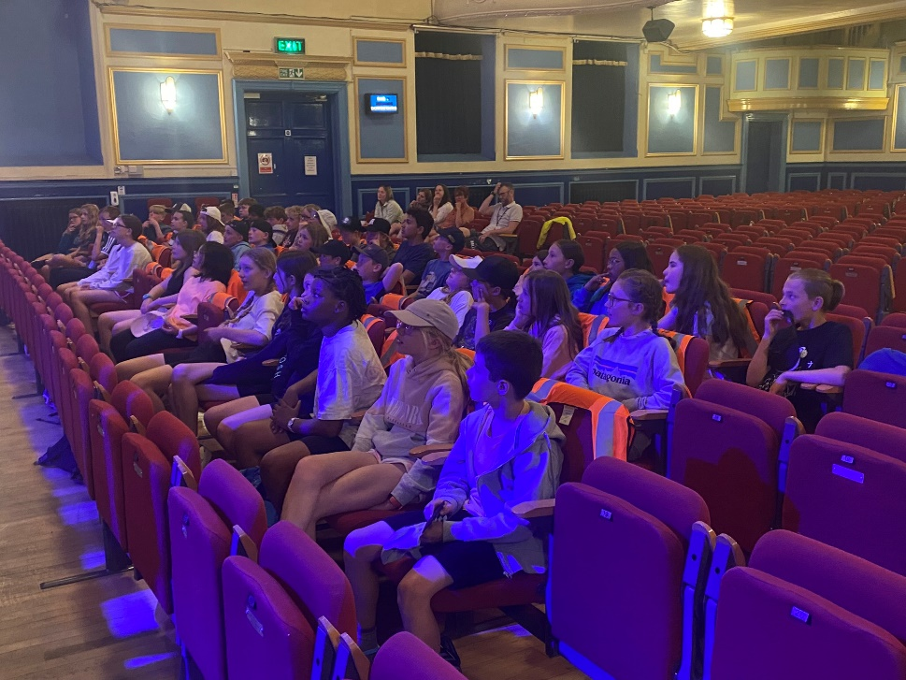
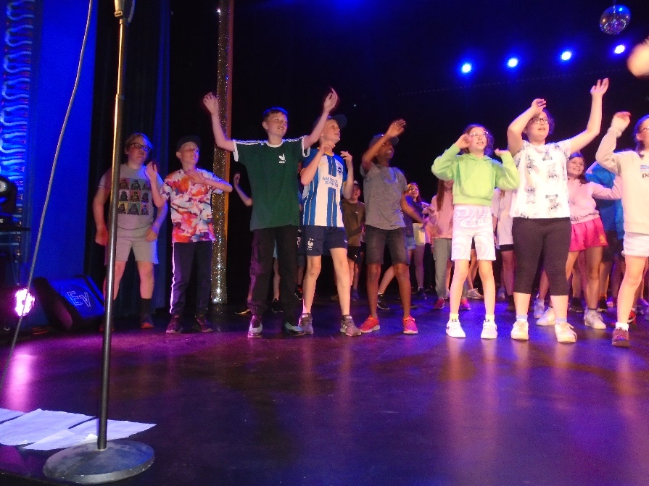
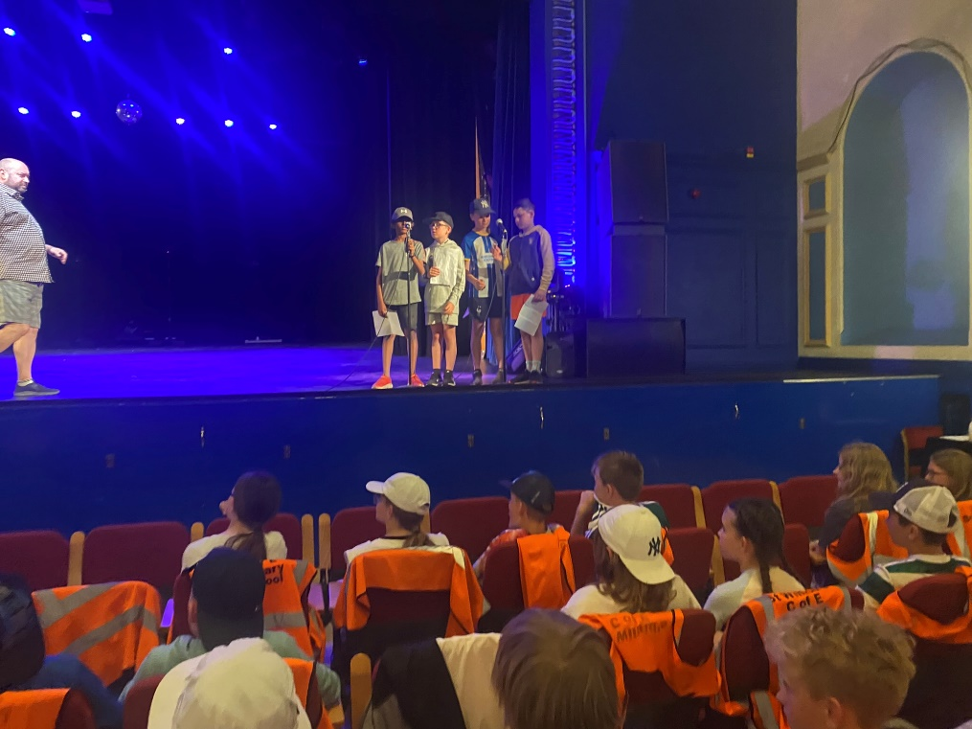
Curriculum Links
Drama
Theatre performance, tour and workshop

Slide 32
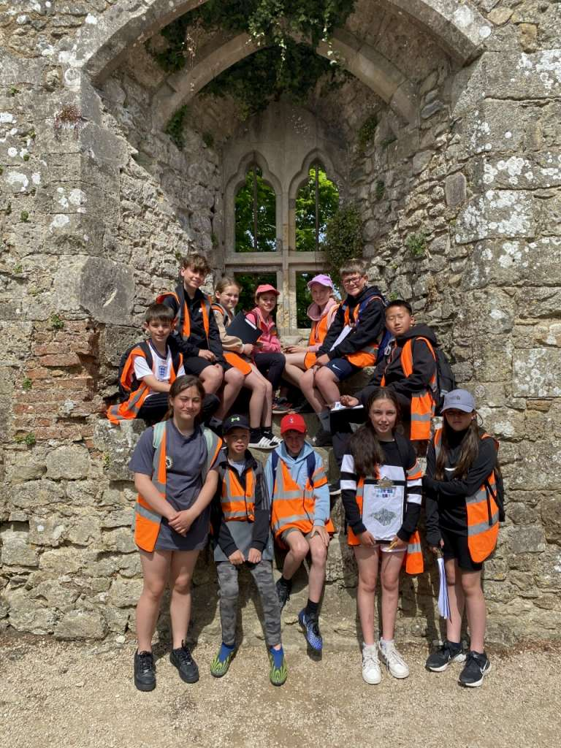
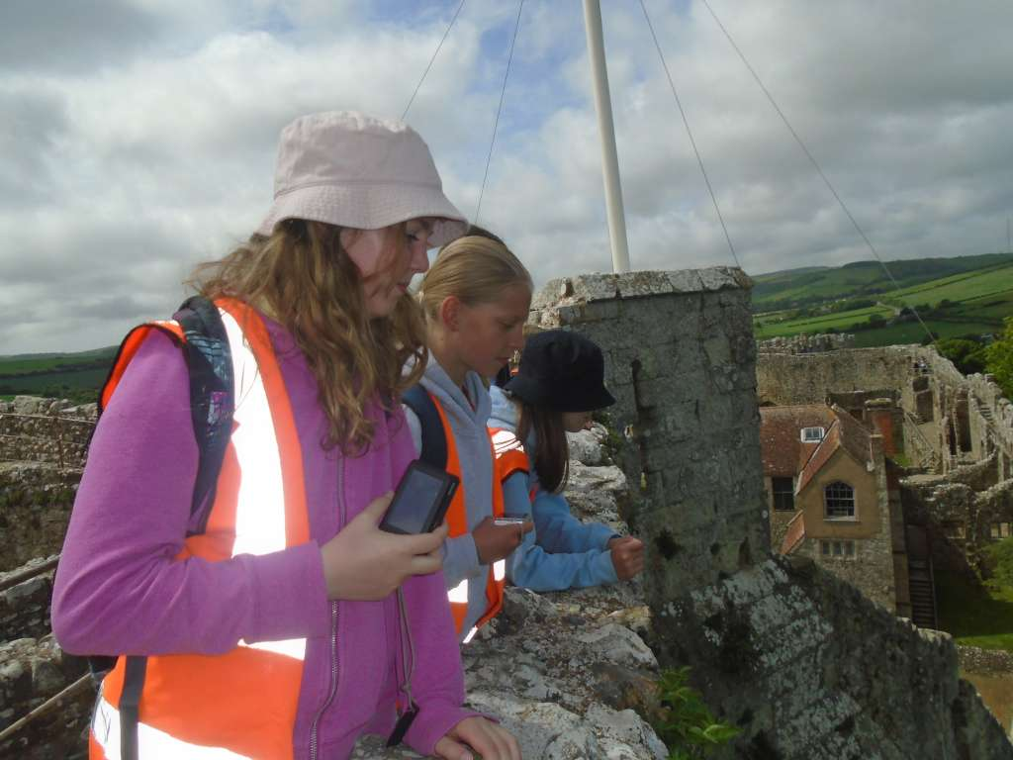
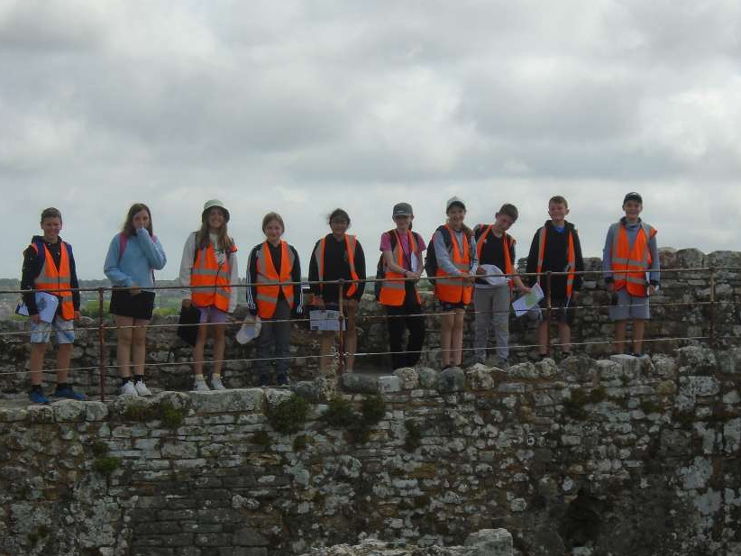
Curriculum Links
History
Carisbrooke Castle

Slide 33
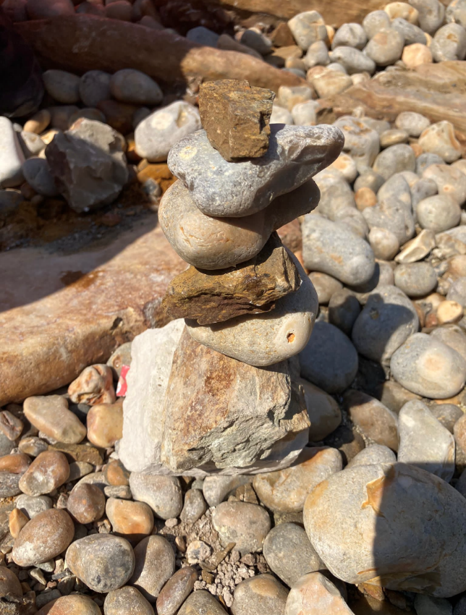
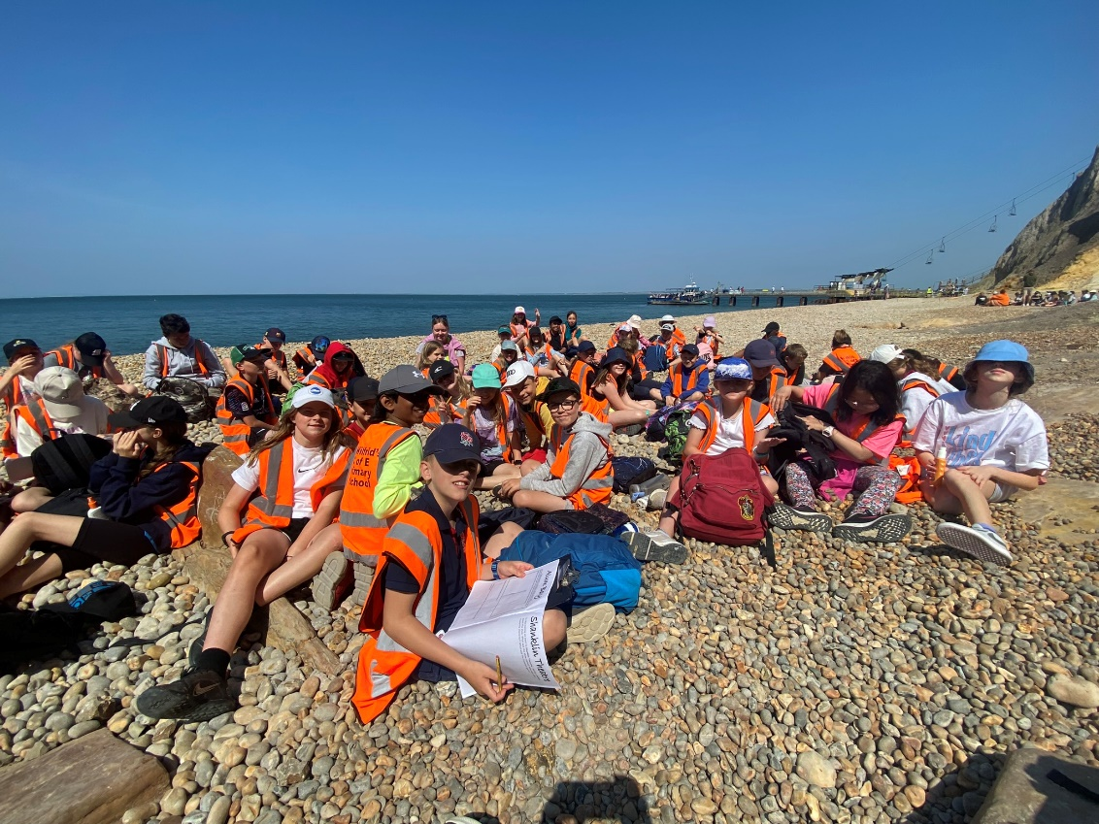
Curriculum Links
English
Beach Poetry
Art
Sketching and making sculptures on the beach

Slide 34
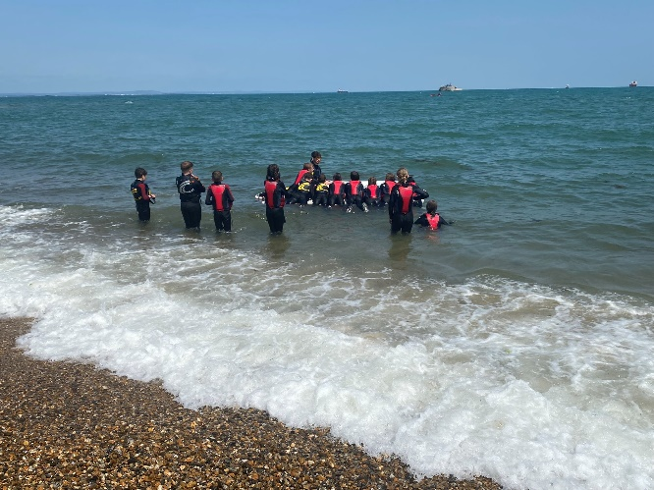
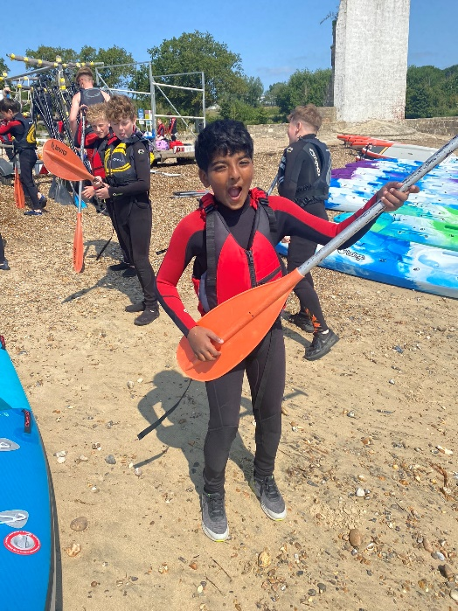
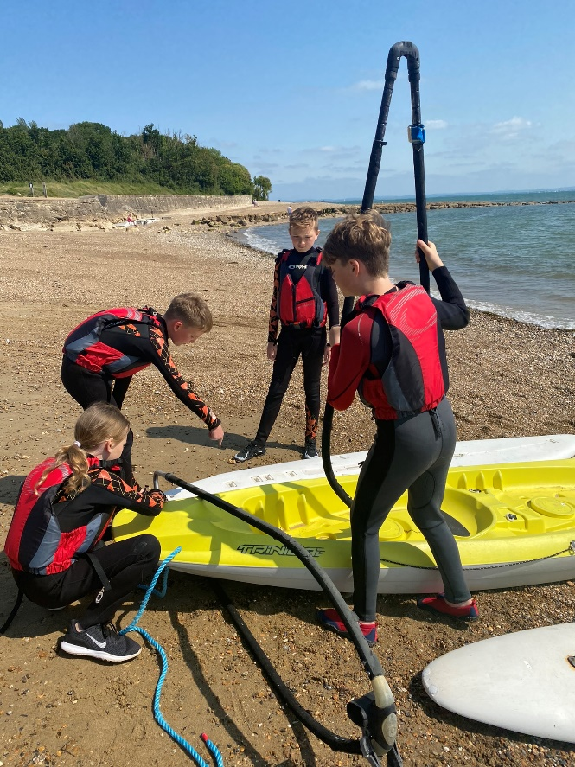
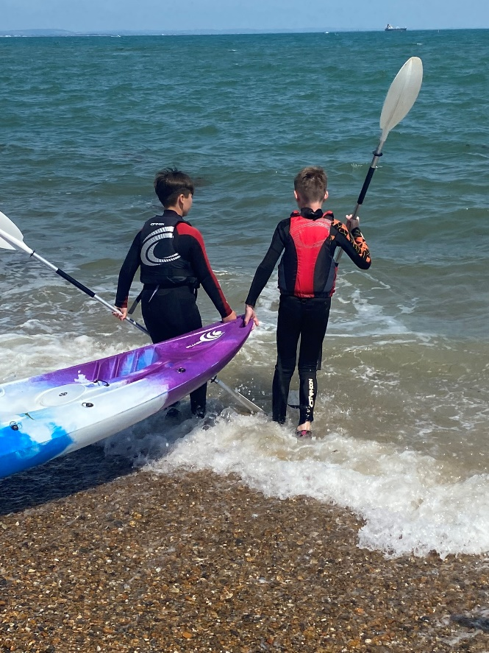
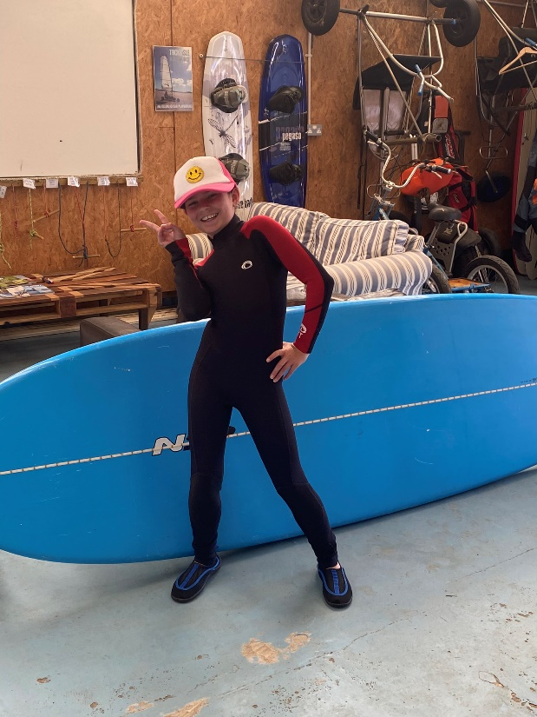
Outdoor activities
Water Sports

Slide 35
Important Issues
Come and speak to us!
No mobile phones or devices that link to the internet

