Slide 1

Parent Meeting
Introduction to Read Write Inc.
Notes:
Approximately 20 minutes is needed for this session.
Notes are provided to help you lead the presentation.
Notes in italics are for your attention only.
This bitesize parent session is designed as an introduction to Read Write Inc. when you first implement the programme in your school or for your new Reception/ P1 intake.
Use the other bitesize parent PPTs throughout the year to discuss and practise how parents can help their child at home based on the child’s group.
Provide copies of ‘Reading at Home Booklet 1 or 2’ from Oxford Owl.
Booklet 1 is for Set 1 sound groups and Ditty/ Red Groups and Booklet 2 for Green – Grey Storybooks.

Slide 2
Teach a child to read and keep that child reading and we will change everything.
And I mean everything.
Jeanette Winterson
Notes:
Read quote.
This is what we do in our school.
Research shows that children who learn to read early go on to succeed both in school and in life.
Today I will explain how your child will learn to read using the Read Write Inc. Phonics programme.

Slide 3



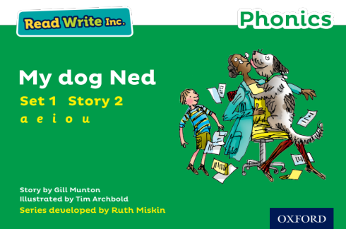
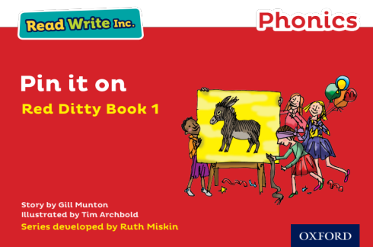
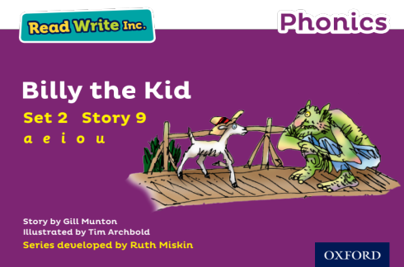
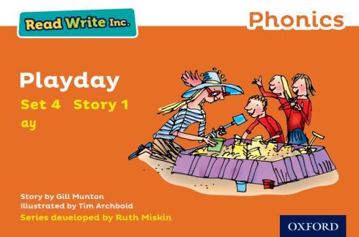
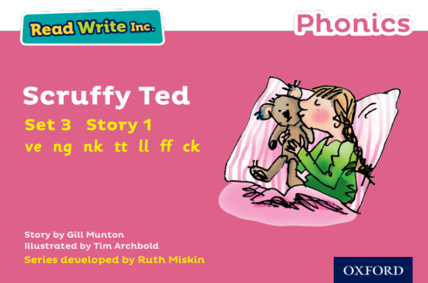
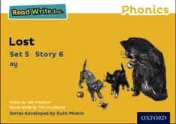
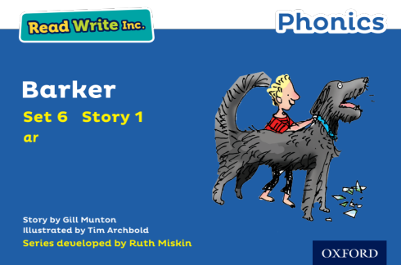
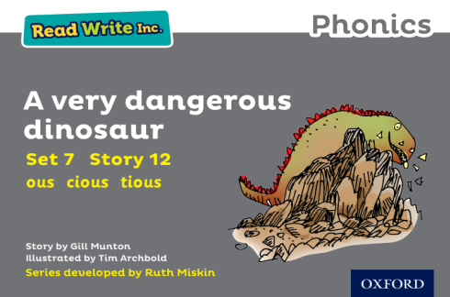




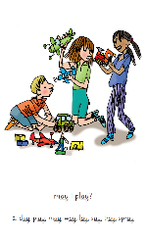
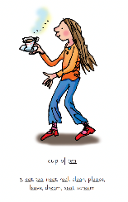
Read Write Inc. Phonics daily lessons
Notes:
What Read Write Inc. does is simple - we teach children to read and write sounds (click), children practise reading and spelling words containing these sounds (click), then we give children decodable books (click) containing sounds and words they can read.
They read each Storybook three times at school and again with you at home.
On each reading, children’s fluency increases and the more they can focus on what the story is about.
Children also learn to spell the words they have been reading and develop their ideas into sentences so that they can write about the Storybooks they read.
Alongside this we read stories to children: (click) stories they cannot yet read for themselves

Slide 4
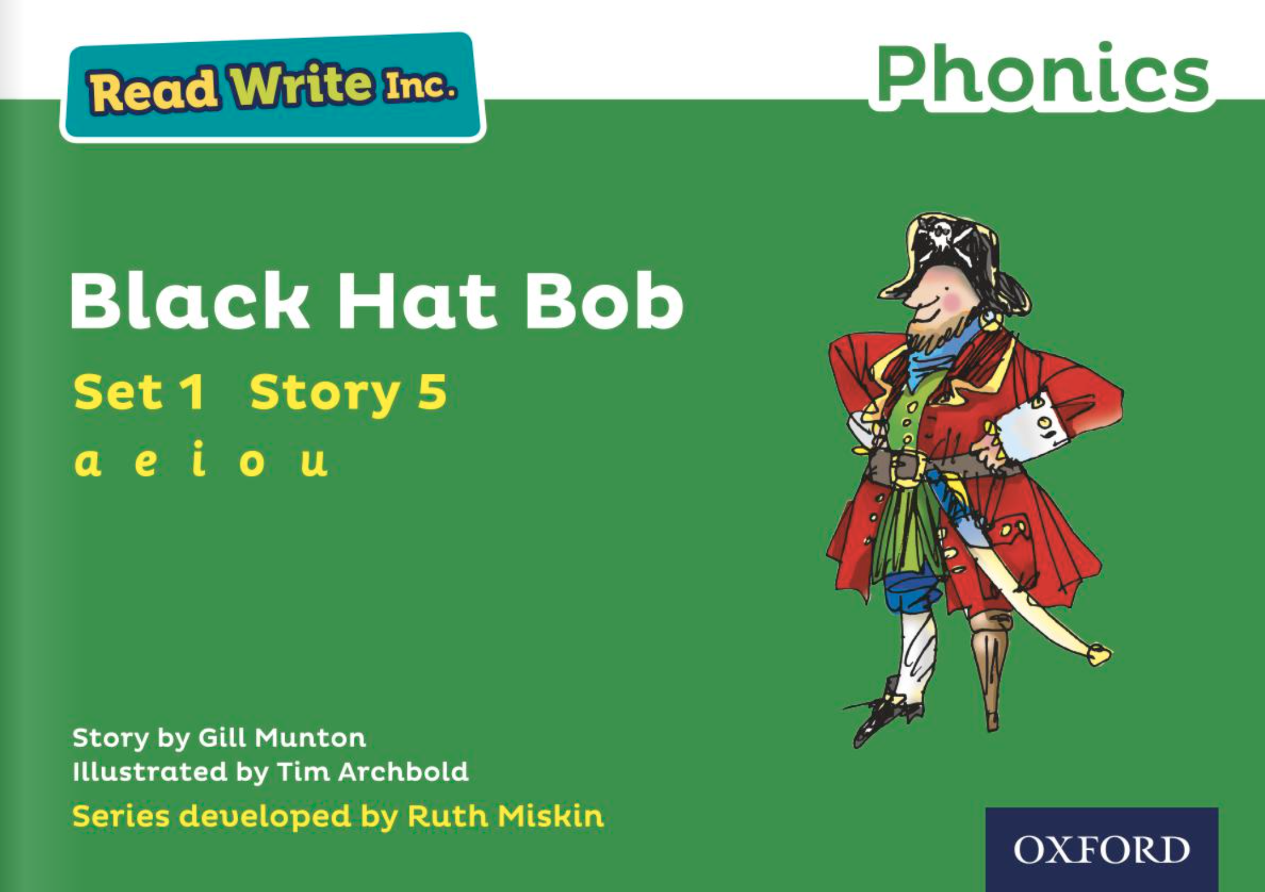
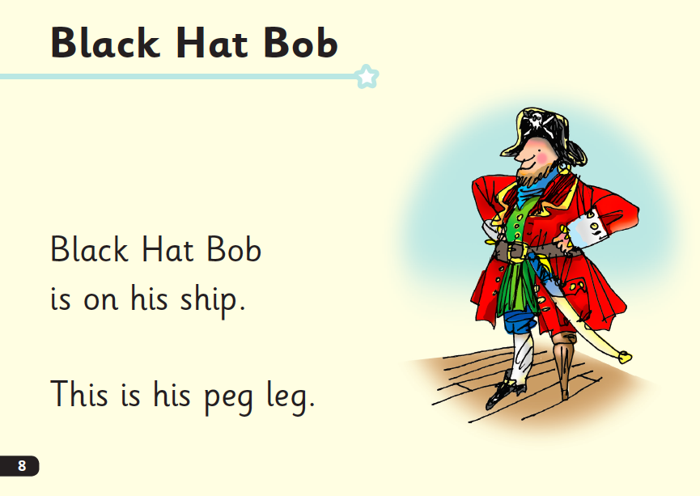
Who is Read Write Inc. for?
Notes:
Phonics is for children in Reception, Y1 and Y2 who are learning to read.
Phonics is also for children in Y3 and Y4 who haven’t met the KS1 reading expectations.
Fresh Start is for children in Years 5 and 6, who are need extra practice to learn to read.
We want to to make sure they catch up quickly and leave our school a reader.
Fresh Start is structured in the same way as the Phonics programme, but uses age-appropriate texts.

Slide 5

Progress groups
Group children by phonic stages.
Teach to the group’s challenge level.
Re-assess all children every half term.
Group children by their progress in word reading and fluency.
Notes:
In the same way as children learning to swim, play the violin or learn tai kwondo, while your children are learning to read, they work in progress groups to master each level of phonics and reading.
Children work in these progress group for one hour each day. This means they are learning at their ‘challenge’ level for five hours a week. (Reception children build up to this throughout the year).
As the reading leader, I assess and re-group the children every half-term.
This allows us to whisk children through the phonic stages as quickly as possible.

Slide 6









What is phonics?
Sounds (graphemes)
demonstrate, containing, roamed, trivial, injured, whimper
Notes:
All words are made up of individual sounds. These sounds are blended together to form words.
e.g. in ‘mat’ we have the sounds ‘m’, ‘a’, ‘t’, ship – ‘sh’, ‘i’, ‘p’.
A grapheme is another name for the letters we use to write the sound. It’s spelling of a sound on the page.
Using phonics, children learn to read by saying each sound and blending them to read a word.
Children learn to spell by segmenting a word into sounds and writing the matching graphemes.
The National Curriculum ensures that all children are taught Phonics systematically.
This gives your children the tools to read any word, for example demonstrate, containing, roamed, trivial, injured, whimper.

Slide 7


Some codes are easier than others
English
44 speech sounds
26 letters
150+ graphemes
Spanish
24 speech sounds
26 letters
29 graphemes
Notes:
We use 44 sounds to make all the words in the English language. This means we’ve got a problem.
Click. We’ve got 44 speech sounds, only (click) 26 letters to write them,
The 26 letters work singly, in pairs and sometimes in threes to represent one sound.
We have to group letters together to write some sounds e.g. ‘igh’, ‘air’.
And (click) over 150 graphemes – 150 different ways to spell the sounds. This makes our language one of the most complex in the world!
Most languages have a simpler code.
Take Spanish. Spanish has (click) 24 speech sounds, (click) 26 letters in their alphabet and (click) 29 graphemes. Neat.
N.B. It can be argued that Spanish has 27 letters due to the 'ñ', a letter that plays a key role in the pronunciation of many Spanish words.

Slide 8

English is complex
I take it you already know of tough and bough and cough and dough.
Others may stumble, but not you, on hiccough, thorough, laugh and through.
Beware of heard, a dreadful word, that looks like beard and sounds like bird.
And dead: it’s said like bed and not like bead. For goodness sake don’t call it deed.
A moth is not a moth in mother, nor both in bother, broth in brother;
And here is not a match for there. Nor dear and fear for bear and pear.
And do and go and thwart and cart. Come, come, I’ve hardly made a start!
A dreadful language full of tricks! I should have mastered it when I was six.
Notes:
Read this poem. Give them enough time to read it through once.
TTYP – In what way is the English alphabetic code so complex?
Key points to emphasise
There are simply too many graphemes!
There are many ways to write most sounds (e.g. ‘e’ in bed, dead and said), so we have to remember the right spelling of the sound – and the vowel sound in particular.
Sometimes one grapheme also represents more than one sound (e.g. ‘ea’ is ‘ee’ in bead and ‘e’ in dead).

Slide 9
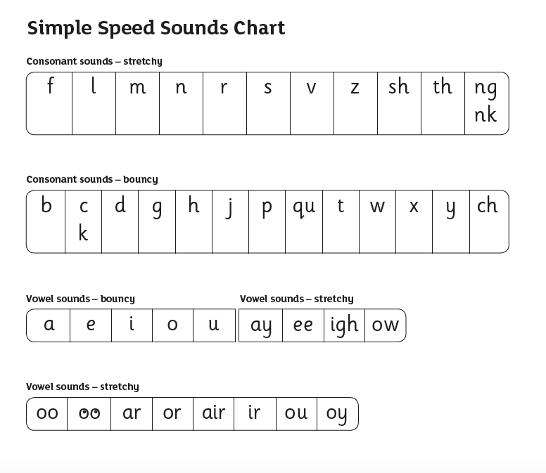
Speed Sounds Set 1
Notes:
Read Write Inc, Phonics makes learning to read easy for children because we start by teaching them just one way of reading and writing every sound. Here they are on the Simple Speed Sounds chart.
We teach Set 1 sounds first - (sounds as far as a e i o u).

Slide 10
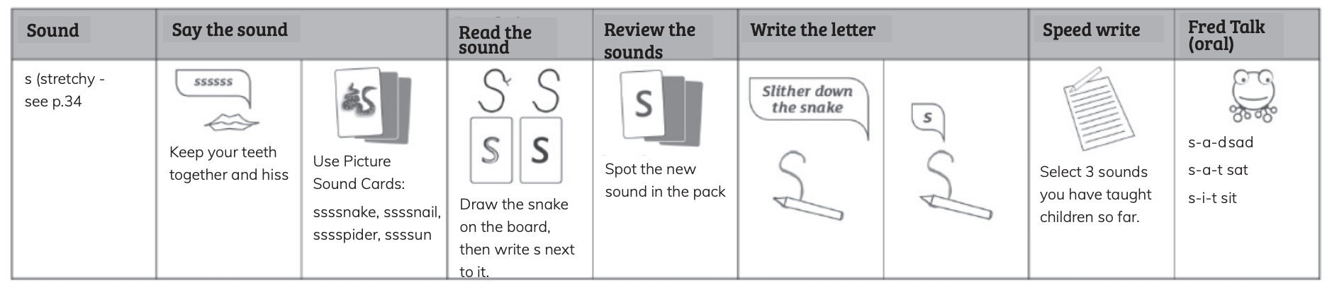
Set 1 Speed Sounds
Notes:
Each day, we teach children a new Set 1 sound. We know that children learn more rapidly at this age than at any other time in their lives so you can teach a new sound every day.

Slide 11

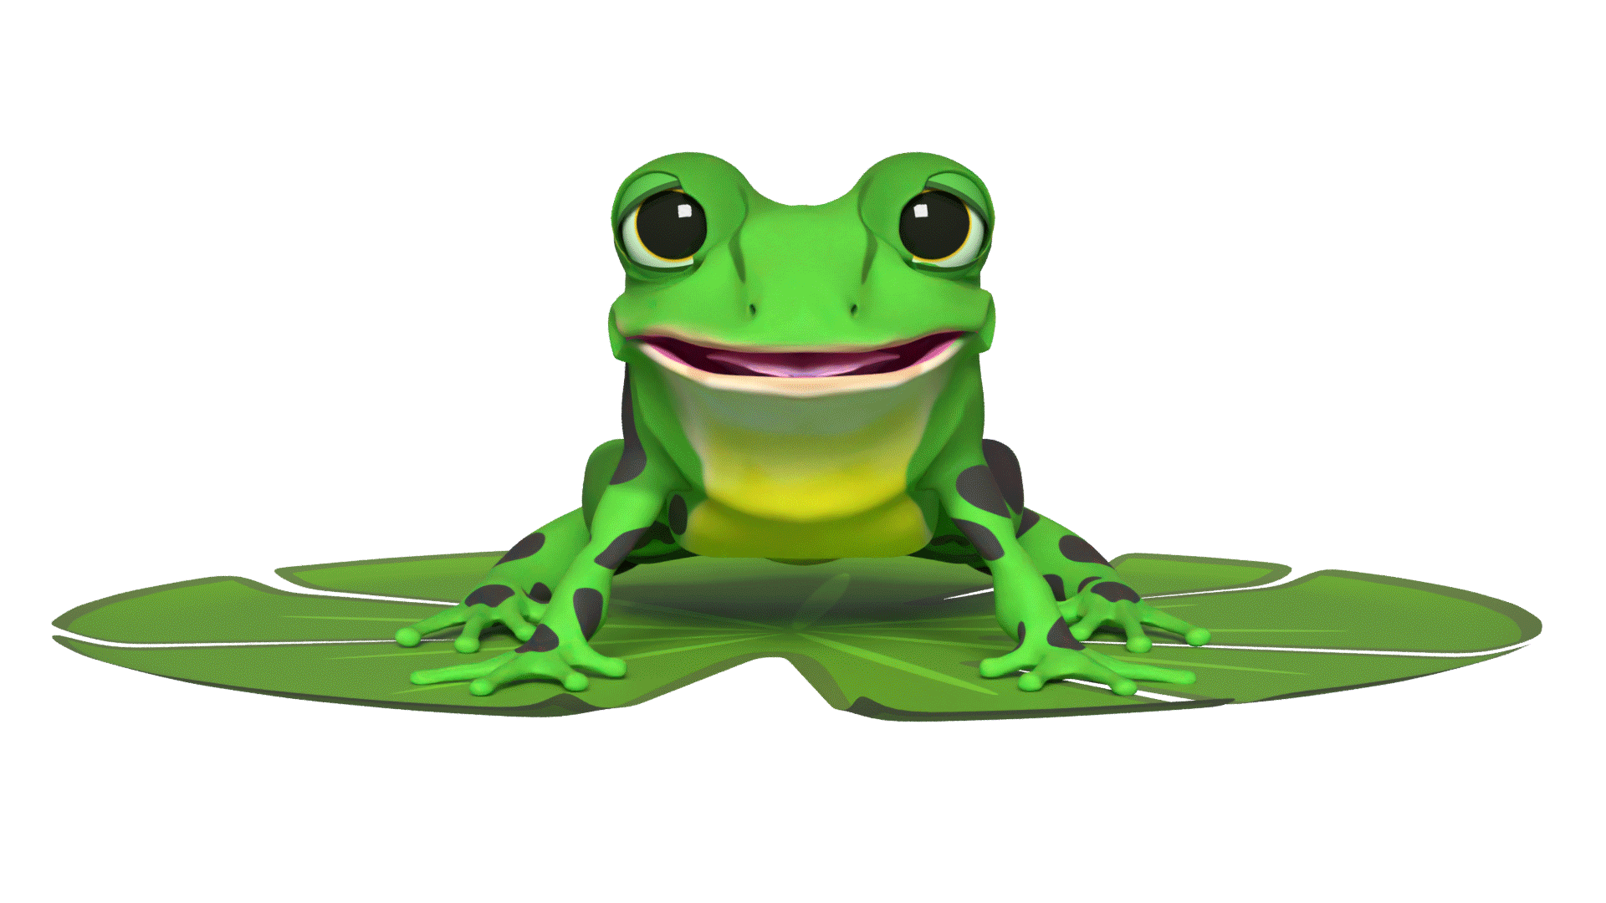

Speedy sounds + Fred = decoding
Notes:
Alongside teaching children sounds, we teach them to blend sounds to read words e.g. s-a-t, sat.
Once children can read sounds speedily, like this, (show how speedily this needs to be) and understand Fred (m-a-t...mat) (click), they can decode words.

Slide 12
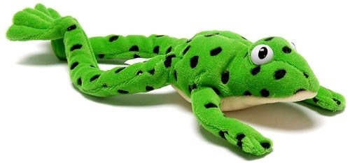

Fred Talk Routine
Say the word in sounds e.g. c-a-t.
Ask the child to repeat.
Can they ‘jump-in’ with the whole word?
Say the word in sounds followed by the whole word e.g. c-a-t, cat.
Ask the child to repeat.
Notes:
Fred Talk follows a consistent routine:
We say the word in sounds as Fred e.g. c-a-t. Ask children to repeat.
We pause to allow children to ‘jump-in’ with the whole word.
Say the word in sounds followed by the whole word e.g. c-a-t, cat. Ask children to repeat.

Slide 13
Fred Talk throughout the day
Shall we have some
What would you like to
Let’s put on your
-ch
l
-n
-u
?
-ay
-l
p
?
-oa
-t
c
.
Notes:
Try to use Fred Talk throughout the day at home to help your child practise orally blending sounds.
Fred Talk words at the end of the sentence and keep the words short and simple.
With the person next to you, have a practise of the three sentences on the screen.
Remember to Fred Talk the last word of the sentence.
You might like to play Fred Games with your child too!

Slide 14
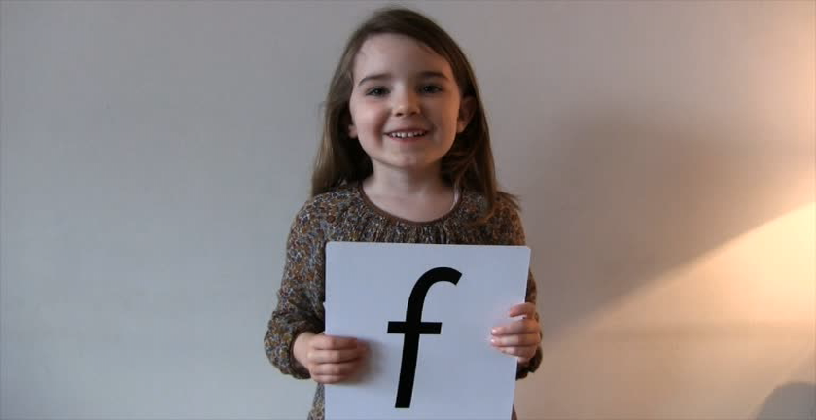
Pure Sounds (ruthmiskin.com)
Notes:
Children need to know sounds – not letter names – to read words.
We say the sounds in a way to make them easy to blend into a word.
We aim to eliminate the ‘uh’ at the end of the sound. This is called a ‘schwa’ sound.
We say ‘c’ ‘a’ ‘t’ rather than cuh a tuh.
Use MTYT to teach each of the Set 1 sounds to parents.
You can watch this film of little Sylvie on the Ruth Miskin website to practise using pure sounds. Play a little bit of the video.

Slide 15
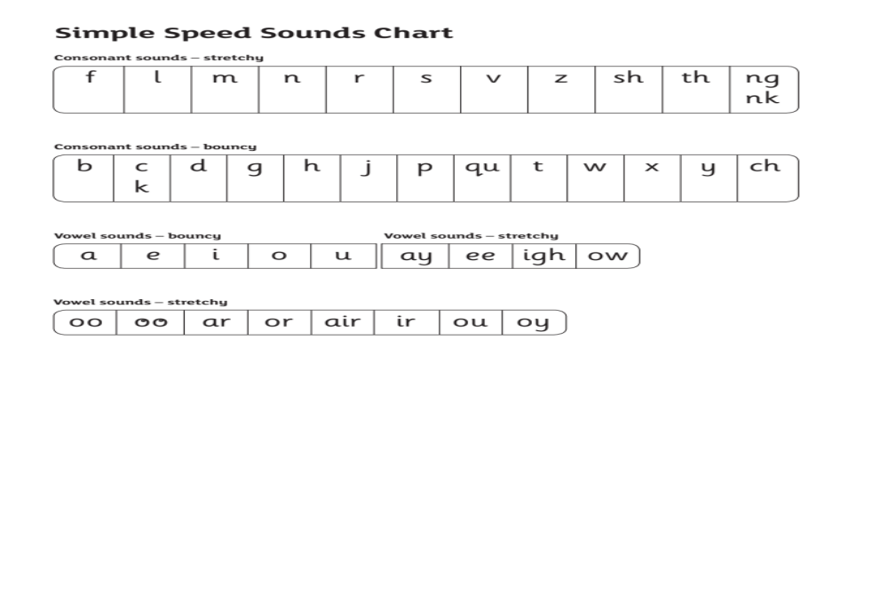
Speed Sounds Set 2
Notes:
Then Set 2 – one way to read and write each of the long vowel sounds.

Slide 16
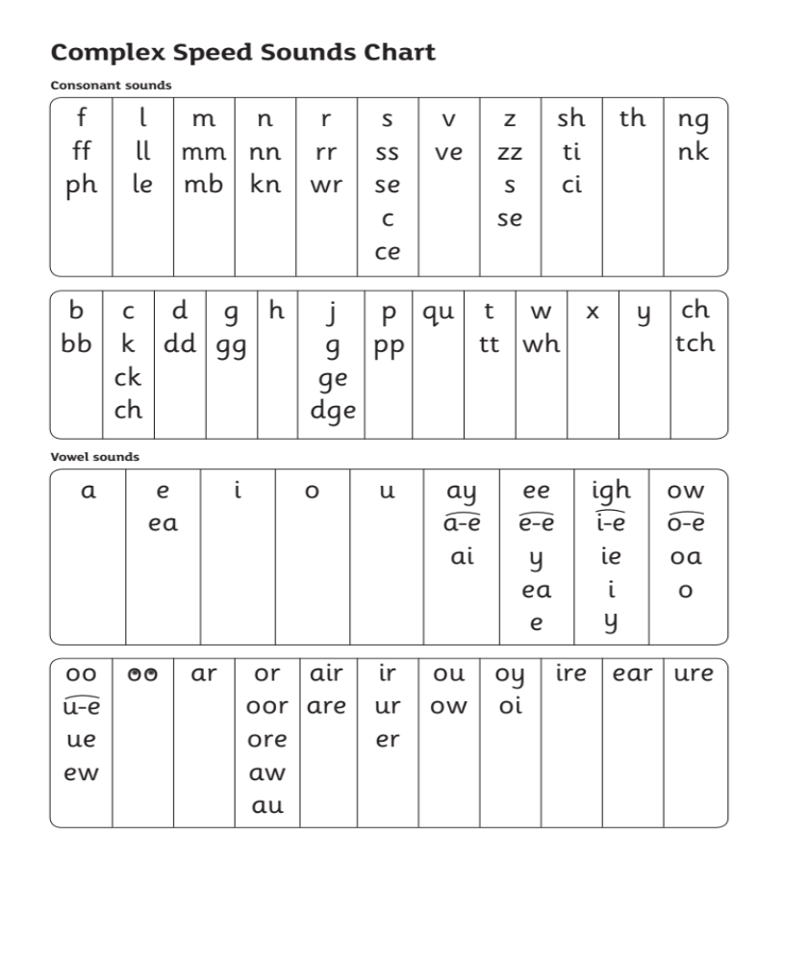
Speed Sounds Set 3
fire
hear
sure
Notes:
Once children know how to read Set 2 sounds, they start to learn Set 3 sounds.
These are different ways to read and spell Set 2 sounds.
We call these Set 3 sounds, but actually they are the same sounds as in Set 2 but with a different spelling.
We say "same sound, different spelling".
Point to the chart to show. For example, they know ‘ay’ and now learn a-e and ai as other spellings for the same sound.
There are three new Set 3 sounds to teach children.
We focus on teaching children the most common graphemes (those shaded) in the Set 3 Speed Sounds lessons.
We teach less common graphemes (click to highlight) in the Storybook lessons.
Once they know all of these sounds, they will be able to read any unfamiliar word.

Slide 17
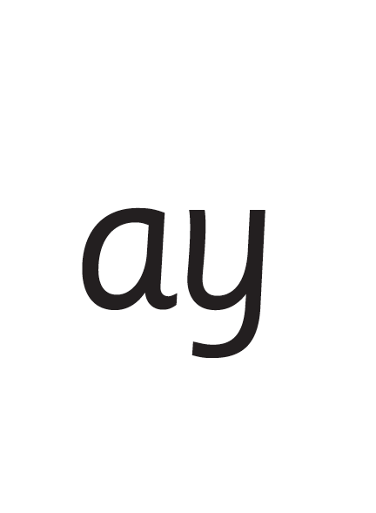
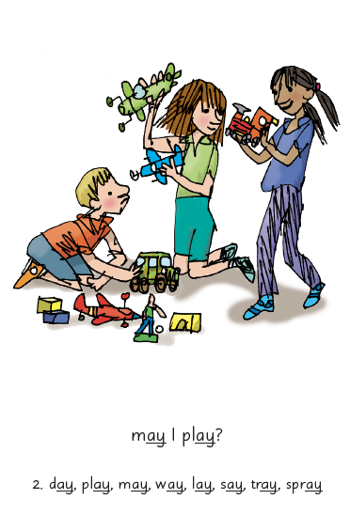

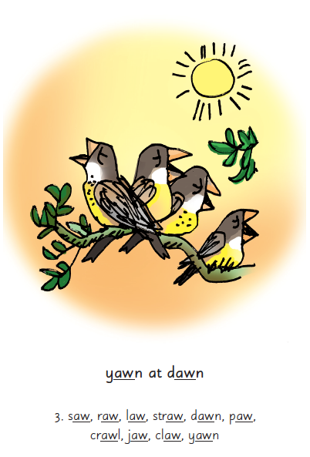
Connect and repeat
Notes:
We use a brief story and a picture phrase to help children to remember the Set 2 and Set 3 sounds. They make a connection that helps them to remember the sound.
For example, ay, may I play? aw, yawn at dawn.
We teach children to read and write three new Set 2 or 3 sounds each week.
We review the sounds we’ve taught before until they can read them speedily. Repeat, repeat, repeat!

Slide 18


’Special Friends’, ‘Fred Talk’
Notes:
Each day, children practise reading the sounds they know in words.
We use the routine ‘Special Friends’, ‘Fred Talk’.
They spot the ‘Special Friends’ first, then Fred Talk to read the word.
For example, ‘ay’, s-p-r-ay, spray.

Slide 19
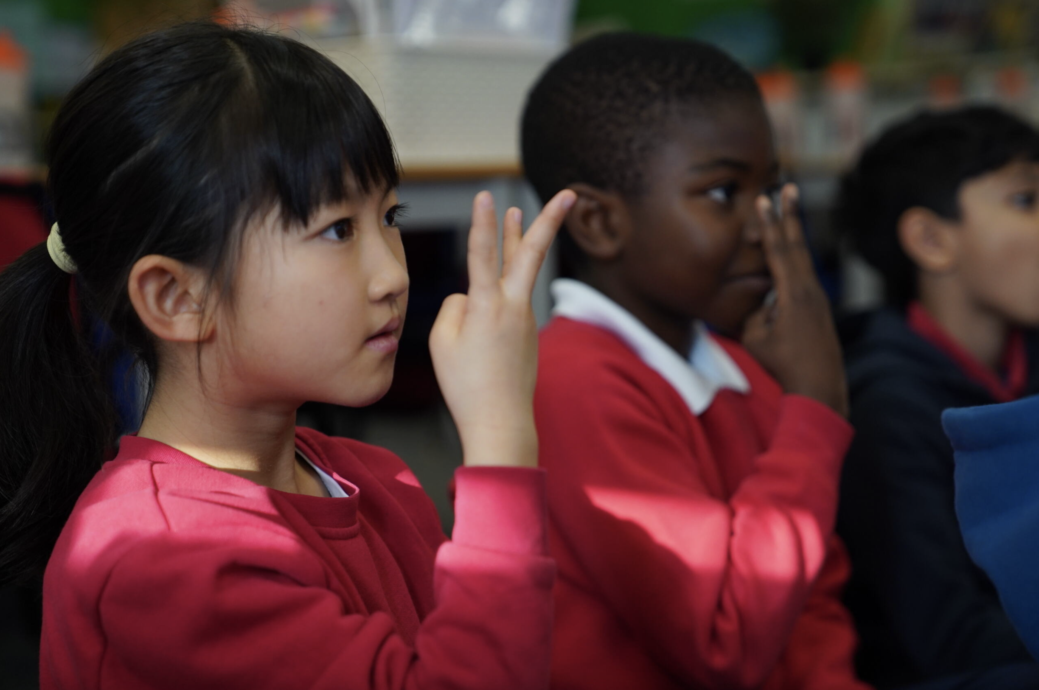
Teach spelling using Fred Fingers
Notes:
We use Fred Fingers to help children sound out words to spell easily.
It means they do not have to memorise lists of spelling words.
It is a tool so they will be able to spell any word.

Slide 20
What books do the children read?
Notes:
In our school, children read Read Write Inc. Storybooks that match the sounds they can read.

Slide 21
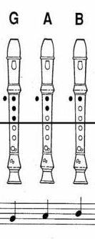
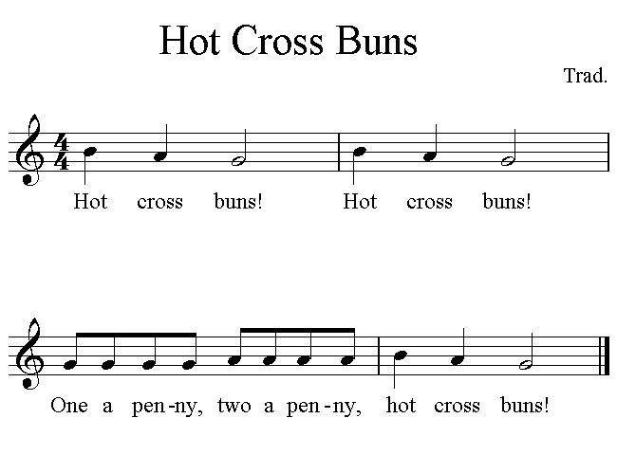
Learning to read music
Notes:
Think about a child learning to play the recorder for the first time. They are taught G-A-B (click). They can then play (click) ‘Hot Cross Buns’ containing just those notes.
They practise this simple tune over and over again. It’s always surprising how much joy they get from playing just these three notes!

Slide 22
Learning to read music
D
D
G
G
D
D
G
G
A
A
B
B
A
A
Notes:
And with just three more notes
(top D, lower D and C), they are ready to play (click) ‘London’s burning’. They practise this tune over and over again.
Beginner recorder players are only ever given music with the notes they can play.
Once children place their fingers on the holes accurately, they practise to gain fluency – over and over again. As their fingers move more quickly, they pay attention to playing expressively - even when playing a simple version of 'Hot Cross Buns'!
Learning to read music is like learning to read using phonics: it’s only once we can read the words, that we are able to focus on fluency and expression.

Slide 23
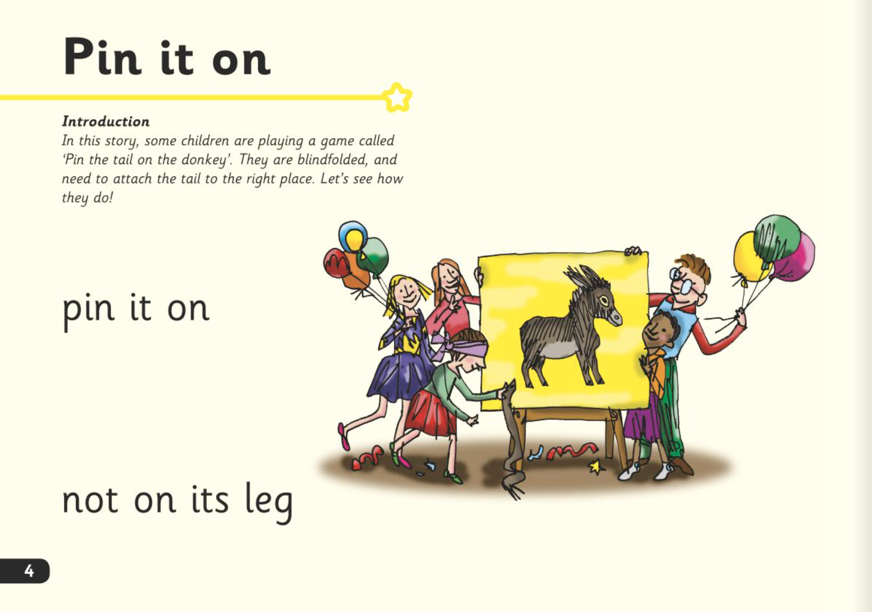
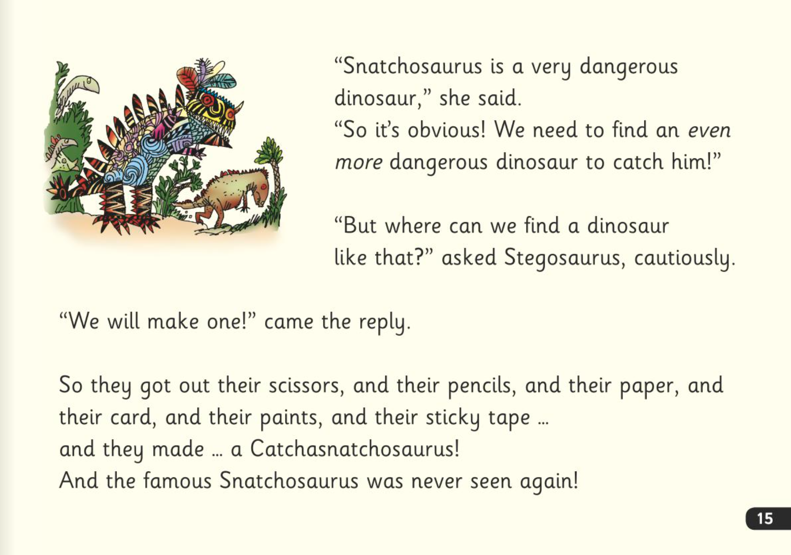
Read Write Inc. Storybooks
Notes:
In our school, children read Read Write Inc. Storybooks that match the sounds they can read.
They know that, with only a little help, they will be able to read every word in every story we give them and, by the time they take it home, they will be able to read the story confidently.
They know that we will never ask them to guess a word, either from a picture or the context - in the same way as we wouldn’t ask them to guess musical notes we hadn’t taught them.
The early texts are below children’s comprehension level because they cannot yet read all the words they can speak. If you read the story to them, they would be able to understand it easily - unless the child is new to English.
Although the story is easy, most children cannot focus on its meaning until they can read the words effortlessly - 'at a glance'. ‘At a glance’ means reading a word in a millisecond – without needing to blend the sounds into the word.

Slide 24

Three reads
Read every word accurately.
Read more words ‘at a glance’.
Read the whole story accurately, fluently and with a storyteller’s voice.
Notes:
Children read the Storybook three times. Each read builds on the last.
On each reading, the number of words they read 'at a glance' increases – and along with it their ability to focus on the story.
1. On the first read, we help children read every word accurately.
2. On the second read, we help children read more words ‘at a glance’.
3. On the third read, we help children read the whole story accurately, fluently and with a storyteller’s voice.
Children then take this same book to enjoy at home.
Right from the start, children enjoy re-reading simple texts.

Slide 25
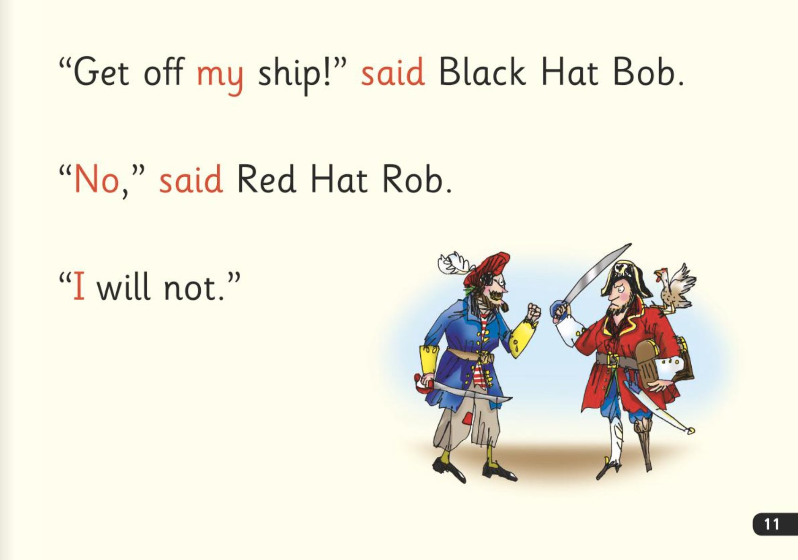

Green words - ’Special Friends’, ‘Fred Talk’
Notes:
Children will be able to read all of the words in the Storybook.
If they hesitate, remind them to read the word using ‘Special Friends, Fred Talk,’.
For example, this means they spot the ‘sh’, then Fred Talk and blend to read the word e.g. sh, sh-i-p, ship.

Slide 26

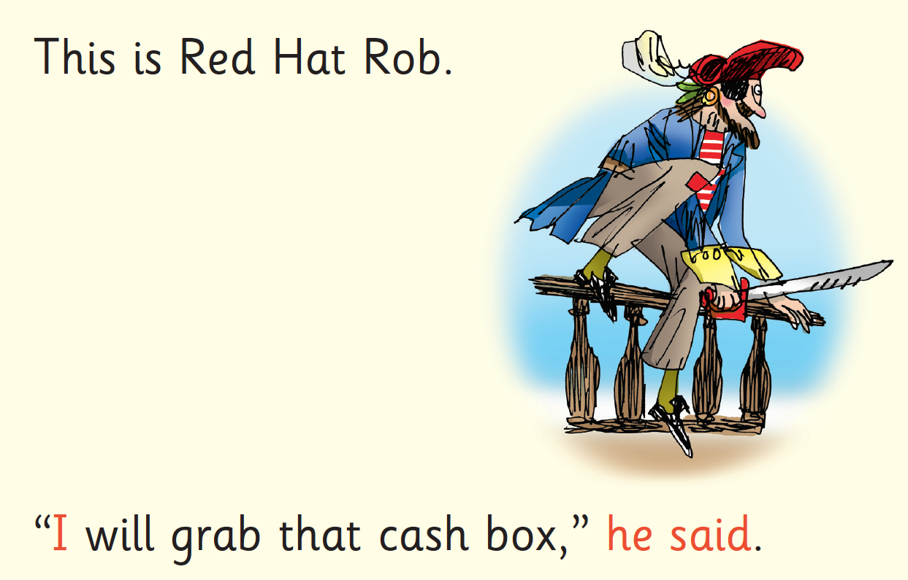
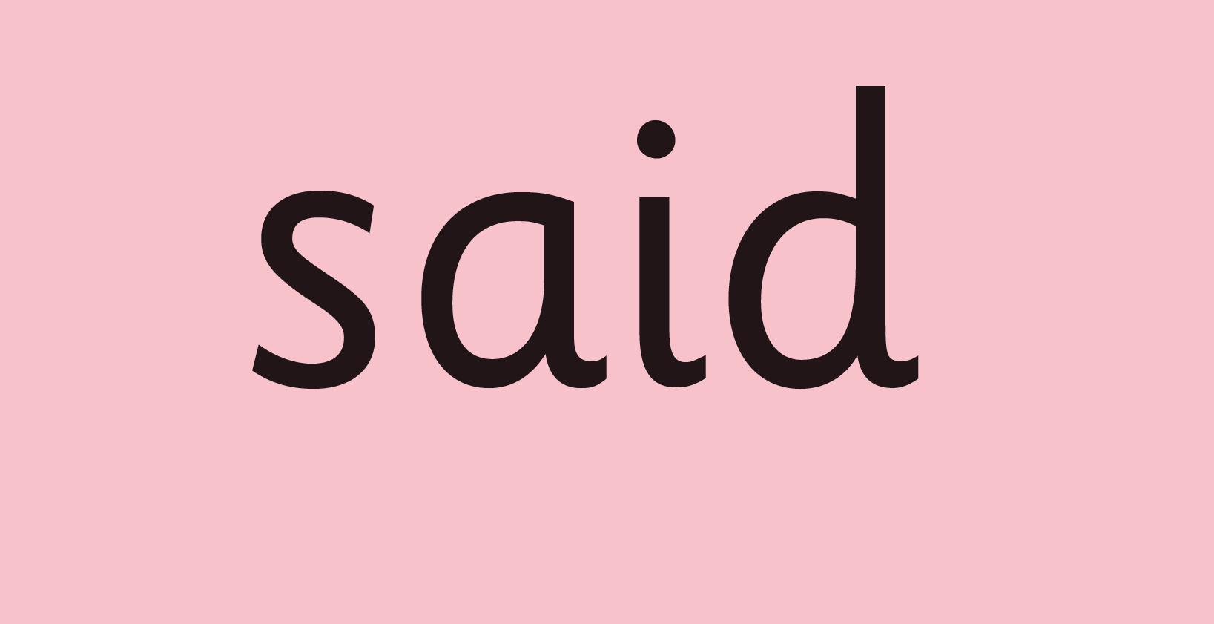
Red Words
Notes:
Some words are ‘tricky’ because they contain letters that don’t match the sounds the child has been taught.
For example, ‘said’ has ‘ai’ making an ‘e’ sound.
We teach these common exception words as Red words.
In the early Storybooks, these words are printed in red text.
Remind your child not to use Fred Talk to read Red words but instead to stop and think if they know the word. Tell them the word if needed.

Slide 27
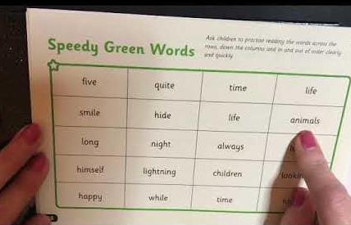
Speedy Green Words
Read more words ‘at a glance’.
Notes:
Some words in the book include previously taught sounds which the children will be familiar with. These are taught as speedy green words.
We want the children to read this at a glance – in 1 millisecond. This helps to build their fluency.
Children in groups green – yellow now have a speedy green word pack at home to help them develop this fluency. It includes some ideas of how to play games to help your children learn the word.
In each half termly assessment the children are assessed on their ability to sound out and read green words, and their ability to recognise and read speedy green words.

Slide 28
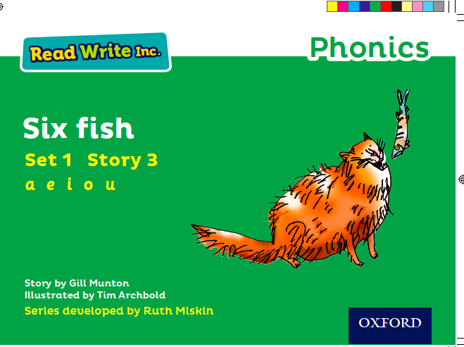
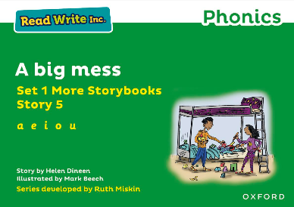
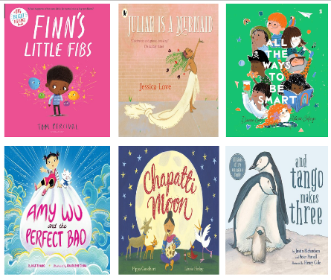
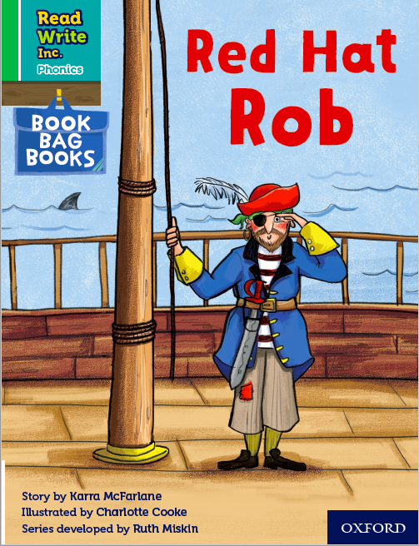
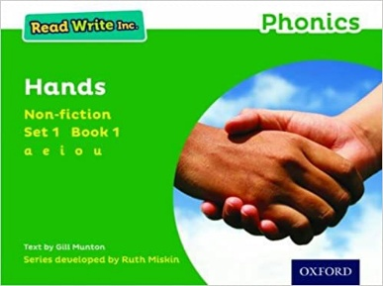
What books will children bring home?
Notes:
In your child’s book bag, they will bring home:
- the Storybook they have just read in class to practise reading what they can already read (they love this book and enjoy reading it in their storyteller voice).
- if applicable a past Storybook – a previously read RWI Storybooks for extra practice. The children enjoy re-reading stories they know well. Their fluency improves on every reading.
- if applicable a Book Bag Book that links to the story they have read in class or a non-fiction or ‘More’ Storybook.
A picture book to share with you which has already been read to them so they care about it. You can read the story to them or they can retell the story by looking at the pictures. They are not expected to read the story themselves.
We make sure that every book that goes into your child’s book bag is a well-loved book – one they know already and want to read again and again.
The more they read, the faster progress they will make.
Please avoid saying, “This book is too easy for you!” but instead say “I love how well you can read this book!”

Slide 29




Reading aloud is transformational
Being read to is the most powerful predictor of a child’s future reading comprehension.
Notes:
Being read to is the most powerful predictor of a child’s future reading comprehension.
Every child has a right to a story every day.
Reading stories to children isn’t an optional extra to fit in if there’s time; it is transformational.
Let’s read aloud books to children with love, confidence and enjoyment - every day.
Let’s do everything we can to ensure all children get the reading habit early.

Slide 30
At five years old:
Never read to - 4,622 words
1-2 times a week - 63,570 words
3-5 times a week - 169,520 words
Daily - 296,600 words
Five books a day - 1,483,300 words
Science Daily (2019)
https://www.sciencedaily.com/releases/2019/04/190404074947.htm
Notes:
In 2019, researchers in the United States looked at the impact of parents reading with their children.
Here’s how many words children would have heard by the time they were 5 years old.

Slide 31

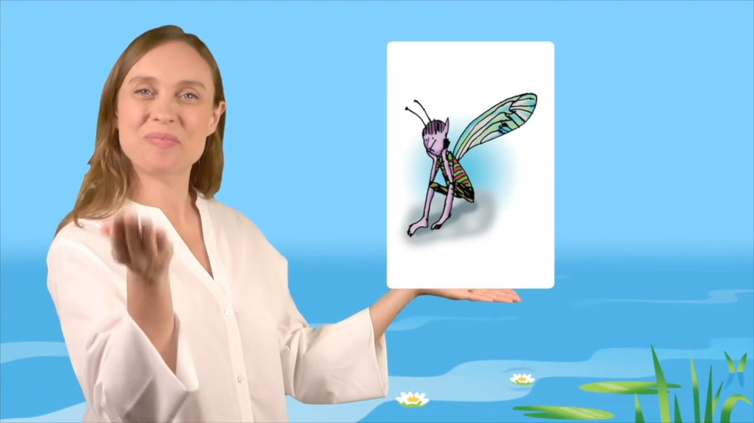
Virtual Classroom
Notes:
Let's watch a short taster of the range of animated films in our virtual classroom.

Slide 32

Reception - What can I do?
Use pure sounds rather than letter names.
Use Fred Talk to help your child to read and spell words.
Listen to your child read their Storybook every day.
Watch the Virtual Classroom films together.
Read stories to your child every day.
Notes:
We will run regular bitesize meetings to look at each of these in more detail.

Slide 33

Year - What can I do?
Practise the sounds and phrases.
Practise reading sounds speedily.
Help your child use ‘Special Friends’, ‘Fred Talk’ to read words.
Watch the Virtual Classroom films together.
Read stories to your child every day.
Notes:
Practise the sounds and phrases.
Practise reading sounds speedily.
Help your child use ‘Special Friends’, ‘Fred Talk’ to read words
Watch the Virtual Classroom films together.

Slide 34
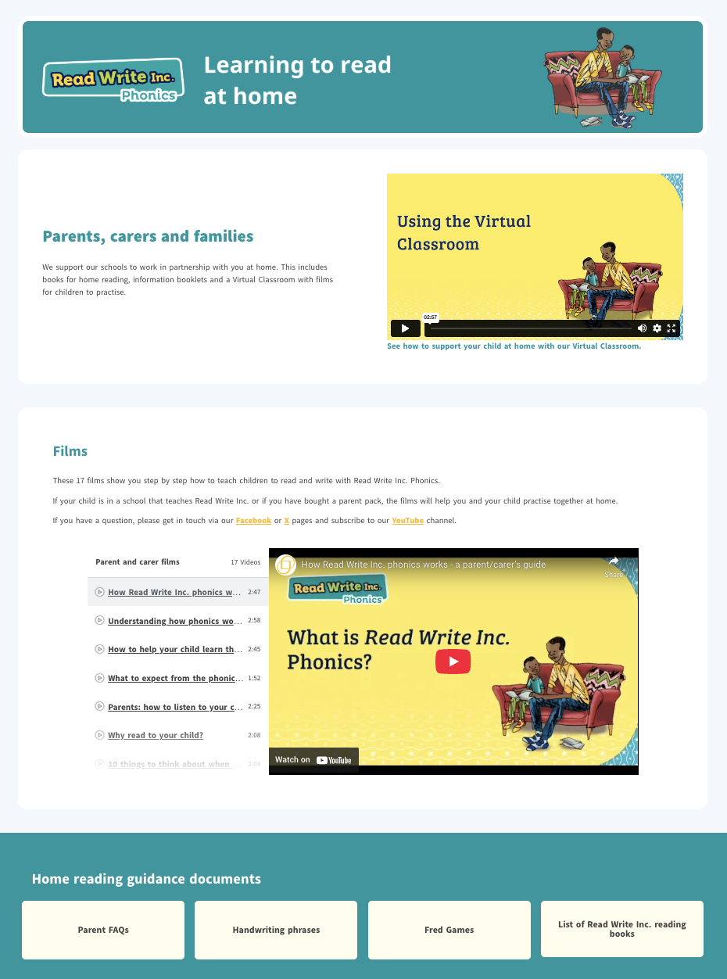
ruthmiskin.com
Notes:
Watch video tutorials on the Ruth Miskin website to help you to understand more about Phonics, Read Write Inc. and how to practise reading and writing with your child at home.
There is also a handy ‘Using the Virtual Classroom’ film.

Slide 35

Any questions?

