Slide 1
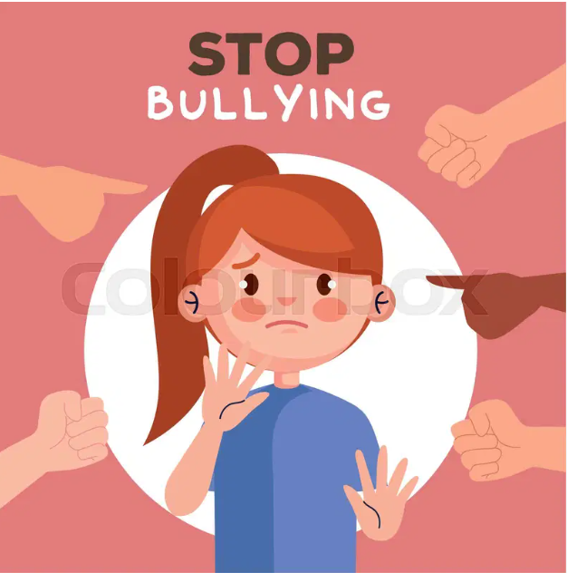
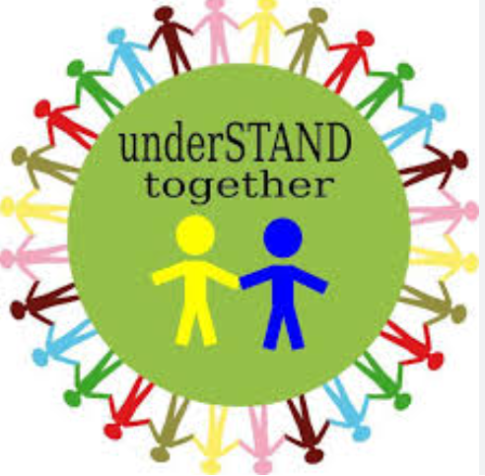
STOP BULLYING!!
Respect means: be kind to everyone you meet , show team work and respect teachers with manners.
Speak out to people and be a buddy not a bully.
Bulling could hurt someone’s feeling.

