Slide 1
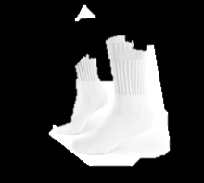
DON,T SAY MEAN THINGS
ANTIBULLYINGWEEK
CARE ABOUT PEOPLE
RESPECT
JESSICA
STOP BULLYING
BE KIND RESPECTFUL

