Slide 1

Welcome

Slide 2
Welcome to our Phase 2 meeting

Slide 4









Slide 5
Expectations for Phase 2
Being exemplary role models for the Phase 1 children
Good amount of sleep (9 to 12 hours)
Uniform
Attendance and punctuality
Parental partnership is important – year2@stwilfrids-hh.school and year3@stwilfrids-hh.school
Weekly letters recapping our learning and events

Slide 6


The St Wilfrid's Reading Challenge

Slide 7
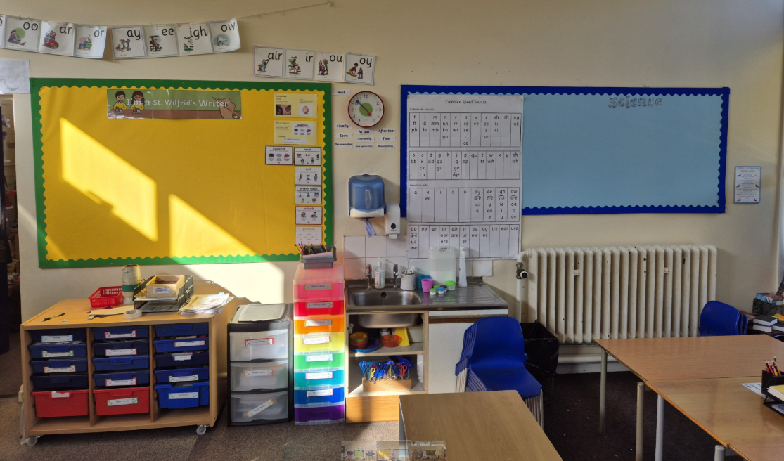
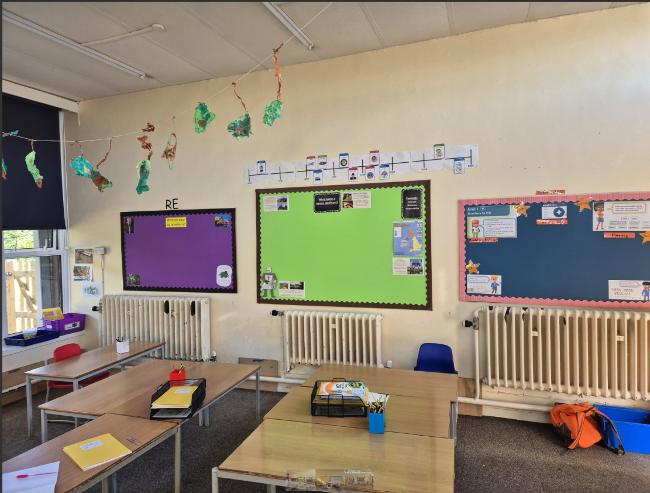
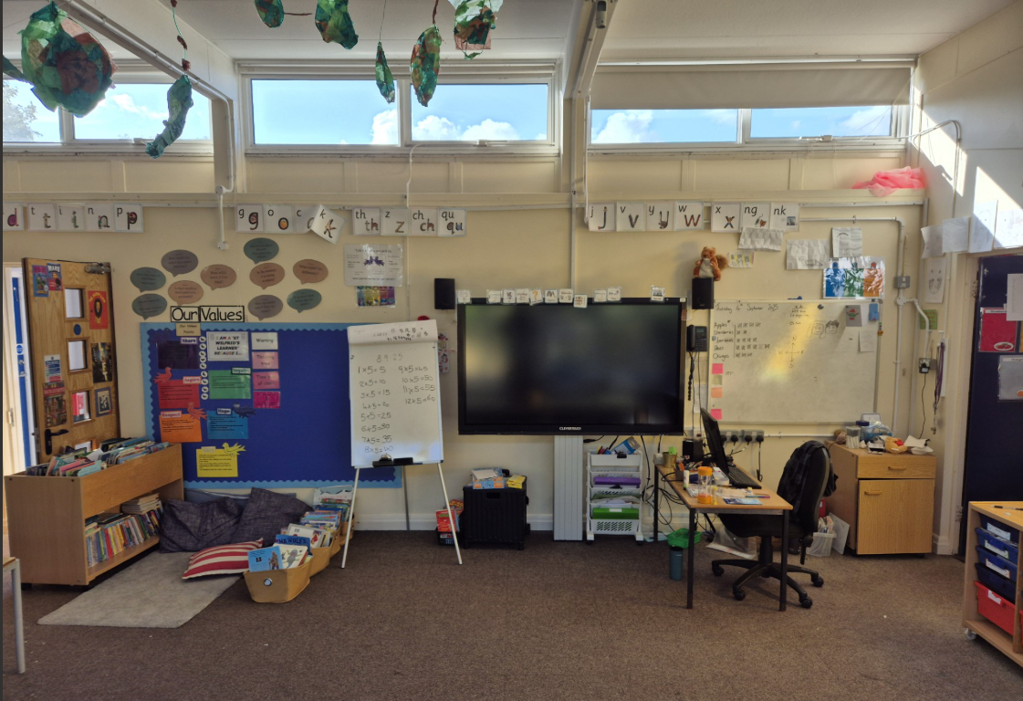
Squirrels Class

Slide 8
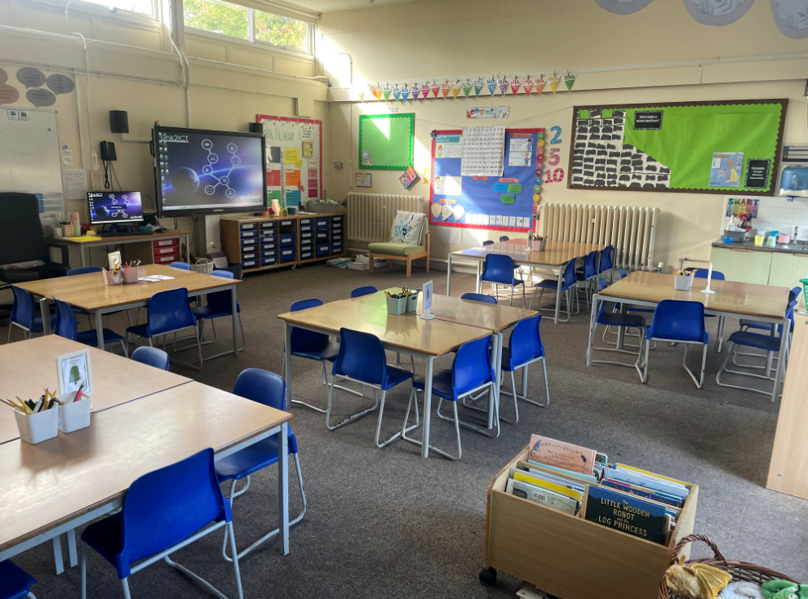
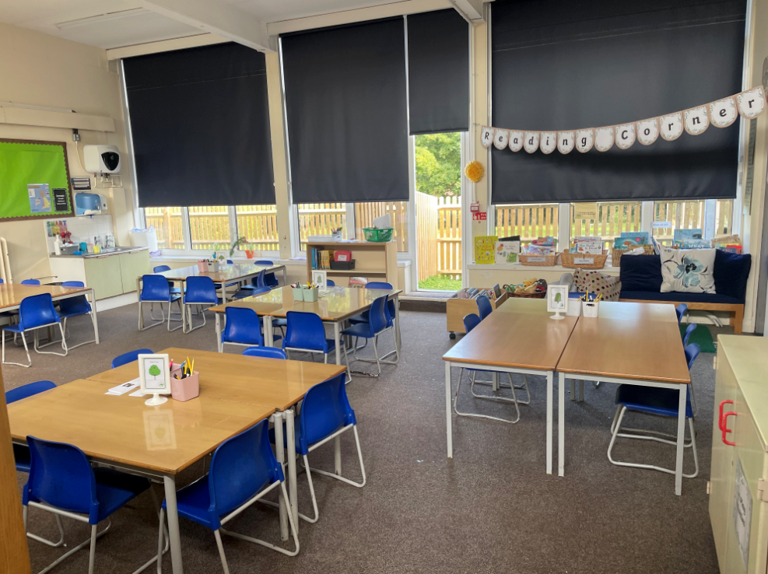
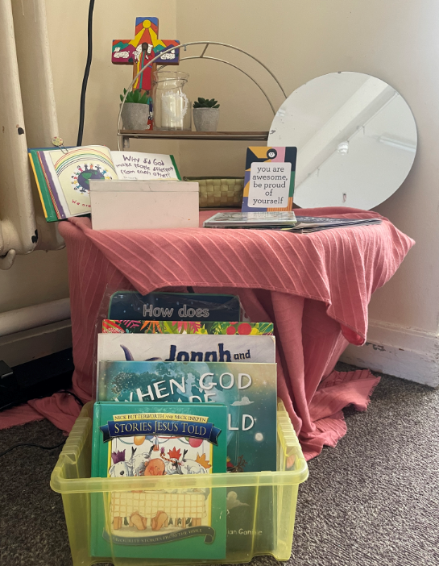
Hedgehogs Class

Slide 9
Year 2
PE is on Wednesday and Thursday (afternoons).
Please ensure all uniform, PE kit clothing is clearly labelled and water bottles are named.
Children are encouraged to eat a fruit or vegetable snack during morning play.
Homework will be given out on Friday and handed in on the following Wednesday.
We will send a weekly review of our learning each Friday with reminders of RWI book swap days, the Reading Challenge and any key dates or information.
We welcome parent/carer volunteers.

Slide 10
Year 2 Project Overview
Autumn Term | Spring Term | Summer Term
What makes a person significant? History: changes to castles structure, battle of Hastings, life in a castle, evaluating a monarch's reign, suffragettes, Rosa parks Art and DT: Development of shields through history, designing and creating shields, Dragon artwork, evolution of puppets and puppet making, tints and tones Geography: Physical and human features, UK countries and surrounding seas RE: What are our big questions? and Christmas project Reading and Writing: Dragon stories, castle life, Minibeast poetry and puppet instructions | How has the coastline and sea changes over time? History: Life in the early 1900s, Why did the Titanic sink, How did the classes differ aboard the Titanic, comparing the Titanic to modern cruises, History of the RNLI DT and Art: Designing shoebox cabins, coastal lighthouse art piece Geography: How has coastlines changed? How are coasts impacted by erosion and humans, Global hot and cold zones, UK harbours and ports, Brighton case study RE: What is the good news Jesus brings and Easter project | What colour is our world? Geography: Weather patterns, Comparison of two cities (Brighton/Manaus), Fair trade, Foodbanks and local communities, Where does our food come from, How to navigate and read maps, Haywards Heath plant investigation, Interpreting statistical data DT and Art: Food preparation, Creating art in response to the artist Andy Goldsworthy, Where the Wild Things are project piece RE: What do Christians believe God is like? and What is important to Muslim children?

Slide 11
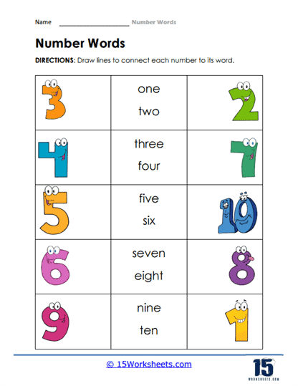
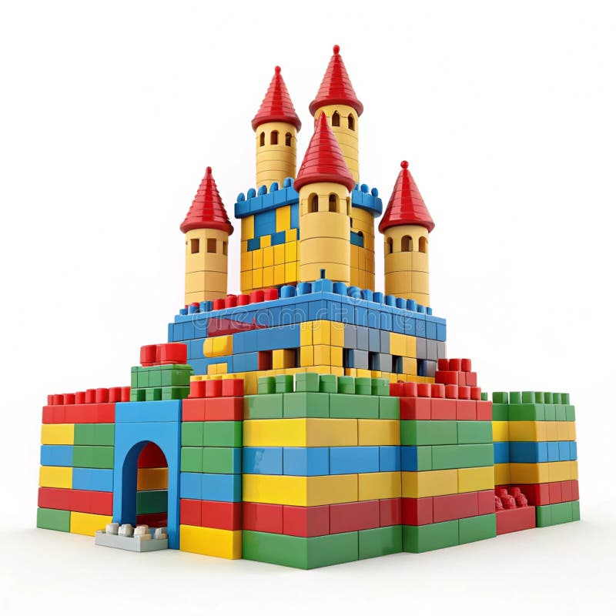
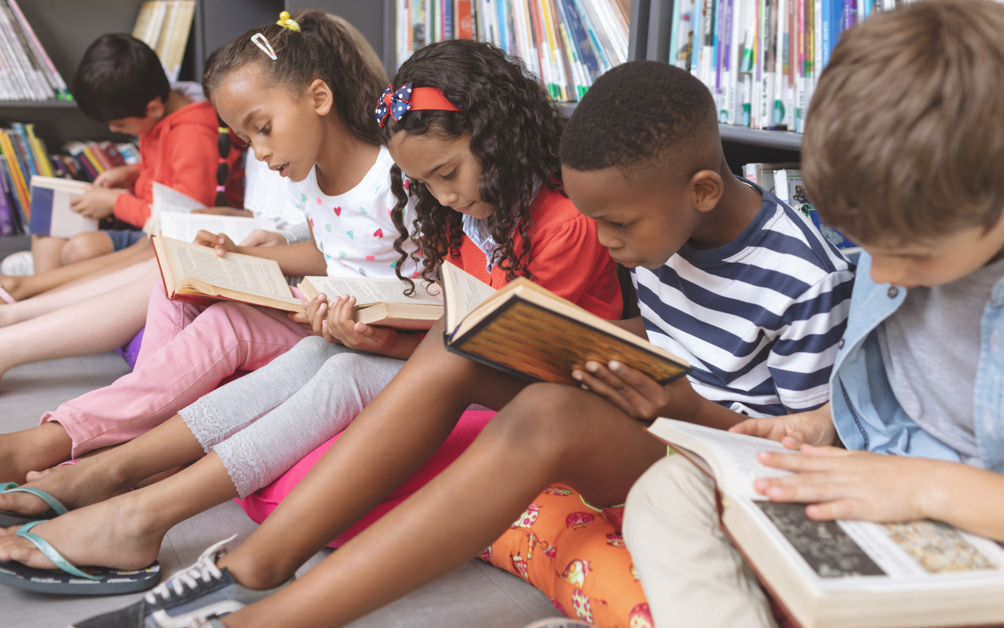
Year 2: Continuous Provision

Slide 12
Year 3
PE is on Monday (afternoon) and Thursday (morning)
Please ensure all uniform, PE kit clothing and water bottles are clearly named
Children are to bring their water bottle, reading book and reading record to school each day
Children are encouraged to bring a healthy snack to school to eat at breaktime
MyMaths and Spelling Homework will be set on a Friday
We will send a weekly review of our learning each Friday with reminders about the Reading Challenge and any key dates or information
We also welcome parent/carer volunteers

Slide 13
Year 3 Project Overview
Autumn Term | Spring Term | Summer Term
What does it mean to be human? History: Changes in Britain from the Stone Age to the Iron Age Writing and reading focus on Stone Age, Mary Anning and healthy eating Science: human body (skeletons and nutrition) and rocks Robots: creating simple mechanisms in DT and writing about Wall-E RE: what are important times and places for Jews? | How does it feel to experience change? History: What was the Roman Empire and its impact on Britain? Geography: What are the features of volcanoes? Writing and reading focus on Pompeii, Romans, Volcanoes Science: light, fossils and soil RE: Inspirational Christians who changed the world. | What's beautiful about the world we live in ? Writing and reading focus: fiction and non-fiction work on bees and plants Art: inspired by artists from different periods – Georgia O'Keefe and Monet Geography: comparing physical and human features in Brighton and Ditchling Science: plants, forces, magnets RE: What do Christians learn from the Creation story?

Slide 14
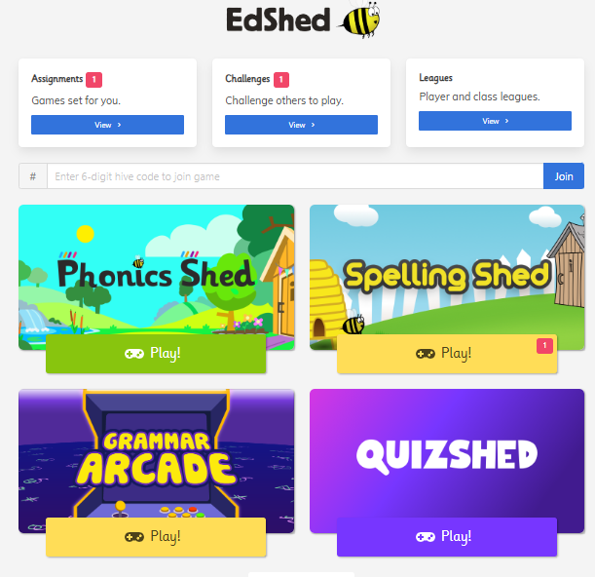
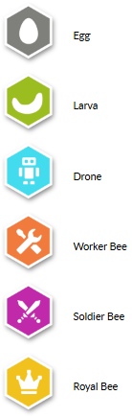
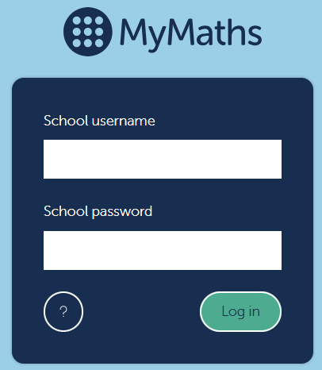
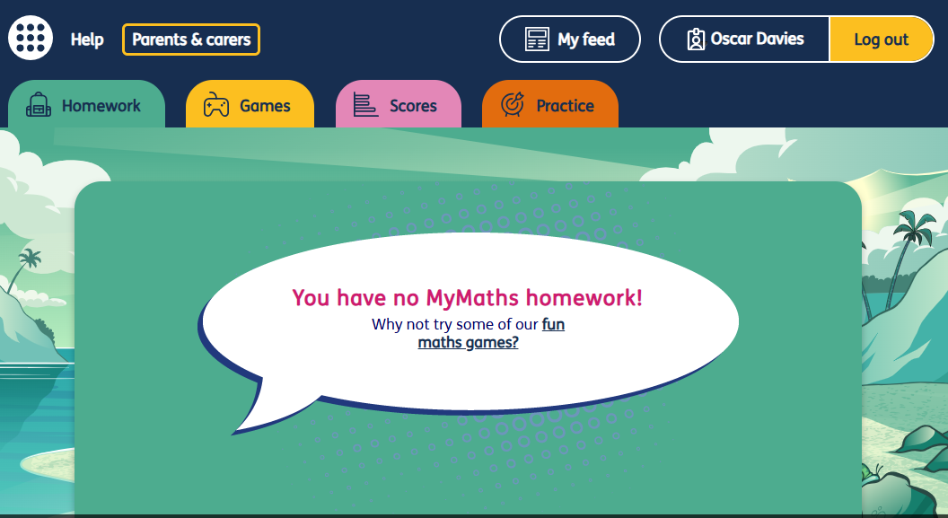
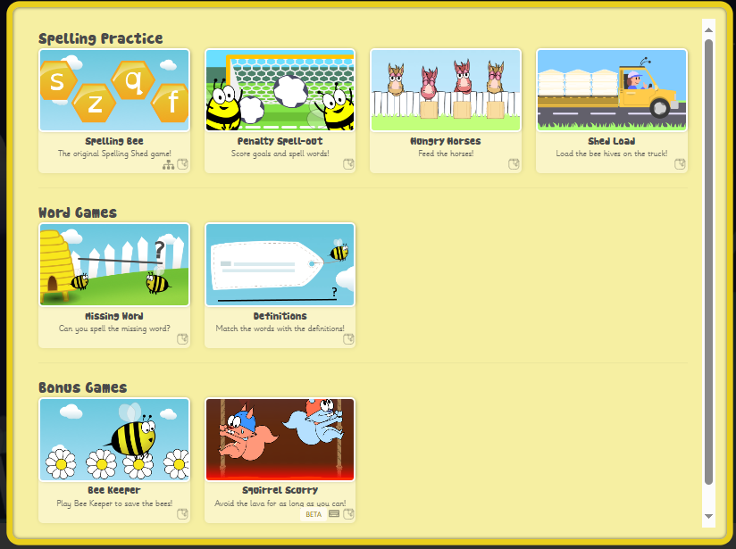
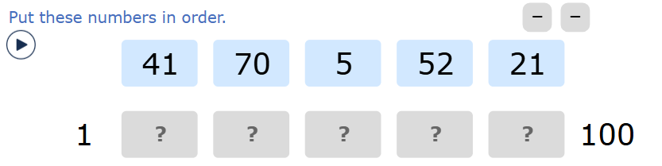
SPELLING & MATHS
Set Friday
Linked to what your child has been taught that week.
-Focused spelling pattern each week
-Play to earn honey pots and move through the 6 stages

Slide 15

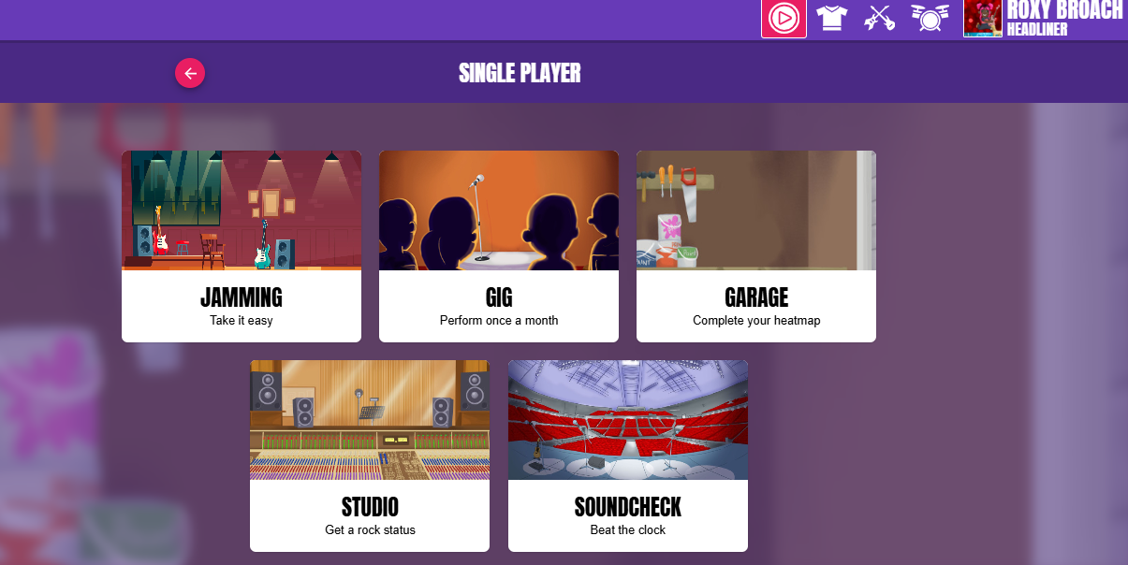
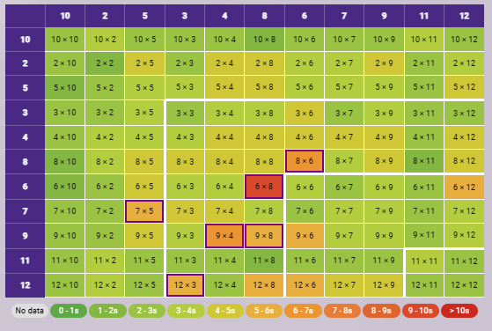
Timestable Rockstars
Ongoing – 4 times a week for 3 minutes
Class competitions each term
Login details for websites are at the back of the Reading Records

Slide 16
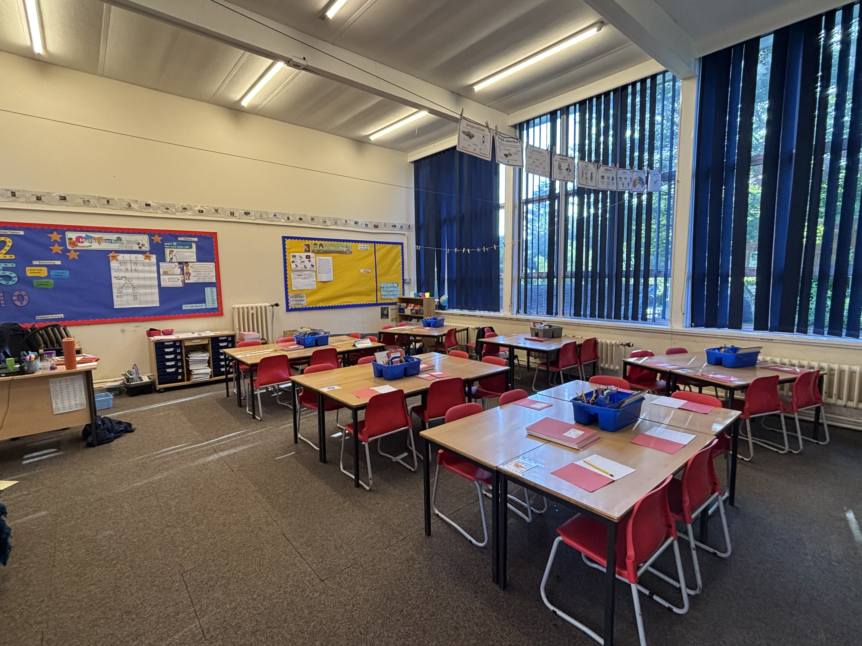
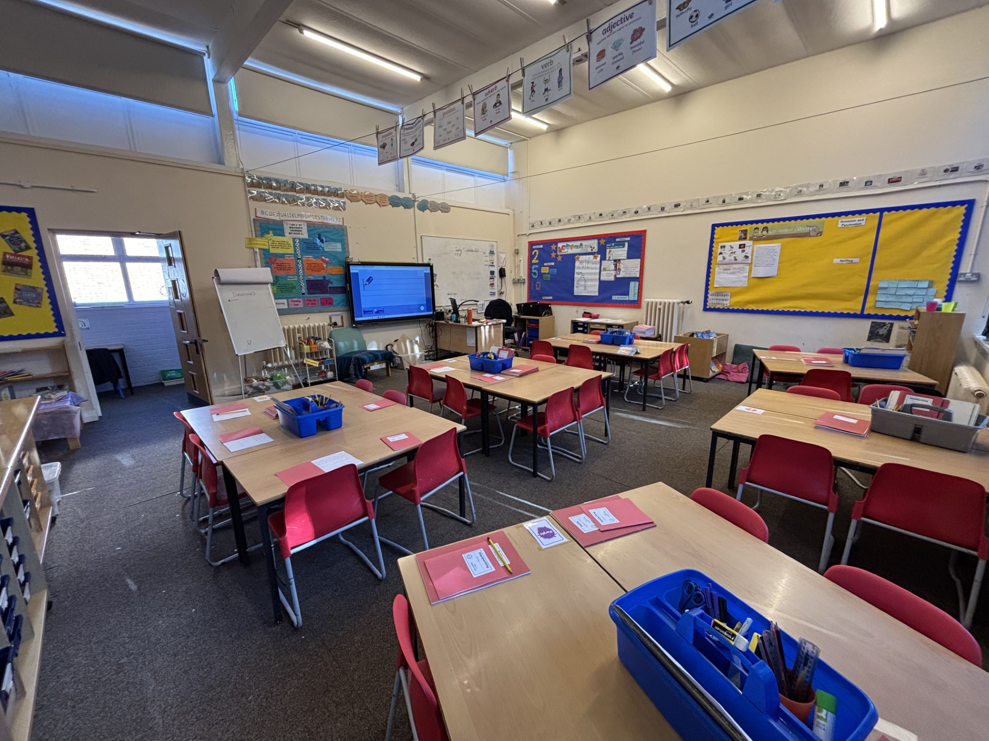
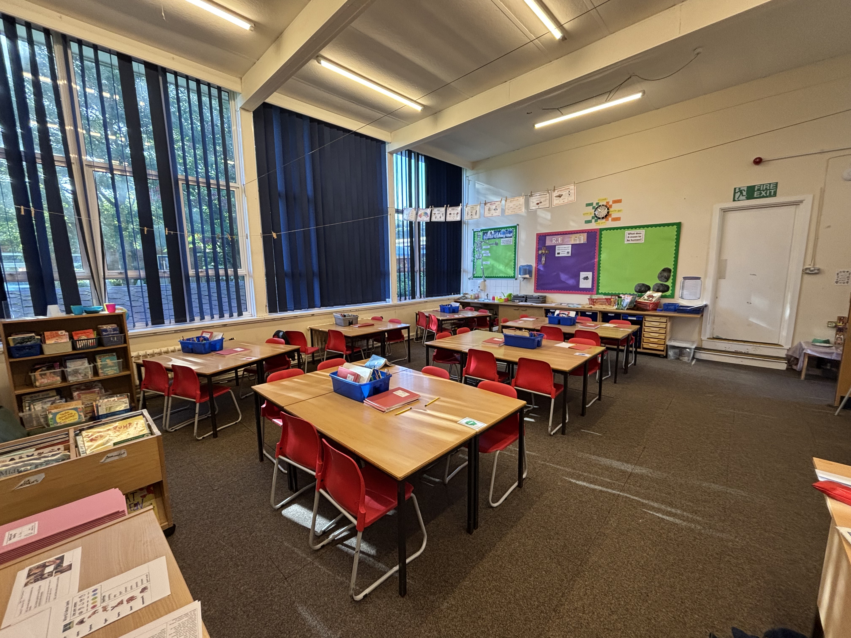
Rabbits Classroom

Slide 17
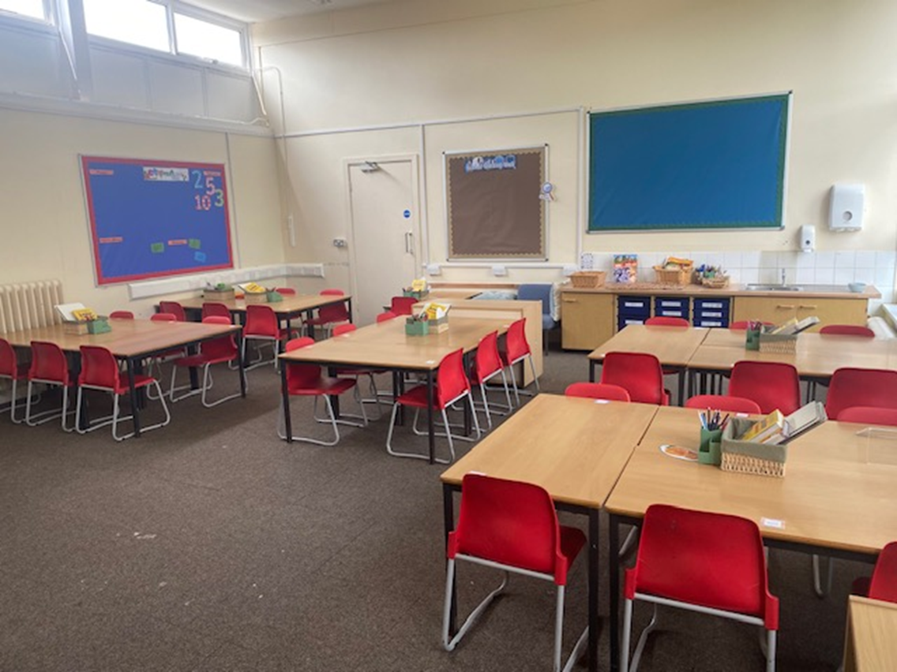
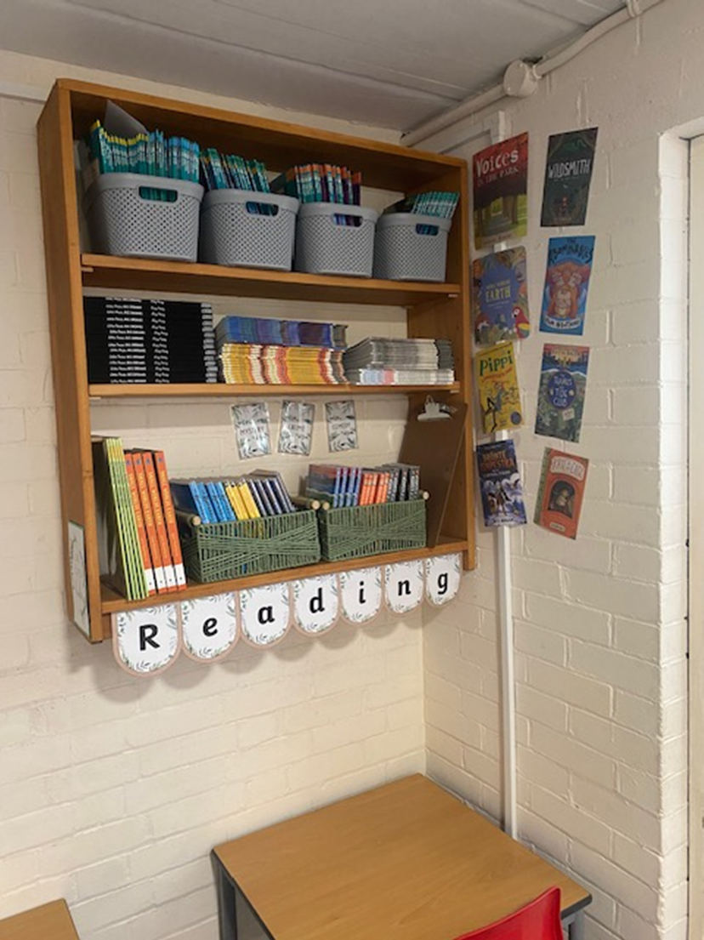
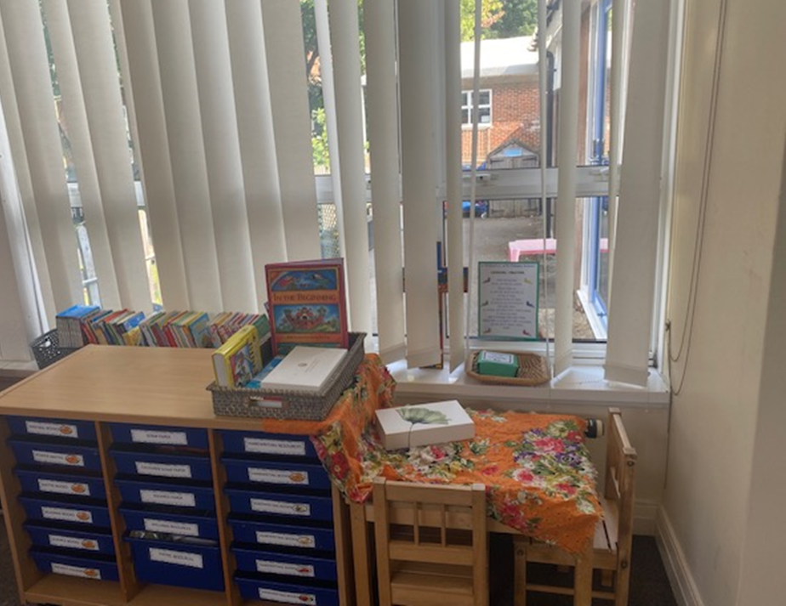
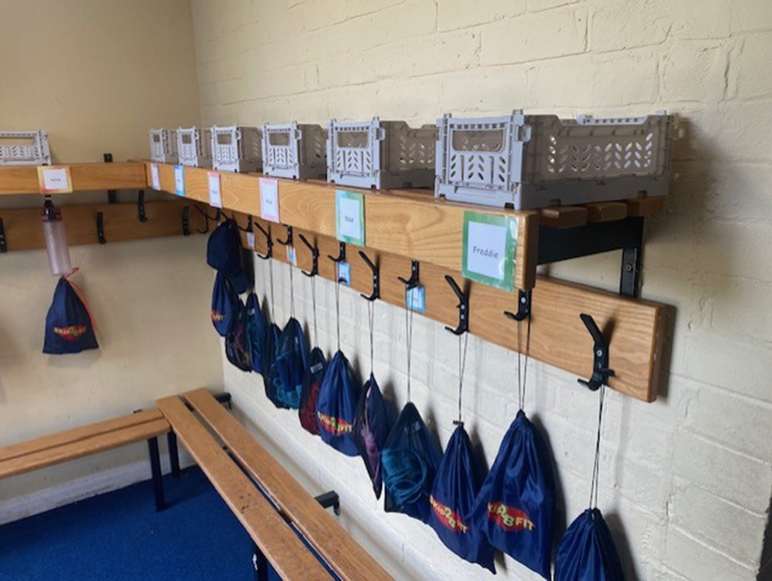
Hares Classroom

